Slide 1

CSE 5406 : Neural Signal Processing
Professor Dr. Md. Sujan Ali
Dept. of Computer Science and Engineering
Jatiya Kabi Kazi Nazrul Islam University

Slide 2
Applications
Neural signal processing is targeted to facilitate brain-machine communications. Brain computer interfaces (BCI) have contributed in various fields of research
Medical
Smart environment
Educational
Games and Entertainment
Security and Authentication fields.

Slide 3
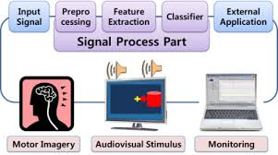
Applications
A Brain-Computer Interface (BCI) is an alternative communicating system between a brain and an external device
It translates neuronal activities into user commands
It direct some external devices, such as a computer, wheelchairs, robotic arms, prostheses etc.
BCI
System

Slide 4
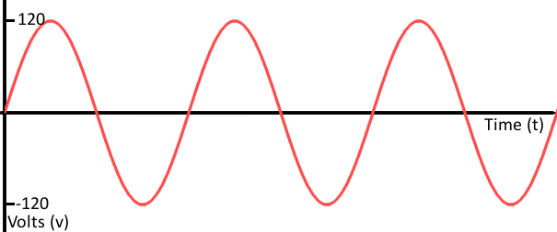
Signal Basics
Signals
A signal is a function that represents the variation of a physical quantity with respect to any parameter (independent quantity e.g., time, distance, space, temperature etc.) which conveys information.
Signal = f(t) = sin (ωt)
X axis used for independent quantity
Y axis used for dependent quantity

Slide 5
Signal Basics
Function
A function is a relation between a set of inputs and a set of outputs.
A function relates an input to an output.
It is like a machine that has an input and an output.
And the output is related somehow to the input.
f(x)=x² (we say f of x equals x squared)
Function without name:
y = x²
x= input, y=output, squaring is the relation

Slide 6
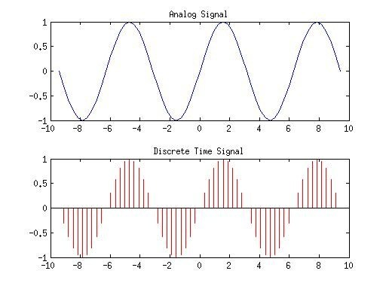
Signal Basics
Continuous-time signals
A signal x(t) is said to be a continuous-time signal if it is defined for all time t.
Discrete-time signals
Discrete-time signal is defined only at discrete instant of time. Thus, in this case, the independent variable has discrete values only.

Slide 7

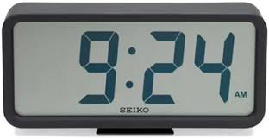
Signal Basics
What?!

Slide 8
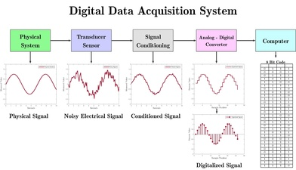
Signal Basics
Data Acquisition
Data acquisition (DAQ) is the process of measuring an electrical or physical phenomenon such as voltage, current, temperature, pressure, or sound with a computer.
A DAQ system consists of sensors, DAQ measurement hardware, and a computer with programmable software.

Slide 9
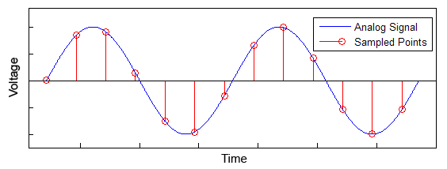
Signal Basics
Sampling
In signal processing, sampling is the reduction of a continuous-time signal to a discrete-time signal.
A sample is a value or set of values at a point in time and/or space.

Slide 10
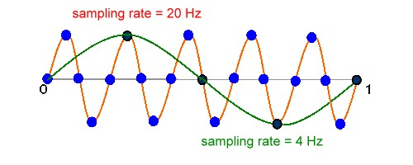
Signal Basics
Sampling Theory
The Sampling Theorem states that a signal can be exactly reproduced if it is sampled at a frequency F, where F is greater than twice the maximum frequency in the signal
Nyquist Rate
In general, to preserve the full information in the signal, it is necessary to sample at twice the maximum frequency of the signal. This is known as the Nyquist rate.

Slide 11
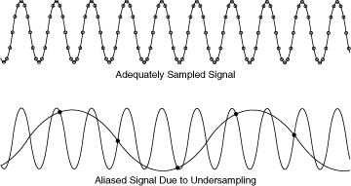
Signal Basics
Aliasing
When the signal is converted back into a continuous time signal, it will exhibit a phenomenon called aliasing.
Aliasing is the presence of unwanted components in the reconstructed signal.
These components were not present when the original signal was sampled.

Slide 12
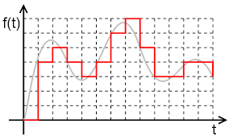
Signal Basics
Quantization
A sequence of samples like x[n] is not a digital signal because the sample values can take on a continuous range of values.
In order to complete analog to digital conversion, each sample value is mapped to a discrete level in a process called quantization.
Quantization is opposite to sampling. It is done on y axis.

Slide 13
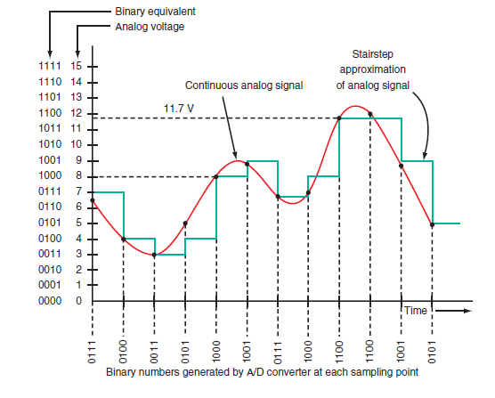
Signal Basics
Quantization
In a B-bit quantizer, each quantization level is represented with B bits, so that the number of levels equals 2^{B}

Slide 14
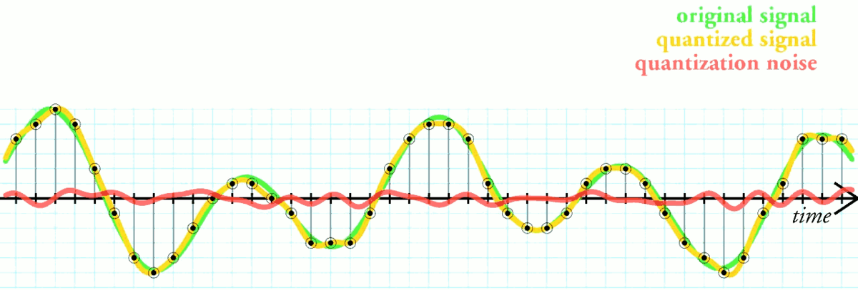
Signal Basics
Quantization Error
Quantization error is the difference between the analog signal and the closest available digital value at each sampling instant from the A/D converter.
When you quantize a signal, you introduce and error which can be defined as q[n]=x_{q}[n]−x[n] where q[n] is the quantization error, x[n] the original signal, and x_{q}[n] of the quantized signal.
The higher the resolution of the A/D converter, the lower the quantization error and the smaller the quantization noise.

Slide 15
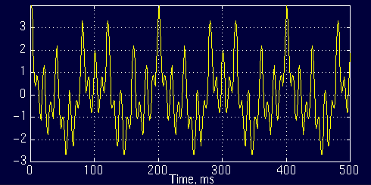
Signal Basics
Stationary Signals
Stationary signals are constant in their statistical parameters (e.g., amplitude, standard deviation) over time.
stationary signal is one whose long-term statistics do not change with time.
For example the following signal
x(t)=cos(2*pi*10*t)+cos(2*pi*25*t)+cos(2*pi*50*t)+cos(2*pi*100*t)
is a stationary signal, because it has frequencies of 10, 25, 50, and 100 Hz at any given time instant. This signal is plotted below:

Slide 16
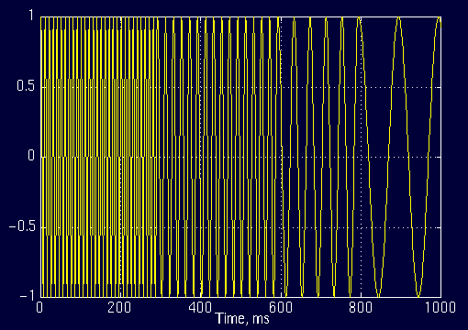
Signal Basics
Non-Stationary Signals
The statistical parameters (e.g., amplitude, standard deviation) of non-stationary signals are not constant over time.
Non-stationary signal is one whose long-term statistics do change with time.
Example :
The interval 0 to 300 ms has a 100 Hz sinusoid, the interval 300 to 600 ms has a 50 Hz sinusoid, the interval 600 to 800 ms has a 25 Hz sinusoid, and finally the interval 800 to 1000 ms has a 10 Hz sinusoid.

Slide 17
Signal Basics
Statistical Properties of Signals
A statistic is measure of some attribute of a sample (set of data). Statistical information is needed to analyze a signal properly.
Examples:
Mean
Standard deviation
Variance
Covariance
Correlation
Skewness
Kurtosis
Eigenvectors
Eigenvalues

Slide 18
Signal Basics
Mean
An example set
The symbol X bar to indicate the mean of the set X . All this formula says is “Add up all the numbers and then divide by how many there are”.

Slide 19
Signal Basics
Standard Deviation
The Standard Deviation (SD) of a data set is a measure of how spread out the data is. The average distance from the mean of the data set to a point.
Why are you using (n-1) and not n ?
Calculate SD of A, B and C where
A= [0 8 12 20]
B= [8 9 11 12]
C= [10 10 10 10]

Slide 20
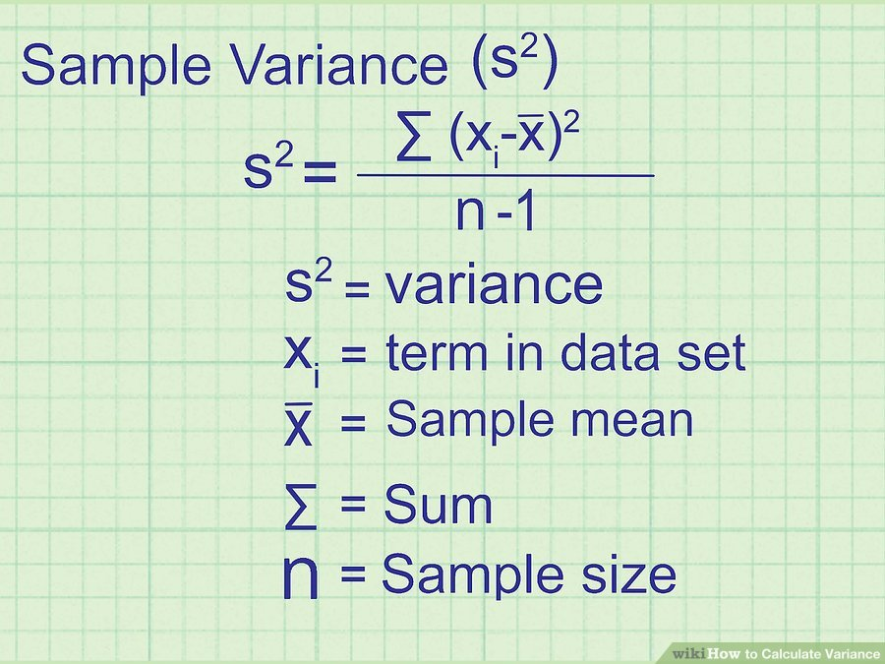
Signal Basics
Variance
The variance of a data set tells you how spread out the data points are. The closer the variance is to zero, the more closely the data points are clustered together.

Slide 21
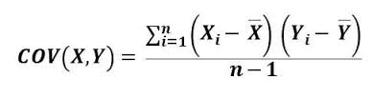
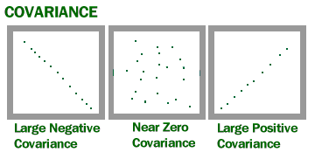
Signal Basics
Covariance
Covariance indicates how two variables are related. A positive covariance means the variables are positively related, while a negative covariance means the variables are inversely related. The formula for calculating covariance of sample data is shown below.

Slide 22

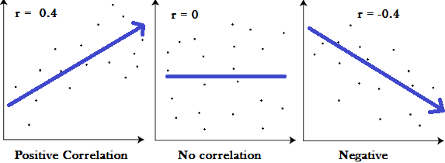
Signal Basics
Correlation
Correlation is another way to determine how two variables are related. In addition to telling you whether variables are positively or inversely related, correlation also tells you the degree to which the variables tend to move together.

Slide 23
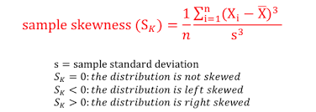
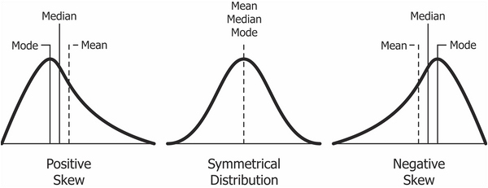
Signal Basics
Skewness
Skewness is a measure of symmetry, or more precisely, the lack of symmetry. A distribution, or data set, is symmetric if it looks the same to the left and right of the center point. Skewness tells you the amount and direction of skew.

Slide 24
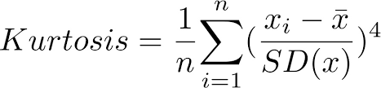
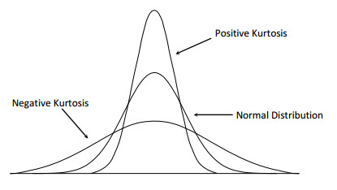
Signal Basics
Kurtosis
Distributions of data and probability distributions are not all the same shape. Kurtosis is the measure of the thickness or heaviness of the tails of a distribution. Kurtosis tells you how tall and sharp the central peak is.

Slide 25
Signal Basics
Eigenvectors and Eigenvalues
A matrix may act on certain vectors by changing only their magnitude, and leaving their direction unchanged (or, possibly, reversing it). These vectors are the eigenvectors of the matrix.
A matrix acts on an eigenvector by multiplying its magnitude by a factor, which is positive if its direction is unchanged and negative if its direction is reversed. This factor is the eigenvalue associated with that eigenvector.

