Slide 1

CSE 5406 : Neural Signal Processing
Professor Dr. Md. Sujan Ali
Dept. of Computer Science and Engineering
Jatiya Kabi Kazi Nazrul Islam University

Slide 2
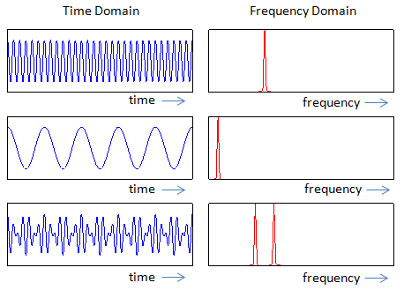
Time-Frequency Representation
Time Domain
The time domain refers to the analysis of mathematical functions or signals with respect to time.
Frequency Domain
The frequency domain refers to the analysis of mathematical functions or signals with respect to frequency, rather than time.

Slide 3
Time-Frequency Representation
Time-frequency representation
A time–frequency representation (TFR) is a view of a signal represented over both time and frequency.

Slide 4


Time-Frequency Representation
Fourier Transform
The Fourier transform decomposes a function of time (a signal) into the frequencies that make it up.
Where,

Slide 5
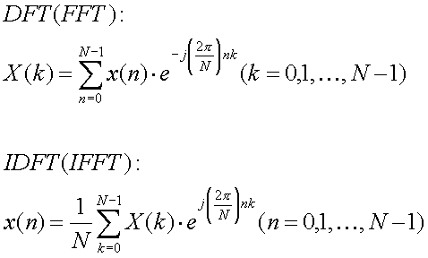
Time-Frequency Representation
Discrete Fourier Transform (DFT)

Slide 6
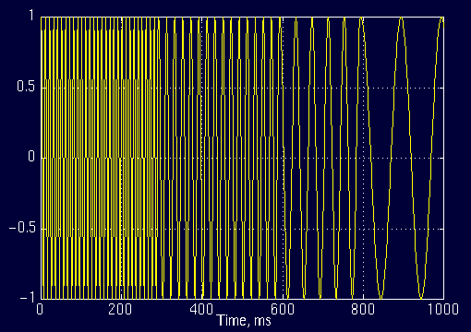
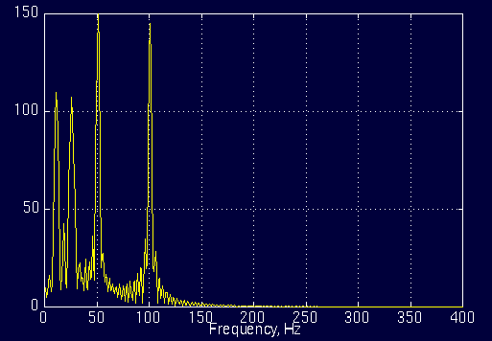
Time-Frequency Representation
Discrete Fourier Transform (DFT)

Slide 7
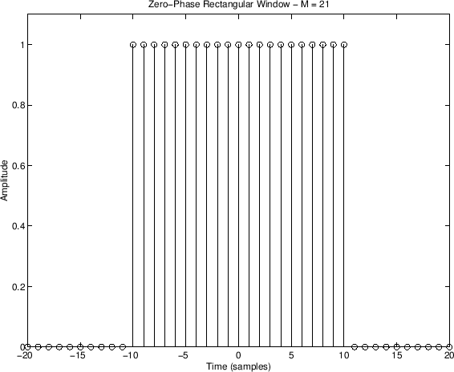
Time-Frequency Representation
Window Function
In signal processing, a window function is a mathematical function that is zero-valued outside of some chosen interval.
Window functions are added to a signal processing algorithm to address the discontinuity problem but do not totally overcome it. These functions operate by multiplying the time waveform by a finite-length window with an amplitude that varies smoothly and gradually toward zero at the edges.
For instance, a function that is constant inside the interval and zero elsewhere is called a rectangular window

Slide 8
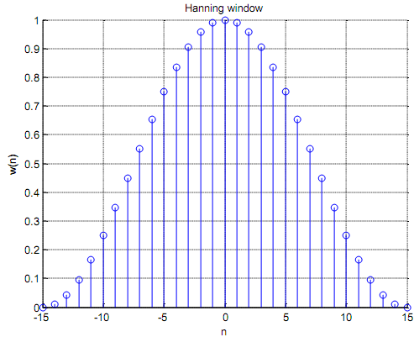
Time-Frequency Representation
Other types of windows
Hanning window

Slide 9
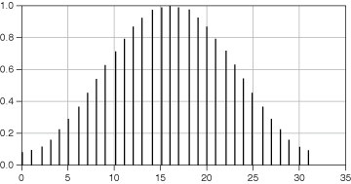
Time-Frequency Representation
Hamming window

Slide 10
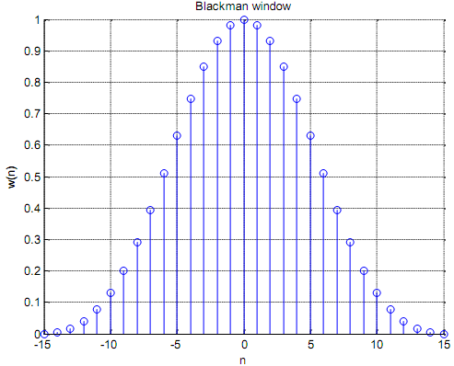
Time-Frequency Representation
Blackman window

Slide 11
Time-Frequency Representation
Need of window function
Signal segments are finite and not periodic.
Signal segment generates a jump discontinuity.
Such jumps result in an artifacts in the FFT amplitudes.
To make the end points smooth.

Slide 12
Time-Frequency Representation
Limitations of DFT
Do not give time information
2. Do not work for non-stationary signals

Slide 13
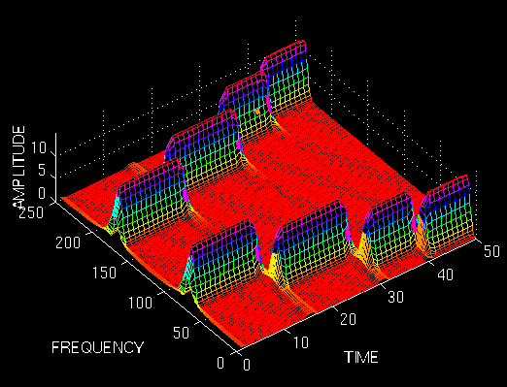
Time-Frequency Representation
Short Time Fourier Transform (STFT)

Slide 14
Time-Frequency Representation
Short Time Fourier Transform (STFT)

Slide 15
Time-Frequency Representation
Heisenberg Uncertainty Principle
This principle originally applied to the momentum and location of moving particles.
It can be applied to time-frequency information of a signal.
It states that one cannot know the exact time-frequency representation of a signal, i.e., one cannot know what spectral components exist at what instances of times
One can only know the time intervals in which certain band of frequencies exist.
Which is a resolution problem of STFT.

Slide 16
Time-Frequency Representation
Limitations of STFT
Resolution problem
Narrow window ===>good time resolution,
poor frequency resolution.
Wide window ===>good frequency resolution,
poor time resolution.

Slide 17
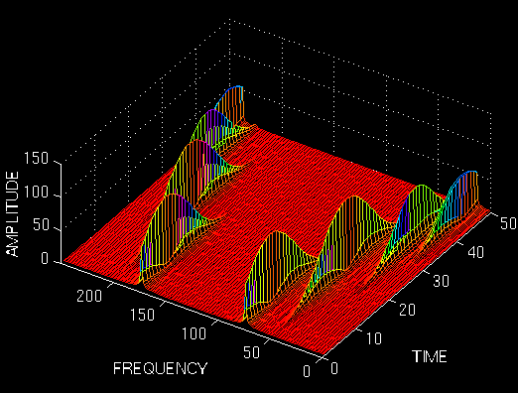
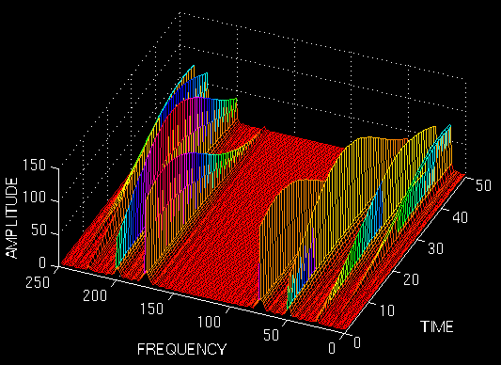
Time-Frequency Representation
Limitations of STFT

Slide 18
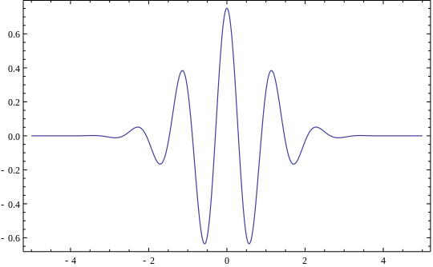
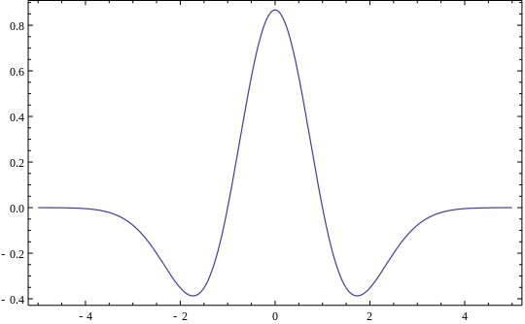
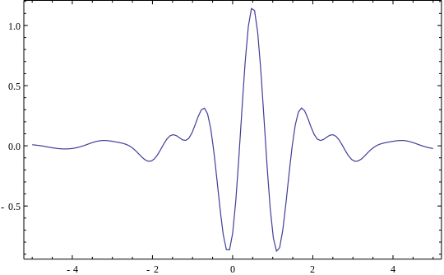
Time-Frequency Representation
Wavelet Transform
Wavelet
A wavelet is a small wave with an amplitude that begins at zero, increases, and then decreases back to zero.
Morlet wavelet
Maxican hat wavelet
Meyer wavelet

Slide 19
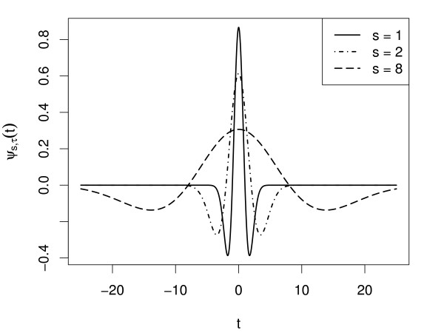
Time-Frequency Representation
Wavelet Transform
Wavelet with different scales

Slide 20

Time-Frequency Representation
Continuous Wavelet Transform (CWT)
The transformed signal is a function of two variables, tau and s, the translation and scale parameters, respectively. psi(t) is the transforming function, and it is called the mother wavelet .
There are two main differences between the STFT and the CWT:
The Fourier transforms of the windowed signals are not taken.
The width of the window is changed as the transform is computed for every single spectral component, which is probably the most significant characteristic of the wavelet transform.

Slide 21
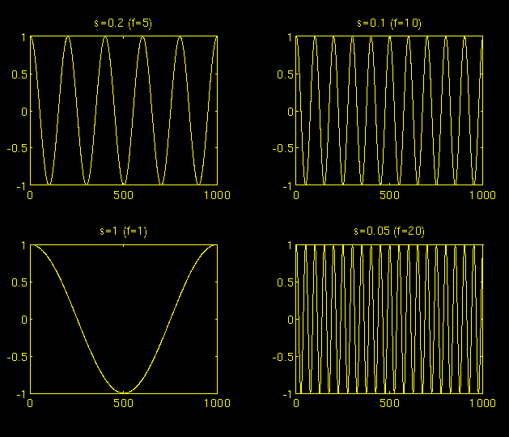
Time-Frequency Representation
Continuous Wavelet Transform (CWT)
Cosine signals corresponding to various scales

Slide 22
Time-Frequency Representation
Continuous Wavelet Transform (CWT)
COMPUTATION OF THE CWT
Let x(t) is the signal to be analyzed.
The procedure will be started from scale s=1 and will continue for the increasing values of s.
The wavelet is placed at the beginning of the signal at the point which corresponds to time=0.
The wavelet function at scale 1 is multiplied by the signal and then integrated over all times.
The result of the integration is then multiplied by the constant number 1/sqrt{s} . This multiplication is for energy normalization purposes so that the transformed signal will have the same energy at every scale.

Slide 23
Time-Frequency Representation
Continuous Wavelet Transform (CWT)
COMPUTATION OF THE CWT
The final result is the value of the transformation, i.e., the value of the continuous wavelet transform at time zero and scale s=1 .
The wavelet at scale s=1 is then shifted towards the right by tau amount to the location t=tau , and the above equation is computed to get the transform value at t=tau , s=1 in the time-frequency plane.
This procedure is repeated until the wavelet reaches the end of the signal. One row of points on the time-scale plane for the scale s=1 is now completed.

Slide 24
Time-Frequency Representation
Continuous Wavelet Transform (CWT)
COMPUTATION OF THE CWT
Then, s is increased by a small value.
This is a continuous transform, and therefore, both tau and s must be incremented continuously .
The above procedure is repeated for every value of s.
Every computation for a given value of s fills the corresponding single row of the time-scale plane.
When the process is completed for all desired values of s, the CWT of the signal has been calculated.

Slide 25
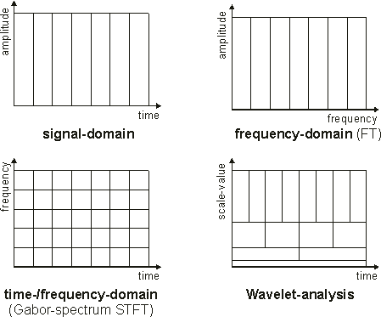
Time-Frequency Representation
Output Tiling

Slide 26
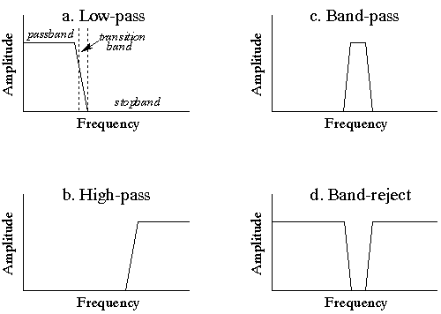
Time-Frequency Representation
Digital Filters
In signal processing, a digital filter is a system that performs mathematical operations on a sampled, discrete-time signal to reduce or enhance certain aspects of that signal.

Slide 27
Time-Frequency Representation
FIR Filters
In signal processing, a finite impulse response (FIR) filter is a filter whose impulse response (or response to any finite length input) is of finite duration, because it settles to zero in finite time.
Where N is filter order

