Slide 1

CSE 5406 : Neural Signal Processing
Professor Dr. Md. Sujan Ali
Dept. of Computer Science and Engineering
Jatiya Kabi Kazi Nazrul Islam University

Slide 2
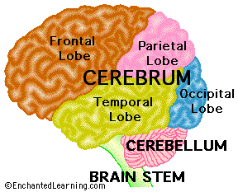
Electroencephalography (EEG)
Human Brain Structure and Functions
Three main parts:
Cerebrum
Cerebellum
Brain stem

Slide 3
Electroencephalography (EEG)
The Cerebrum
The Cerebellum
The part of the brain at the back of the skull, which coordinates and regulates muscular activity.
The Brain Stem
Motor and sensory pathway to body and face.
Frontal Lobe | Occipital Lobe | Parietal Lobe | Temporal Lobe
Behavior Problem solving Attention Creative thought Sense of smell Muscle movements Skilled movements | Vision Reading | Sense of touch Response to internal stimuli Sensory combination and comprehension | Auditory memories hearing Visual memories Music Fear Sense of identity

Slide 4
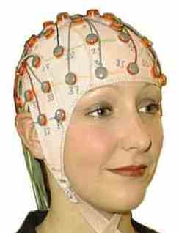
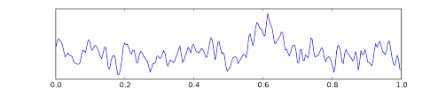
Electroencephalography (EEG)
EEG is an electrophysiological monitoring method to record electrical activity of the brain.
Electrodes measure voltage-differences at the scalp in the microvolt (μV) range.

Slide 5
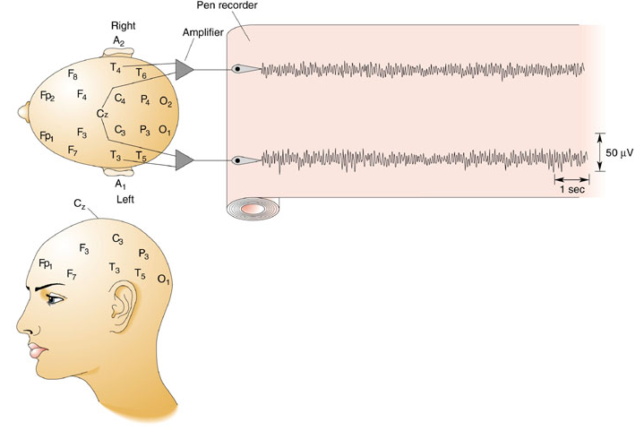
Electroencephalography (EEG)
Standard placements of electrodes on the human scalp: C, central; F, frontal; Fp, frontal pole; O, occipital; P, parietal; T, temporal.

Slide 6
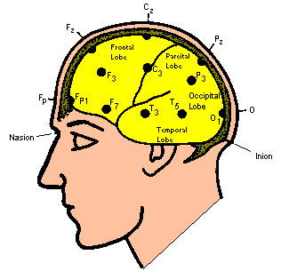
Electroencephalography (EEG)
Electrode Placement
Standard “10-20 System”
Spaced apart 10-20%
Letter for region
  F - Frontal Lobe
  T - Temporal Lobe
  C - Center
  O - Occipital Lobe
Number for exact position
  Odd numbers - left
  Even numbers - right

Slide 7
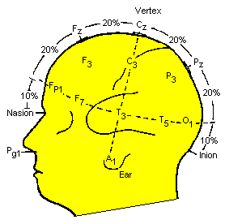
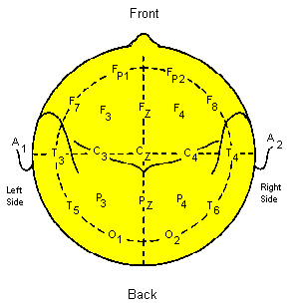
Electroencephalography (EEG)
Electrode Placement
A more detailed view:

Slide 8
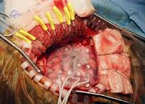
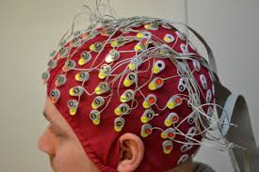
Electroencephalography (EEG)
EEG Recordings
Invasive Non-invasive

Slide 9
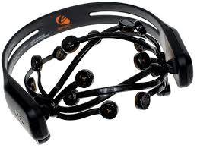
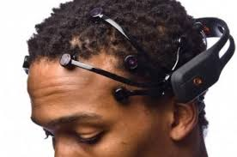
Electroencephalography (EEG)
EEG Recordings
Emotive Headset

Slide 10

Electroencephalography (EEG)
Brain Rhythms
Delta waves
Delta is the frequency range up to 4 Hz.
These waves are primarily associated with deep sleep.
It tends to be the highest in amplitude and the slowest waves.

Slide 11

Electroencephalography (EEG)
Brain Rhythms
Theta waves
Theta is the frequency range from 4 Hz to 8 Hz.
Theta is seen normally in young children.
It may be seen in drowsiness or arousal in older children and adults;

Slide 12

Electroencephalography (EEG)
Brain Rhythms
Alpha waves
Alpha is the frequency range from 8 Hz to 12 Hz.
Alpha waves are usually found over the occipital region of the brain.
Alpha waves have been thought to indicate both a relaxed awareness without any attention or concentration.

Slide 13

Electroencephalography (EEG)
Brain Rhythms
Beta waves
Beta is the frequency range from 12 Hz to about 30 Hz.
Beta activity is closely linked to motor behavior.
Beta wave is associated with active thinking, active attention.

Slide 14

Electroencephalography (EEG)
Brain Rhythms
Gamma waves
Gamma is the frequency range approximately 30–100 Hz.
The amplitudes of these rhythms are very low and their occurrence is rare.
These rhythms can be used for confirmation of certain brain diseases.

Slide 15
Electroencephalography (EEG)
Event Related Potential (ERP)
An ERP is the measured brain response that is the direct result of a specific sensory, cognitive, or motor event.
A sense is a physiological capacity of organisms that provides data for perception.
The motor system is the part of the central nervous system that is involved with movement.
Cognition is "the mental action or process of acquiring knowledge and understanding through thought, experience, and the senses.

Slide 16
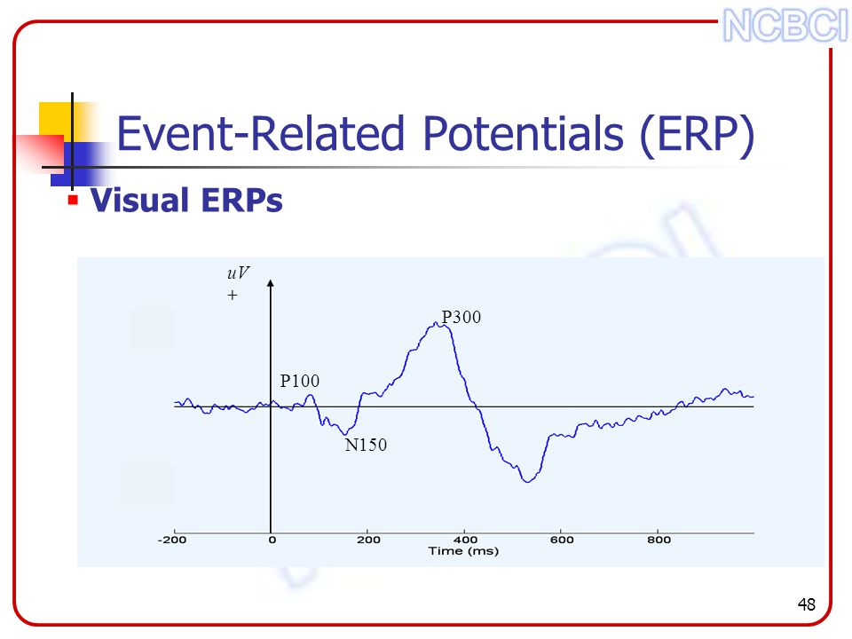
Electroencephalography (EEG)
Event Related Potential (ERP)

Slide 17
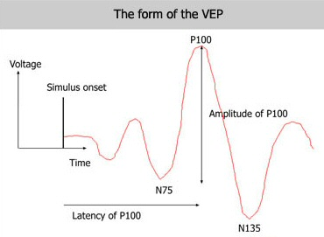
Electroencephalography (EEG)
Auditory Evoked Potential (AEP)
Auditory evoked potential (AEP) is a subclass of ERP.
AEP is very small electrical voltage potentials originating from the brain recorded from the scalp in response to an auditory stimulus, such as different tones, speech sounds, etc.
Visual Evoked Potential (VEP)
The visual evoked potential (VEP), or visual evoked response (VER), is a measurement of the electrical signal recorded at the scalp over the occipital cortex in response to light stimulus.

Slide 18
Electroencephalography (EEG)
Steady State Visual Evoked Potential (SSVEP)
In neurology, SSVEP are signals that are natural responses to visual stimulation at specific frequencies.
When the retina is excited by a visual stimulus ranging from 3.5 Hz to 75 Hz, the brain generates electrical activity at the same (or multiples of) frequency of the visual stimulus.
A typical SSVEP-based BCI system uses a light-emitting diode (LED) for flickering.
Applications of SSVEP
SSVEP BCIs are useful in different applications, especially the ones that need
some major requirements as follows :
• Large number of BCI commands is necessary.
• High reliability of recognition is necessary .
• No training is allowed.

