Slide 1

CSE 5406 : Neural Signal Processing
Professor Dr. Md. Sujan Ali
Dept. of Computer Science and Engineering
Jatiya Kabi Kazi Nazrul Islam University

Slide 2
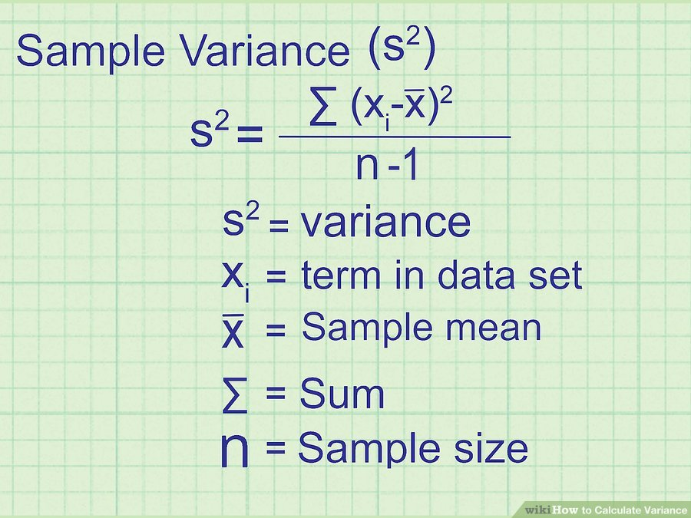
Dimensionality Reduction and Classification
Variance
The variance of a data set tells you how spread out the data points are. The closer the variance is to zero, the more closely the data points are clustered together.

Slide 3
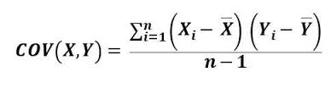
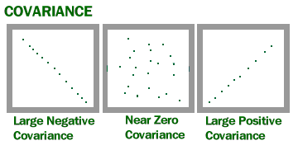
Dimensionality Reduction and Classification
Covariance
Covariance indicates how two variables are related. A positive covariance means the variables are positively related, while a negative covariance means the variables are inversely related. The formula for calculating covariance of sample data is shown below.

Slide 4
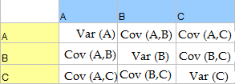
Dimensionality Reduction and Classification
Covariance Matrix
(dispersion matrix/ variance–covariance matrix)
In probability theory and statistics, a covariance matrix is a matrix whose element in the i, j position is the covariance between the i ^{th} and j ^{th} elements of a random vector.

Slide 5
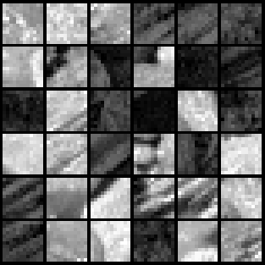
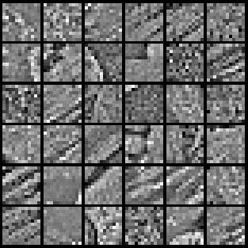
Dimensionality Reduction and Classification
Whitening
A whitening transformation is a linear transformation that transforms a vector of random variables with a known covariance matrix into a set of new variables whose covariance is the identity matrix meaning that they are uncorrelated and all have variance one.
There are two things accomplished with whitening:
Make the features less correlated with one another.
Give all of the features the same variance.
Raw
Image
Whitened
Image

Slide 6
Dimensionality Reduction and Classification
Principal Component Analysis (PCA)
PCA is a statistical procedure that converts a set of data of possibly correlated variables into a set of data of linearly uncorrelated variables called principal components.
Goals of PCA
The goals of PCA are to
Extract the most important information from the data table;
Compress the size of the data set by keeping only this important information;
Simplify the description of the data set.

Slide 7
Eigenvector and Eigenvalue
Eigenvalue Definition
Eigenvalues are the special set of scalars associated with the system of linear equations. It is mostly used in matrix equations. ‘Eigen’ is a German word that means ‘proper’ or ‘characteristic’. Therefore, the term eigenvalue can be termed as characteristic value, characteristic root, proper values or latent roots as well. In simple words, the eigenvalue is a scalar that is used to transform the eigenvector. The basic equation is
Ax = λx
The number or scalar value “λ” is an eigenvalue of A.
What are EigenVectors?
Eigenvectors are the vectors non−zero that do not change the direction when any linear transformation is applied. It changes by only a scalar factor. In a brief, we can say, if A is a linear transformation from a vector space V and x is a vector in V, which is not a zero vector, then v is an eigenvector of A if AX is a scalar multiple of x.

Slide 8
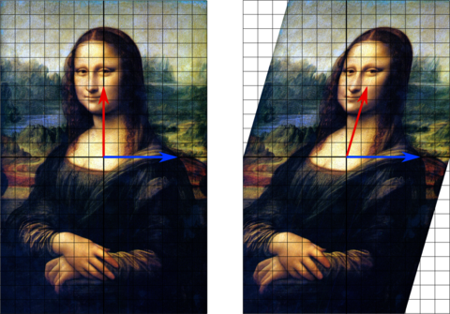
Eigenvector and Eigenvalue
In this shear mapping the red arrow changes direction, but the blue arrow does not. The blue arrow is an eigenvector of this shear mapping because it does not change direction, and since its length is unchanged, its eigenvalue is 1.

Slide 9
Dimensionality Reduction and Classification
Principal Component Analysis (PCA)
Listed below are the 6 general steps for performing a principal component analysis.
1. Take the whole dataset consisting of d-dimensional samples ignoring the class labels
2. Compute the d-dimensional mean vector (i.e., the means for every dimension of the whole dataset)
3. Compute the covariance matrix of the whole data set
4. Compute eigenvectors (e1,e2,...,e_{d}) and corresponding eigenvalues (λ1,λ2,...,λ_{d})
5. Sort the eigenvectors by decreasing eigenvalues and choose k eigenvectors with the largest eigenvalues to form a d×k dimensional matrix
6. Use this d×k eigenvector matrix to transform the samples onto the new subspace. This can be summarized by the mathematical equation: y=W^{T}×x (where x is a d×1-dimensional vector representing one sample, and y is the transformed k×1-dimensional sample in the new subspace.)

Slide 10
Dimensionality Reduction and Classification
Independent Component Analysis (ICA)
ICA is a technique used to separate independent sources linearly mixed in several sensors.
This technique is currently finding applications in analysis of biomedical signals (e.g. ERP, EEG, fMRI, optical imaging), and in models of visual receptive fields and separation of speech signals.
For instance, when recording electroencephalograms (EEG) on the scalp, ICA can separate out artifacts embeded in the data (since they are usually independent of each other).

Slide 11
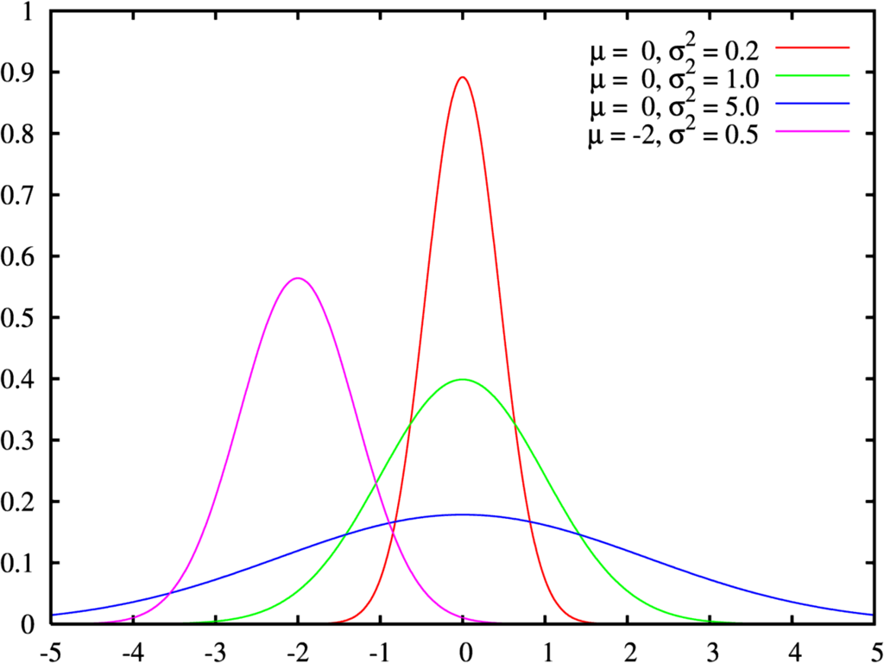
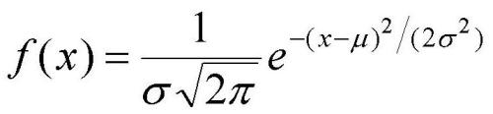
Dimensionality Reduction and Classification
Independent Component Analysis (ICA)
Gaussian Function/Distribution:
What is Gaussian used for?
Gaussian functions are widely used in statistics to describe the normal distributions, in signal processing to define Gaussian filters

Slide 12
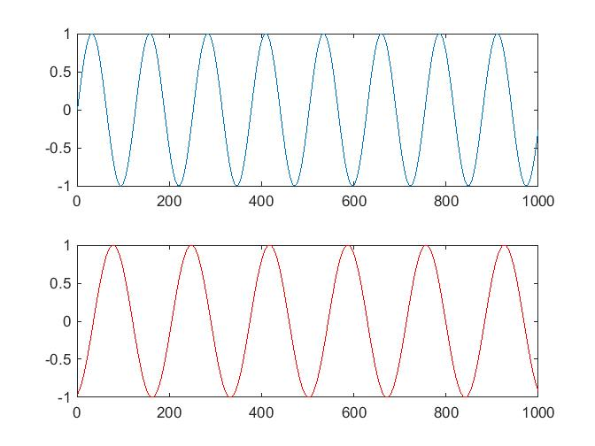
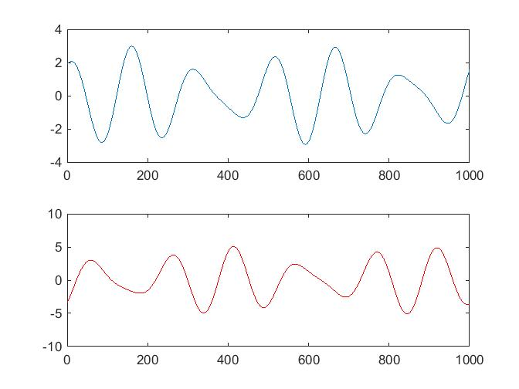
Dimensionality Reduction and Classification
ICA Example:
First mix and then separate two sources
M1=X-2*Y
X
Y
M2=1.73*X+3.41*Y

Slide 13
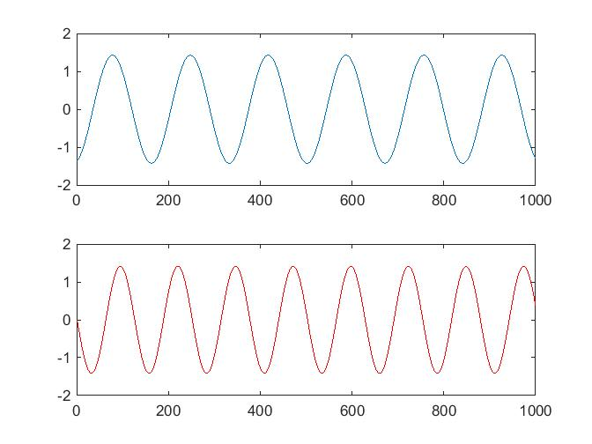
Dimensionality Reduction and Classification
ICA Example:
Then input these M1 and M2 into ICA algorithm which is able to separate the original X and Y
X
Y

Slide 14
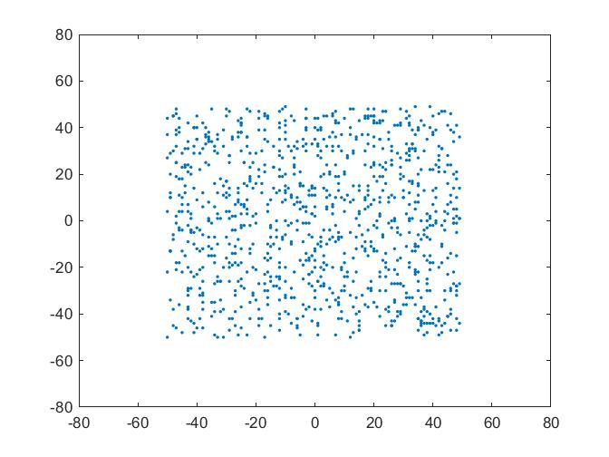
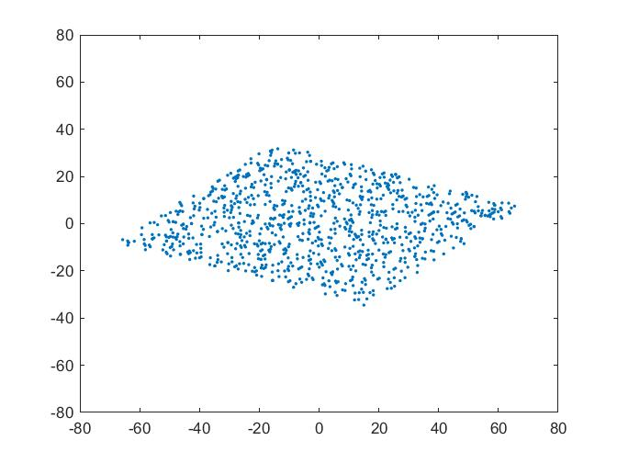
Dimensionality Reduction and Classification
Whitening data:
Mix two random sources A and B.
A ; B M1 = 0.54*A - 0.84*B; M2 = 0.42*A + 0.27*B;

Slide 15
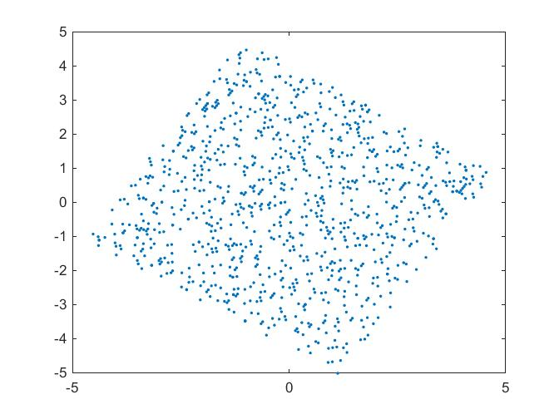
Dimensionality Reduction and Classification
Whitening data:
Then if we whiten the two linear mixtures, we get the following plot

Slide 16
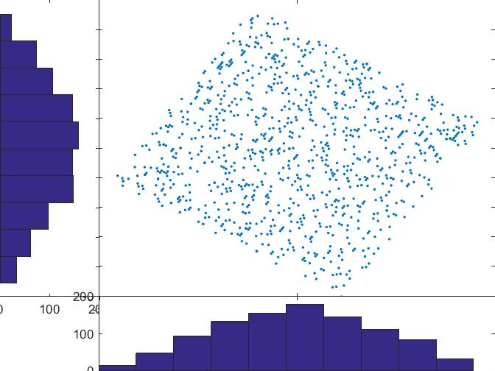
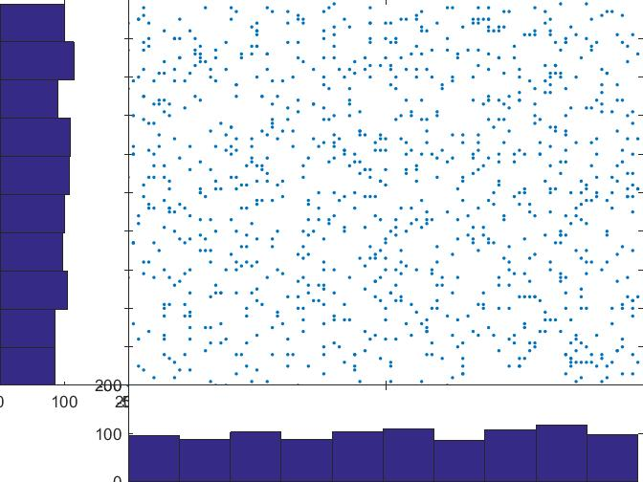
Dimensionality Reduction and Classification
ICA Algorithm:
ICA rotates the whitened matrix back to the original (A,B) space. It performs the rotation by minimizing the Gaussianity of the data projected on both axes

Slide 17
Dimensionality Reduction and Classification
Assignment 3 (Extension of Assignment 2)
After assignment 2
1. Consider artifact free EEG and extracted EOG and plot.
2. Filter both signal and separate 8-32 Hz (alpha and beta) component.
3. Plot the component in both time and frequency domain.
4. Measure the statistical properties of the two signal (plsease do not use built-in functions).
5. Compare them using the properties.

Slide 18
Dimensionality Reduction and Classification
Linear Discriminant Analysis (LDA)
Linear discriminant analysis (LDA), also known as Fisher’s linear discriminant analysis is a technique used to find a linear combination of features that separates two or more classes of data.
It is typically used as a dimensionality reduction step before classification.
Objectives of LDA
The objectives of LDA are to
reduce dimensionality
but at the same time to preserves as much of the class discriminatory information as possible.
to use a separating hyperplane that maximally separate the data representing the different classes.
The hyperplane is found by selecting the projection, where the same classes are projected very close to each other and the distance between two classes means is as maximum as possible .

Slide 19
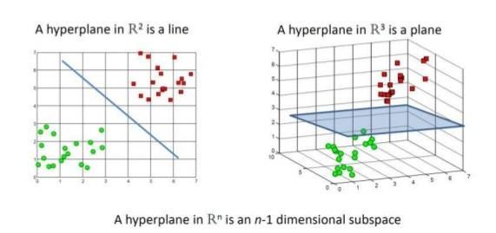
Dimensionality Reduction and Classification
Hyperplane
A hyperplane is a subspace of one dimension less than its ambient space.
If a space is 3-dimensional then its hyperplanes are the 2-dimensional planes, while if the space is 2-dimensional, its hyperplanes are the 1-dimensional lines.

Slide 20
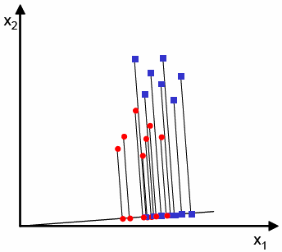
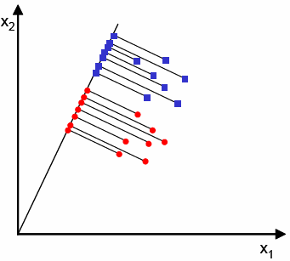
Dimensionality Reduction and Classification
Linear Discriminant Analysis (LDA)
The two classes are not well separated when projected onto this line
This line succeeded in separating the two classes

Slide 21
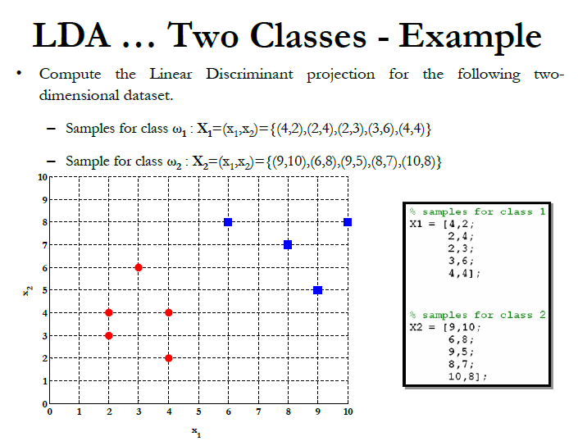
Dimensionality Reduction and Classification

Slide 22
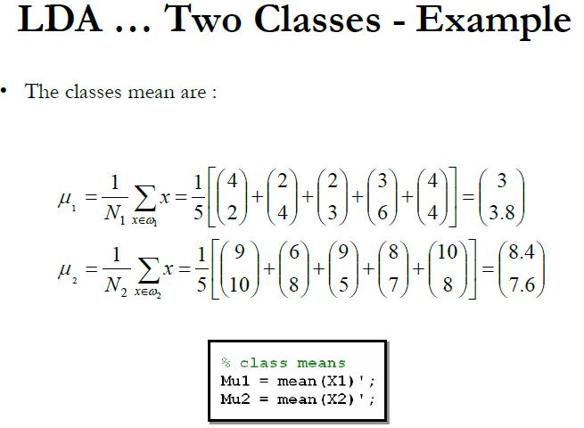
Dimensionality Reduction and Classification

Slide 23
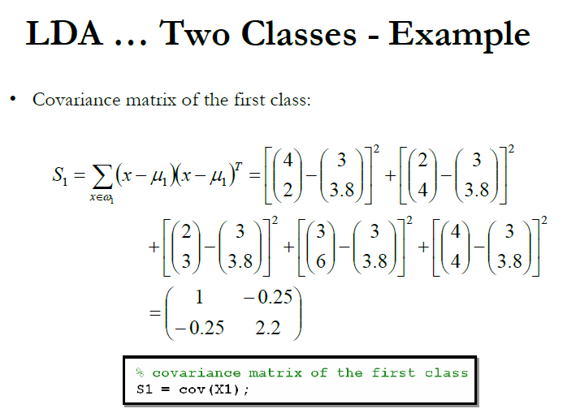
Dimensionality Reduction and Classification

Slide 24
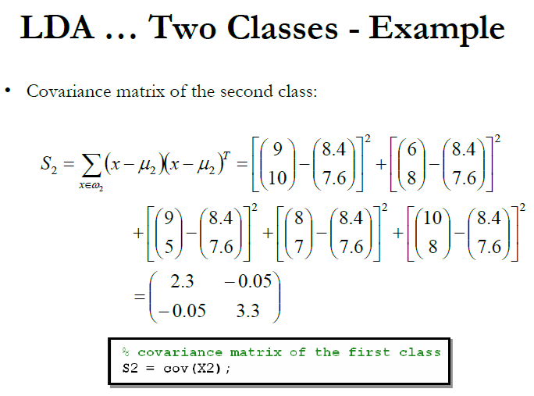
Dimensionality Reduction and Classification

Slide 25
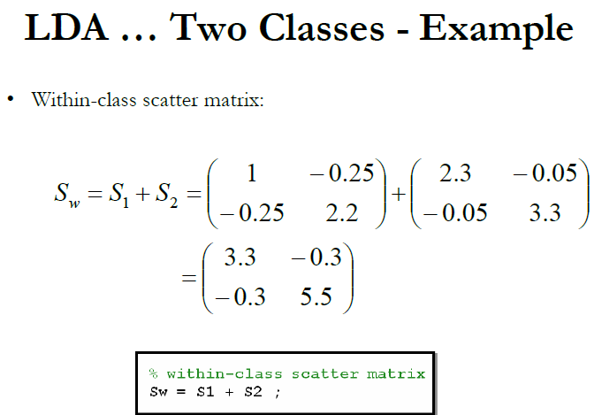
Dimensionality Reduction and Classification

Slide 26
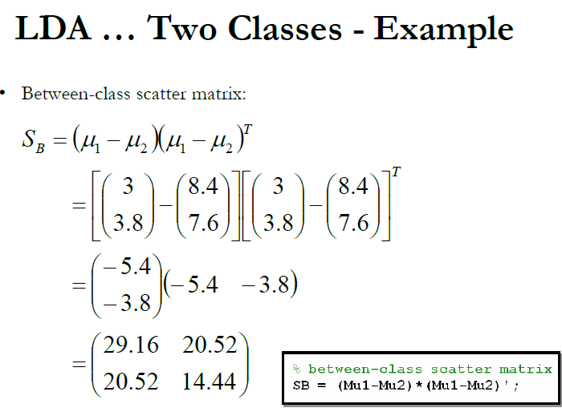
Dimensionality Reduction and Classification

Slide 27
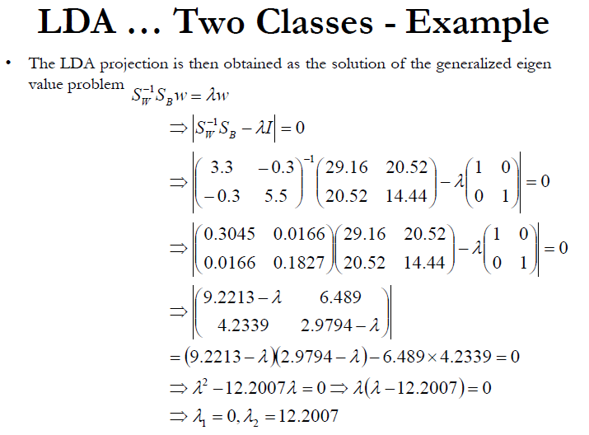
Dimensionality Reduction and Classification

Slide 28
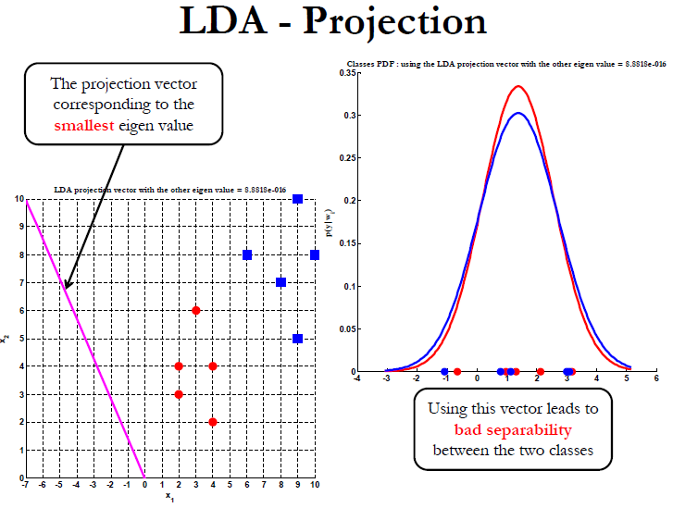
Dimensionality Reduction and Classification

Slide 29
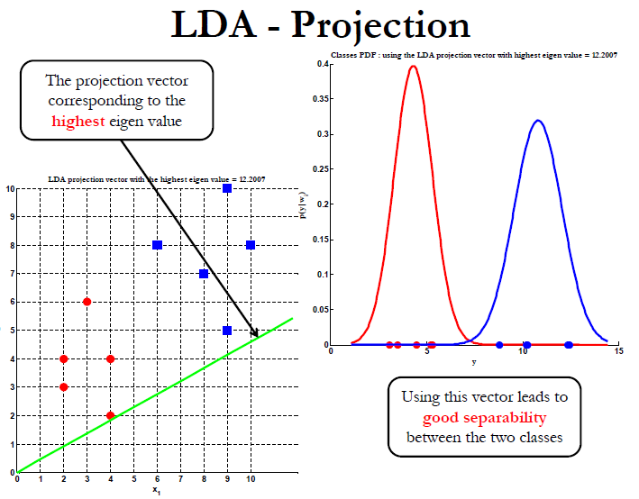
Dimensionality Reduction and Classification

Slide 30

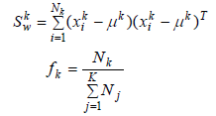
Dimensionality Reduction and Classification
Mathematical explanation
Let as assume that we have K classes, each containing N observations x_{i}. The within-class scatter, for all K classes can be calculated as:
where the within-class covariance matrix and the fraction of data are calculated according to the following formulas:

Slide 31


Dimensionality Reduction and Classification
Mathematical explanation
where N_{k} is the number of observations of k^{th} class and indicates mean of the all observations x_{i} for k^{th} class. The between class scatter for all K classes is calculated as:
where the between class covariance matrix, can be estimated as
where indicates the mean of the all observations x_{i} for all classes.

Slide 32

Dimensionality Reduction and Classification
Mathematical explanation
The main objective of LDA is to find a projection matrix that maximizes the ratio of the determinants. The projections that providing the best class separation are eigenvectors with the highest eigenvalues of matrix M:
Now, the aim of the LDA is to seek (K-1) projections by means of (K-1) projection vectors. The transformed data set y is obtained as a linear combination of all input features x with weights W.
where is a matrix form with the H eigenvectors of matrix M associated with the highest eigenvalues. The LDA reduces the original feature space dimension to H.

Slide 33
Dimensionality Reduction and Classification
Limitations of LDA
The LDA performs well when the discriminatory information of data depends on the mean of the data.
But it does not work for the variance depended discriminatory informative data.
Also, the performance of the LDA is not good for nonlinear classification

Slide 34
Dimensionality Reduction and Classification
Support Vector Machine (SVM)
A SVM performs classification by finding the hyperplane that maximizes the margin between the two classes.
It draws the widest channel, or street, between the two classes.
Binary classification can be viewed as the task of separating classes in feature space.
w^{T}x + b = 0
w^{T}x + b > 0
w^{T}x + b < 0

Slide 35
Which of the linear separators is optimal?
Dimensionality Reduction and Classification

Slide 36
Best Linear Separator?
Dimensionality Reduction and Classification

Slide 37
Best Linear Separator?
Dimensionality Reduction and Classification

Slide 38
Best Linear Separator?
Dimensionality Reduction and Classification

Slide 39
Find Closest Points in Convex Hulls
Dimensionality Reduction and Classification
d
c

Slide 40
Plane Bisect Closest Points
Dimensionality Reduction and Classification
w^{T} x + b =0
w = d - c
d
c

Slide 41
Classification Margin
Dimensionality Reduction and Classification
Distance from example data to the separator is
Data closest to the hyperplane are support vectors.
Margin ρ of the separator is the width of separation between classes
SVMs maximize the margin around the separating hyperplane
Margin
Width
ρ
What we know:
w . x⁺ + b = +1
w . x⁻ + b = -1
w . (x⁺-x⁻⁾ = 2
r

Slide 42
Dimensionality Reduction and Classification
Common Spatial Pattern (CSP):
CSP is a feature extraction technique used in signal processing for separating a multivariate signal into additive sub-components.
The technique used to design spatial filters such that the variance of the filtered data from one class is maximized while the variance of the filtered data from the other class is minimized.
The CSP algorithm finds spatial filters that are useful in discriminating different classes of EEG signals such as those corresponding to different types of motor activities.

Slide 43
Dimensionality Reduction and Classification
Applications of CSP:
This method can be applied to several multivariate signal but it seems that most works on it concern electroencephalographic signals.
Particularly, the method is mostly used on brain–computer interface in order to analyze cerebral activity for a specific task (e.g. hand movement).
It can also be used to separate artifacts from electroencephalographics signals.

Slide 44
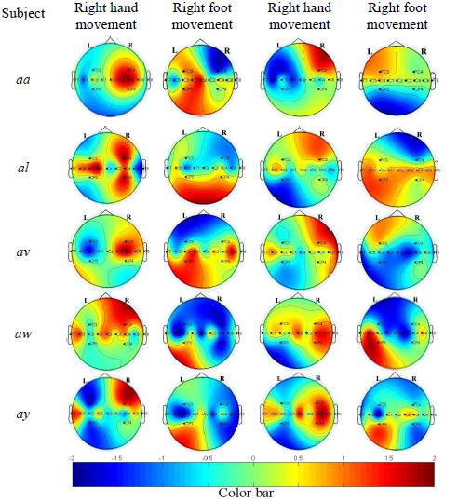
Dimensionality Reduction and Classification
Applications of CSP

