Slide 1


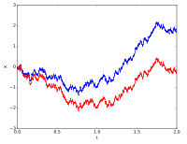
Stochastic Process for MS
CSE 5403: Stochastic Process Cr. 3.00
Course Teacher: Dr. A H M Kamal
Course Leaner: 2nd semester of MS 2015-16

Slide 2
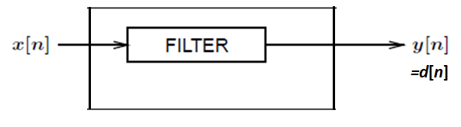
Stochastic Process for MS
Wiener Filter:
We wish to filter a signal x[n] to modify it such that it approximates some other signal d[n] in some statistical sense. That is, the output of the filter y[n] is a good estimate of d[n]. The output error e[n] represents the mismatch between y[n] and d[n]. This can be considered a time-domain specification of the filter.

Slide 3
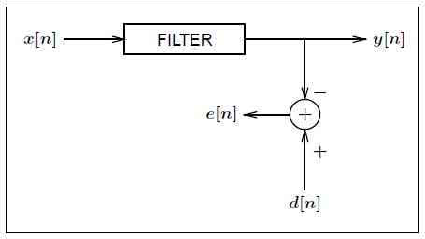
Stochastic Process for MS
Wiener Filter:
We wish to filter a signal x[n] to modify it such that it approximates some other signal d[n] in some statistical sense. That is, the output of the filter y[n] is a good estimate of d[n]. The output error e[n] represents the mismatch between y[n] and d[n]. This can be considered a time-domain specification of the filter.

Slide 4
Stochastic Process for MS
Wiener Filter:
We wish to filter a signal x[n] to modify it such that it approximates some other signal d[n] in some statistical sense. That is, the output of the filter y[n] is a good estimate of d[n]. The output error e[n] represents the mismatch between y[n] and d[n]. This can be considered a time-domain specification of the filter.
Why would we want to do this?
Well, consider the problem of predicting the stock market. Assume that x[n] represents the price of a particular stock on day n and d[n] is the price of that stock one day in the future.
The goal is to find a filter that will predict d[n] given x[n]. Moreover, we would like to find the best such linear predictor.

Slide 5
Stochastic Process for MS
Wiener Filter:
We wish to filter a signal x[n] to modify it such that it approximates some other signal d[n] in some statistical sense. That is, the output of the filter y[n] is a good estimate of d[n]. The output error e[n] represents the mismatch between y[n] and d[n]. This can be considered a time-domain specification of the filter.
Well, consider the problem of predicting the stock market. Assume that x[n] represents the price of a particular stock on day n and d[n] is the price of that stock one day in the future.
Goal: To find an optimal filter.
The goal is to find a filter that will predict d[n] given x[n]. Moreover, we would like to find the best such linear predictor.
In order to talk about an “optimal” filter which estimates d[n] from x[n], we must have a method of measuring how good a job the filter does. A “cost function” is used to judge the performance, and could take on many different forms.

Slide 6


Stochastic Process for MS
Wiener Filter:
We wish to filter a signal x[n] to modify it such that it approximates some other signal d[n] in some statistical sense. That is, the output of the filter y[n] is a good estimate of d[n]. The output error e[n] represents the mismatch between y[n] and d[n]. This can be considered a time-domain specification of the filter.
We most commonly use the mean square error (MSE) as our cost function.
That is:
The filter that is optimum in the MSE sense is called a Wiener filter.

Slide 7
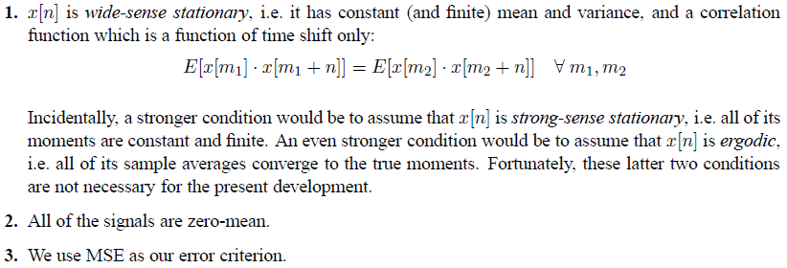
Stochastic Process for MS
Wiener Filter:
We wish to filter a signal x[n] to modify it such that it approximates some other signal d[n] in some statistical sense. That is, the output of the filter y[n] is a good estimate of d[n]. The output error e[n] represents the mismatch between y[n] and d[n]. This can be considered a time-domain specification of the filter.
We assume that:.

Slide 8


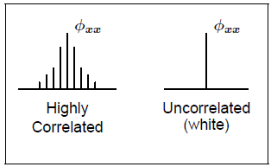
Stochastic Process for MS
Wiener Filter:
We wish to filter a signal x[n] to modify it such that it approximates some other signal d[n] in some statistical sense. That is, the output of the filter y[n] is a good estimate of d[n]. The output error e[n] represents the mismatch between y[n] and d[n]. This can be considered a time-domain specification of the filter.
It is a measure of the similarity between two random variables,

Slide 9
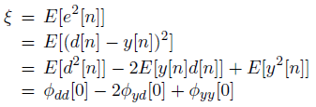
Stochastic Process for MS
Wiener Filter:
We wish to filter a signal x[n] to modify it such that it approximates some other signal d[n] in some statistical sense. That is, the output of the filter y[n] is a good estimate of d[n]. The output error e[n] represents the mismatch between y[n] and d[n]. This can be considered a time-domain specification of the filter.
It is a measure of the similarity between two random variables,
Wiener Filter:
So, the cost function is itself a function of the correlation and cross correlation of the output of the filter and the desired output.

Slide 10

Stochastic Process for MS
Wiener Filter:
We wish to filter a signal x[n] to modify it such that it approximates some other signal d[n] in some statistical sense. That is, the output of the filter y[n] is a good estimate of d[n]. The output error e[n] represents the mismatch between y[n] and d[n]. This can be considered a time-domain specification of the filter.
It is a measure of the similarity between two random variables,
Wiener Filter:
We know that:

Slide 11
Stochastic Process for MS
Wiener Filter:
We wish to filter a signal x[n] to modify it such that it approximates some other signal d[n] in some statistical sense. That is, the output of the filter y[n] is a good estimate of d[n]. The output error e[n] represents the mismatch between y[n] and d[n]. This can be considered a time-domain specification of the filter.
It is a measure of the similarity between two random variables,
Wiener Filter:
We know that:

Slide 12
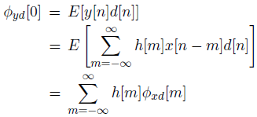
Stochastic Process for MS
Wiener Filter:
We wish to filter a signal x[n] to modify it such that it approximates some other signal d[n] in some statistical sense. That is, the output of the filter y[n] is a good estimate of d[n]. The output error e[n] represents the mismatch between y[n] and d[n]. This can be considered a time-domain specification of the filter.
It is a measure of the similarity between two random variables,
Wiener Filter:

Slide 13

Stochastic Process for MS
Wiener Filter:
We wish to filter a signal x[n] to modify it such that it approximates some other signal d[n] in some statistical sense. That is, the output of the filter y[n] is a good estimate of d[n]. The output error e[n] represents the mismatch between y[n] and d[n]. This can be considered a time-domain specification of the filter.
It is a measure of the similarity between two random variables,
Wiener Filter:

Slide 14
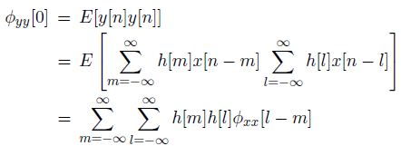
Stochastic Process for MS
Wiener Filter:
We wish to filter a signal x[n] to modify it such that it approximates some other signal d[n] in some statistical sense. That is, the output of the filter y[n] is a good estimate of d[n]. The output error e[n] represents the mismatch between y[n] and d[n]. This can be considered a time-domain specification of the filter.
It is a measure of the similarity between two random variables,
Wiener Filter:

Slide 15

Stochastic Process for MS
Wiener Filter:
We wish to filter a signal x[n] to modify it such that it approximates some other signal d[n] in some statistical sense. That is, the output of the filter y[n] is a good estimate of d[n]. The output error e[n] represents the mismatch between y[n] and d[n]. This can be considered a time-domain specification of the filter.
It is a measure of the similarity between two random variables,
Wiener Filter:

Slide 16

Stochastic Process for MS
Wiener Filter:
We wish to filter a signal x[n] to modify it such that it approximates some other signal d[n] in some statistical sense. That is, the output of the filter y[n] is a good estimate of d[n]. The output error e[n] represents the mismatch between y[n] and d[n]. This can be considered a time-domain specification of the filter.
It is a measure of the similarity between two random variables,
Wiener Filter:

Slide 17


Stochastic Process for MS
Wiener Filter:
We wish to filter a signal x[n] to modify it such that it approximates some other signal d[n] in some statistical sense. That is, the output of the filter y[n] is a good estimate of d[n]. The output error e[n] represents the mismatch between y[n] and d[n]. This can be considered a time-domain specification of the filter.
It is a measure of the similarity between two random variables,
Therefore,
Observe that it depends on the cross
correlation between x[n] and d[n] and the autocorrelation function of x[n].

Slide 18
Stochastic Process for MS
Wiener Filter:
We wish to filter a signal x[n] to modify it such that it approximates some other signal d[n] in some statistical sense. That is, the output of the filter y[n] is a good estimate of d[n]. The output error e[n] represents the mismatch between y[n] and d[n]. This can be considered a time-domain specification of the filter.
It is a measure of the similarity between two random variables,
Therefore,
The optimal filter is known as the Wiener solution.

Slide 19
Stochastic Process for MS
Wiener Filter:
We wish to filter a signal x[n] to modify it such that it approximates some other signal d[n] in some statistical sense. That is, the output of the filter y[n] is a good estimate of d[n]. The output error e[n] represents the mismatch between y[n] and d[n]. This can be considered a time-domain specification of the filter.
It is a measure of the similarity between two random variables,
Therefore,
Observing, the left hand side of the equation is equal to the convolution of hopt[n] and xx[n]

Slide 20
Stochastic Process for MS
Wiener Filter:
We wish to filter a signal x[n] to modify it such that it approximates some other signal d[n] in some statistical sense. That is, the output of the filter y[n] is a good estimate of d[n]. The output error e[n] represents the mismatch between y[n] and d[n]. This can be considered a time-domain specification of the filter.
It is a measure of the similarity between two random variables,
As the left side is a convolution, we need to apply a transformation to separate the optimal filter. Now apply z-transformation.

Slide 21
Stochastic Process for MS
Wiener Filter:
We wish to filter a signal x[n] to modify it such that it approximates some other signal d[n] in some statistical sense. That is, the output of the filter y[n] is a good estimate of d[n]. The output error e[n] represents the mismatch between y[n] and d[n]. This can be considered a time-domain specification of the filter.
It is a measure of the similarity between two random variables,
z-transformation:
Target filter

