Slide 1


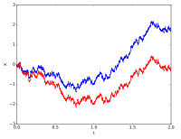
Stochastic Process for MS
CSE 5403: Stochastic Process Cr. 3.00
Course Teacher: Dr. A H M Kamal
Course Leaner: 2nd semester of MS 2018-19

Slide 2
Stochastic Process for MS
A stochastic process is a probabilistic (non-deterministic) system that evolves with time via random changes to a collection of variables. A finite stochastic process consists of a finite number of stages in which the outcomes and associated probabilities at each stage depend on the outcomes and associated probabilities of the preceding stages.
Input
Outcome and probabilities of Stage 1
Outcome of Stage n
Stage 1
Stage 2
Stage n

Slide 3
Stochastic Process for MS
A stochastic process is a probabilistic (non-deterministic) system that evolves with time via random changes to a collection of variables. A finite stochastic process consists of a finite number of stages in which the outcomes and associated probabilities at each stage depend on the outcomes and associated probabilities of the preceding stages.
One type of finite stochastic process is called a Random Walk. A Random Walk process is "memoryless": the next state depends only on the current state and not on the sequence of events that preceded it.
X(t=1)
X(t=0)=X_0
X(t=0)=X_0
X(t=k)
X(t=0)=X_0
X(t=0)
X(t=1)= X(t=0)+d.X(t=1)
=X_0+d.X(t=1)
X(t=k) =X(t=k-1)+d.X(t=k)
=X_0+d.X(t=1)+d.X(t=2)+…+d.X(t=k)
Random Walk Process

Slide 4
Stochastic Process for MS
Aim of the course:
The object of this course is to lead to a good understanding of stochastic processes, their most commonly used models and their properties, as well as the derivation of some of the most commonly used estimators for such processes : Wiener and Kalman filters, predictors and smoothers
At the end of this course, the students will be able to :
-- Probabilities and random variables;
-- Estimation of Random variables ;
-- Classical models of stochastic process;
-- Estimation of Random Process;
-- Synthetize predictors, filters and smoothers, in both Wiener or Kalman frameworks.

Slide 5
Stochastic Process for MS
The course is subdivided into four parts/chapters:
-- Probabilities, random variables, moments, change of variables.
-- Stochastic processes, independence, stability, ergodicity, spectral representation, classical models of stochastic processes.
-- Estimation (for random variables) : biais, variance, bounds, convergence, asymptotic properties, classical estimators.
-- Estimation (for random processes) : filtering, prediction, smoothing, Wiener and Kalman estimators.
However, we will learn few more topics in this course if we can manage time.

Slide 6
Stochastic Process for MS
Is Stochastic Process useful for Computer Science Students?
Stochastic processes underlie many ideas in statistics such as time series, markov chains, markov processes, bayesian estimation algorithms, etc. Thus, a study of stochastic processes will be useful in two ways:
Enable you to develop models for situations of interest to you.
Enable you to better understand the nuances of the statistical methodology that uses stochastic processes.
The short answer probably is that all observable processes, which we may want to analyze with statistical tools, are stochastic processes, that is, they contain some element of randomness

Slide 7
Stochastic Process for MS
CSE 5403: Stochastic Process Cr. 3.00
Course Teacher: A H M Kamal
Evaluation Method:
One mid Term 10%
One presentation 10%
Assignment to solve in MATLAB 10%
Attendance 10%
Final exam 60%

Slide 8
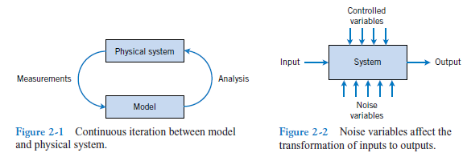
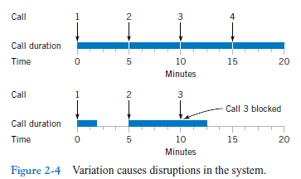
Stochastic Process for MS
Why Randomness?

Slide 9



Stochastic Process for MS
Randomness
Key point: Outcomes
22}
Adult suffrage
Continuous
17
Office hours
Days temperature
Discrete
Are you liking stochastic process course?

Slide 10
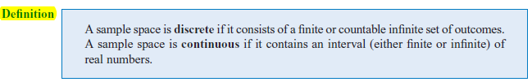
Stochastic Process for MS
Randomness
Key point: Outcomes
Key point: Continuous and Discrete Sample Space

Slide 11
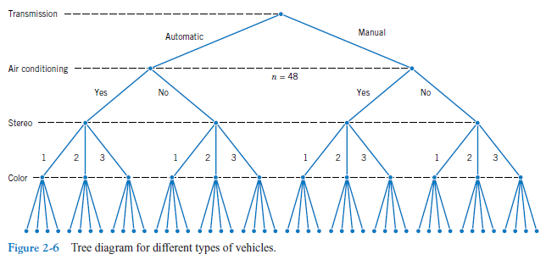
Stochastic Process for MS
Why Randomness?

Slide 12
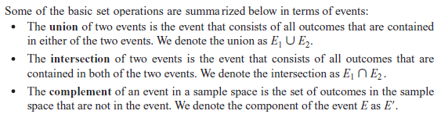
Stochastic Process for MS
Event
Often we are interested in a collection of related outcomes from a random experiment.
An event is a subset of the sample space of a random experiment.

Slide 13
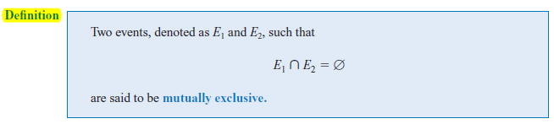
Stochastic Process for MS
Event
?

Slide 14

Stochastic Process for MS
Event

Slide 15
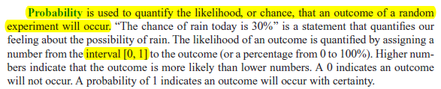


Stochastic Process for MS
Probability

Slide 16

Stochastic Process for MS
Probability

Slide 17
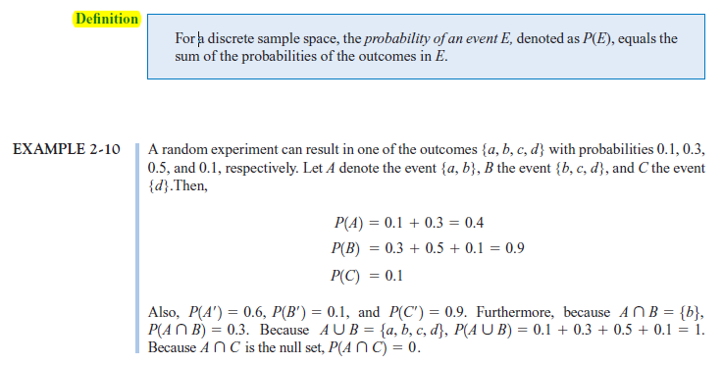
Stochastic Process for MS
Probability

Slide 18
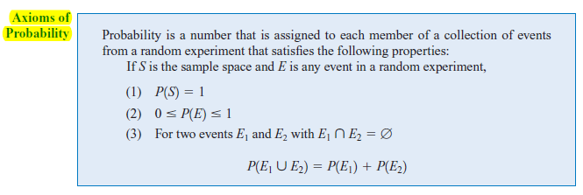
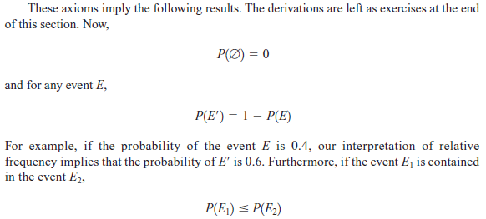
Stochastic Process for MS
Probability

Slide 19



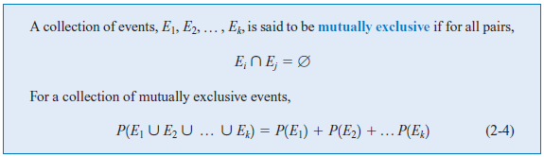
Stochastic Process for MS
Probability
Additional Rules:
Two events:
More events:

Slide 20


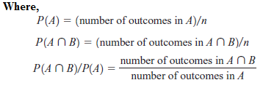
Stochastic Process for MS
Probability
Conditional Probability:
When two events A, B are dependent it is important to know the probability
that the event B will occur, given that A has already happened. We define this to
be conditional probability, denoted by P(B|A).

Slide 21

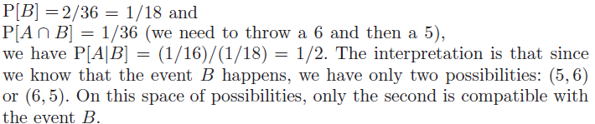

Stochastic Process for MS
Probability
Conditional Probability:
When two events A, B are dependent it is important to know the probability
that the event B will occur, given that A has already happened. We define this to
be conditional probability, denoted by P(B|A).
Multiplication rule:

Slide 22
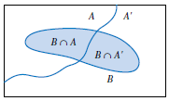


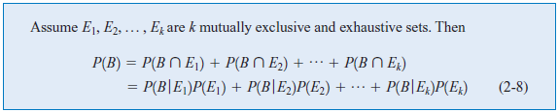
Stochastic Process for MS
Probability
Total Probability:
Total Probability of B:
As A and A’ are mutually exclusive:

Slide 23
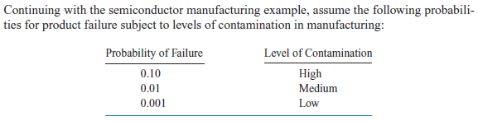

Stochastic Process for MS
Probability
Total Probability:

Slide 24
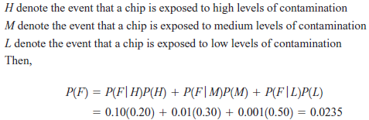
Stochastic Process for MS
Probability
Total Probability:

Slide 25
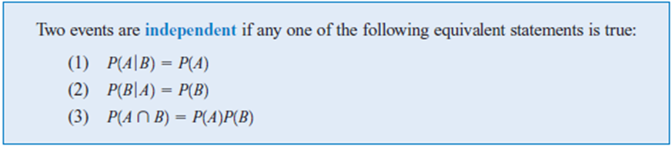
Stochastic Process for MS
Probability: Independence

Slide 26
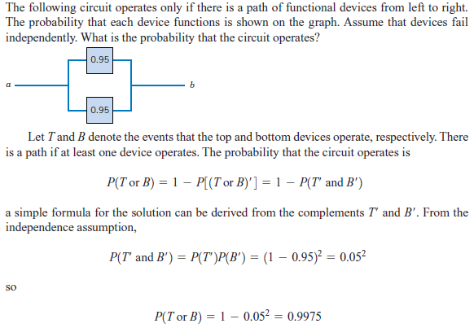
Stochastic Process for MS
Probability: Independence
As we know P(A)=1-P(A’)
As: P(T)=0.95, P(T’)=1-0.95
P(B)=0.95, P(B’)=1-0.95

Slide 27
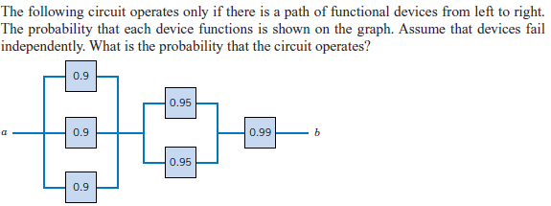
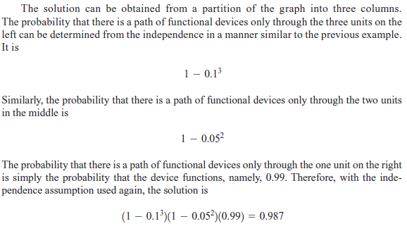
Stochastic Process for MS
Probability: Independence

Slide 28

Stochastic Process for MS
Probability: Bayes’ Theorem
Deduced by:
According to the law of conditional probability:
According to multiplication law:

Slide 29
Stochastic Process for MS
=
Probability: Bayes’ Theorem
Consider that a boy will place at first or second position in your class. It is certain. Now what is the probability of taking another place by a girl?
Is it ½?
Let b and g represent the sample of a boy and girl, respectively.
Then, the sample space is {bb, bg, gb, gg}. Let A={bb, bg, gb} and B={bg, gb, gg}, where every sample in A consisted of at least a boy and the sample of B consists of at least a girl.
The P[A]=P[B]=3/4. Again, P[B|A]=2/3 because P[B|A]=

Slide 30
Stochastic Process for MS
Probability: Bayes’ Theorem
When boys and girls fall in love either the boy or the girl first proposes. In an experiment, it is observed that 30% of the boys and 10% of girls fall in love first. Then, if a person is identified as a lover, what is the probability that the person is a boy?
Ans: Let the event of love is E and assume two letter B and G to denote boy and girl, respectively.
Here, P(B)=P(G)=0.5
P(E|B)=0.3 and P(E|G)=0.1.
According to Bayes' law

Slide 31
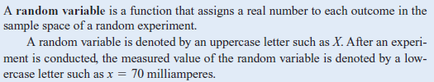

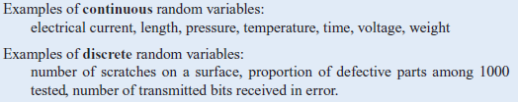
Stochastic Process for MS
Random Variable:

Slide 32


Stochastic Process for MS
Random Variable:

Slide 33

Stochastic Process for MS
Probability Distribution:
The probability distribution of a random variable X is a description of the probabilities associated with the possible values of X. For a discrete random variable, the distribution is often specified by just a list of the possible values along with the probability of each.
There is a chance that a bit transmitted through a digital transmission channel is received in error. Let X equal the number of bits in error in the next four bits transmitted. The possible values for X are {0, 1, 2, 3, 4}. Based on a model for the errors that is presented in the following section, probabilities for these values will be determined. Suppose that the probabilities are
The probability distribution of X is specified by the possible values along with the probability of each. A graphical description of the probability distribution of X is shown in Fig. 3-1.

Slide 34
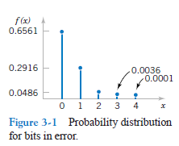
Stochastic Process for MS
Probability Distribution:
There is a chance that a bit transmitted through a digital transmission channel is received in error. Let X equal the number of bits in error in the next four bits transmitted. The possible values for X are {0, 1, 2, 3, 4}. Based on a model for the errors that is presented in the following section, probabilities for these values will be determined. Suppose that the probabilities are
The probability distribution of X is specified by the possible values along with the probability of each. A graphical description of the probability distribution of X is shown in Fig. 3-1.

Slide 35
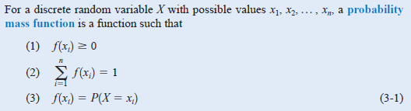
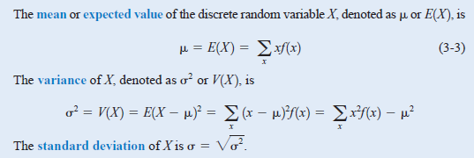
Stochastic Process for MS
Probability Mass Function:
A probability mass function (pmf) is a function that gives the probability that a discrete random variable is exactly equal to some value.

Slide 36
Stochastic Process for MS
Probability Mass Function:
A probability mass function (pmf) is a function that gives the probability that a discrete random variable is exactly equal to some value.
City | Family | Probability of baby born
Mymensingh | 50 Lakh | 0.4
Dhaka | 150 Lakh | 0.25
Chittagong | 70 Lakh | 0.35
X1=50Lakh
X2=150Lakh
X3=70Lakh
F(X1)=P(X=X1)=0.4
F(X2)=P(X=X2)=0.25
F(X3)=P(X=X3)=0.35
E(X)=(50*0.4+150*0.25+70*0.35)*100000

Slide 37
Stochastic Process for MS
Probability Mass Function:
A probability mass function (pmf) is a function that gives the probability that a discrete random variable is exactly equal to some value.

Slide 38
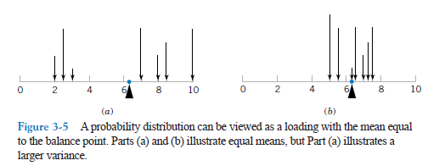
Stochastic Process for MS
Probability Mass Function:

Slide 39
Stochastic Process for MS
Probability Mass Function:
The mean of a discrete random variable X is a weighted average of the possible values of X, with weights equal to the probabilities. If is the probability mass function of a loading on a long, thin beam, is the point at which the beam balances. Consequently, describes the “center’’ of the distribution of X in a manner similar to the balance point of a loading.

Slide 40

Stochastic Process for MS
Probability Mass Function:
The variance of a random variable X is a measure of dispersion or scatter in the possible values for X. The variance of X uses weight f(x) as the multiplier of each possible squared deviation (x-μ)². Figure 3-5 illustrates probability distributions with equal means but different variances.

Slide 41
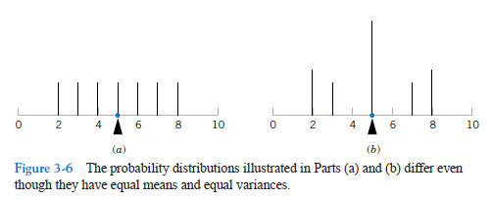
Stochastic Process for MS
Probability Mass Function:

Slide 42
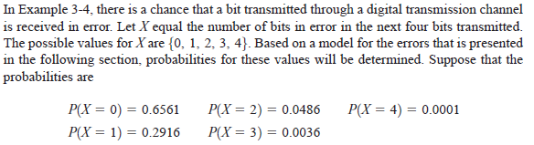

Stochastic Process for MS
Probability Mass Function:
V(X)=?

Slide 43
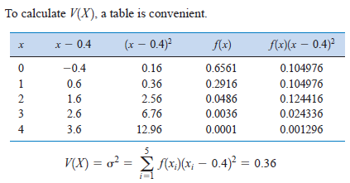

Stochastic Process for MS
Probability Mass Function:
We can also compute
V(X) by:

Slide 44
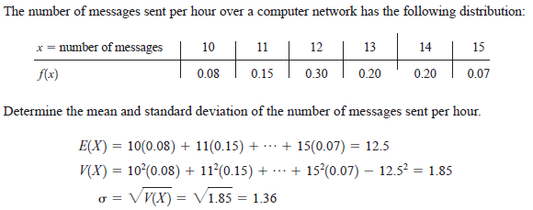
Stochastic Process for MS
Probability Mass Function:

Slide 45


Stochastic Process for MS
Probability Mass Function:

Slide 46
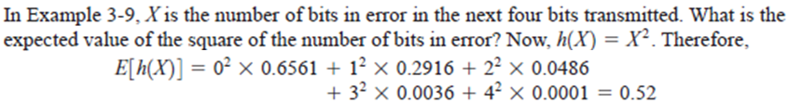
Stochastic Process for MS
Probability Mass Function:

Slide 47

Stochastic Process for MS
Probability Mass Function:

Slide 48
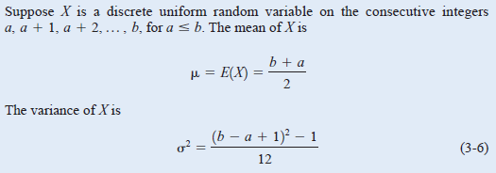
Stochastic Process for MS
Probability Mass Function:

Slide 49
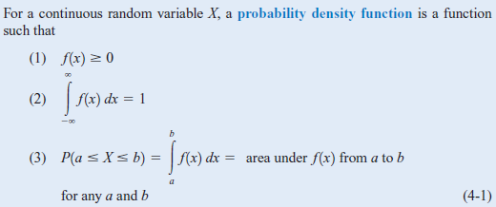
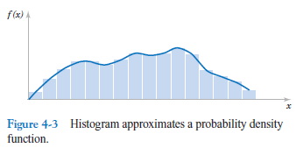

Stochastic Process for MS
Probability Density Function:
A probability density function f(x) can be used to describe the probability distribution of a continuous random variable X.
A histogram is an approximation to a
probability density function.

Slide 50
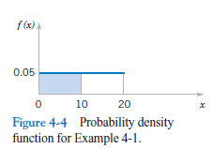
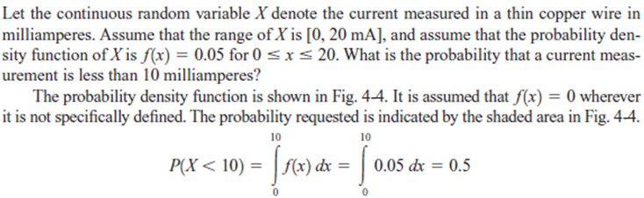
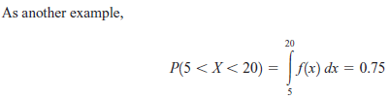
Stochastic Process for MS
Probability Distribution Function:

Slide 51
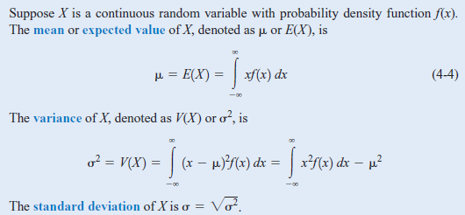
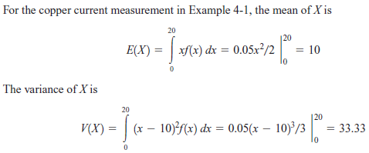
Stochastic Process for MS
Probability Distribution Function:

Slide 52
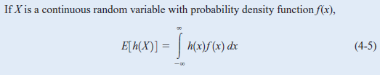
Stochastic Process for MS
Probability Distribution Function:

Slide 53
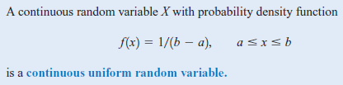
Stochastic Process for MS
Probability Distribution Function:

Slide 54
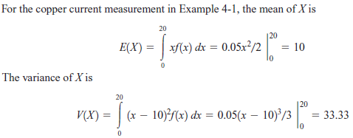
Stochastic Process for MS
Probability Distribution Function:

Slide 55

Stochastic Process for MS
Probability Distribution Function:

Slide 56
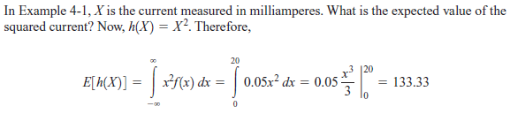
Stochastic Process for MS
Probability Distribution Function:

Slide 57
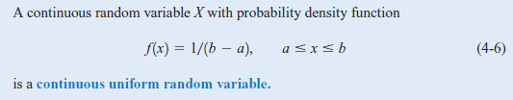
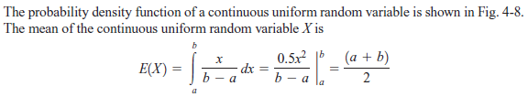

Stochastic Process for MS
Probability Distribution Function:

Slide 58
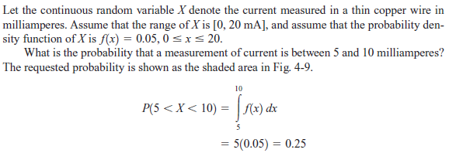
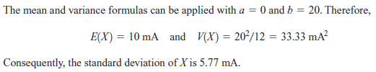
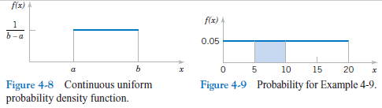
Stochastic Process for MS
Probability Distribution Function:

