Slide 1

CSE 203: Data Structure
Data Structure
TREE:
What is this?

Slide 2
CSE 203: Data Structure
Data Structure
TREE:
What is this?

Slide 3
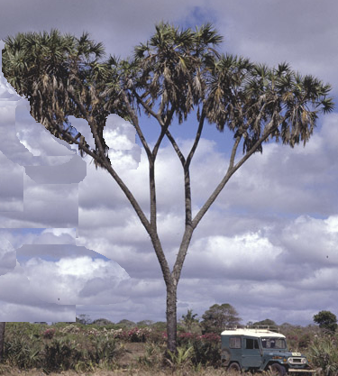
CSE 203: Data Structure
Data Structure
TREE:
What is this?

Slide 4
CSE 203: Data Structure
Data Structure
TREE:
Rotated by 180⁰

Slide 5
CSE 203: Data Structure
Data Structure
TREE:
Cropped tree.

Slide 6
CSE 203: Data Structure
Data Structure
TREE:
Identify the branching points.

Slide 7
CSE 203: Data Structure
Data Structure
TREE:
Identify the leaf points.

Slide 8
CSE 203: Data Structure
Data Structure
TREE:
Number each interior points/ nodes.
1
2
3
4
7
5
6

Slide 9
CSE 203: Data Structure
Data Structure
TREE:
Number each leaf points/ nodes.
1
2
3
4
7
5
6
8
9
15
10
11
13
14
12

Slide 10
CSE 203: Data Structure
Data Structure
TREE:
1
2
3
1
4
7
5
6
2
3
8
9
15
10
11
13
14
12
4
7
5
6
8
9
Drawing an instance of the tree.
10
11
15
13
14
12

Slide 11
CSE 203: Data Structure
Data Structure
TREE:
1
2
3
1
4
7
5
6
2
3
8
9
15
10
11
13
14
Reshaping the drawn tree.
12
4
7
5
6
1
8
9
15
10
11
13
14
12
2
3
4
5
6
7
8
9
10
11
12
13
14
15

Slide 12
CSE 203: Data Structure
Data Structure
TREE:
1
This is called tree.
2
3
4
5
6
7
A tree T has a root node, R
Each inner node contains one or more successors
If the root R has successors, each successor branches to a subtree.
The terminal nodes do not have any successor. These are called leaf nodes.
The tree T is called empty tree, if its root R is empty.
If N is a node in T with left successor S1 and right successor S2,
  N is called the parent of S1 and S2.
  S1 and S2 are called child of N
  S1 and S2 are called siblings.
Line drawn from a node N to its successor S is called edge.
A sequence of consecutive edges is called a path.
A path ending in a leaf is call branch
8
9
10
11
12
13
14
15
N
S1
S2

Slide 13
CSE 203: Data Structure
Data Structure
TREE:
0
1
1
2
3
2
4
5
6
7
3
8
9
10
11
12
13
14
15
Level of Tree:
The root R is assigned a level number 0
Every node is assigned a level number that is 1 more than its parent.
The nodes with the same level are called same generation.

Slide 14
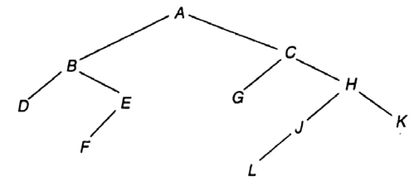
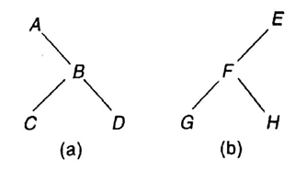
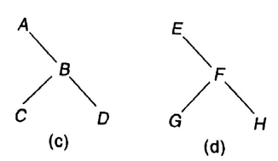
CSE 203: Data Structure
Data Structure
TREE:
Depth/Height of Tree:
Maximum number of nodes in a branch.
It is 1 more than the largest level
Depth is 5
Similar Tree:
Two tree T1 and T2 are called similar if they have the same structure

Slide 15
CSE 203: Data Structure
Data Structure
TREE:
1
2
3
4
5
6
7
8
9
10
11
12
13
14
15
Binary Tree:
A binary tree T contains a distinguished node R.
Each contains no more than two children.
Remaining nodes of T forms an order pair of disjoint binary tree T1 and T2

Slide 16
CSE 203: Data Structure
Data Structure
TREE:
1
Complete Binary Tree:
A tree is said complete if all its levels, except the last,
have the possible maximum number of nodes.
2
3
4
5
6
7
8
9
10
11
12
1
2
3
Not complete
4
5
6
7
8
9
10
11

Slide 17
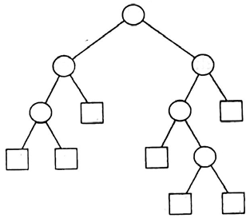
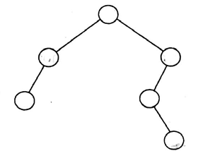
CSE 203: Data Structure
Data Structure
TREE:
1
Extended Binary Tree:
A tree is said extended binary or 2-tree if each node
either have 0 or 2 children.
Nodes with 2 children are called internal node
Nodes with 0 children are called external nodes
Internal nodes are represented by circles
External nodes are represented by rectangles
2
3
4
5
6
7
8
9
10
11
12
What will happen for such a tree?
Convert it to 2-tree by replacing each empty sub-tree by a new node

Slide 18
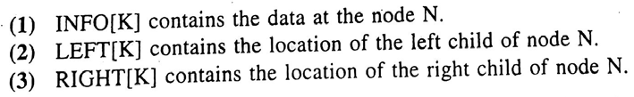
CSE 203: Data Structure
Data Structure
TREE:
Representation of a binary tree in memory
1
2
3
4
5
6
7
8
9
10
11
12
13
14
15
Link List Representation:

Slide 19
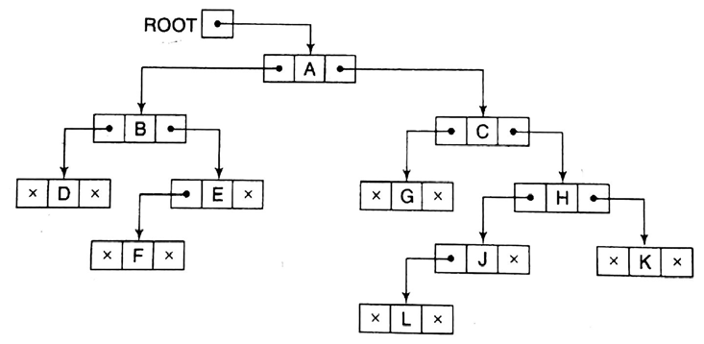
CSE 203: Data Structure
Data Structure
TREE:
Representation of a binary tree in memory
Link List Representation:
LEFT INFO RIGHT

Slide 20
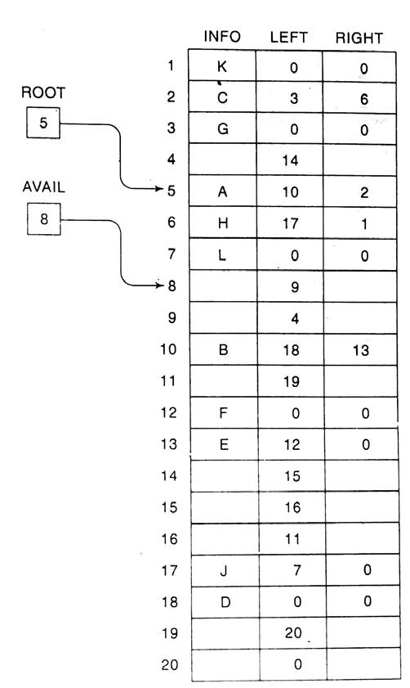
CSE 203: Data Structure
Data Structure
TREE:
Representation of a binary tree in memory
Link List Representation:

Slide 21
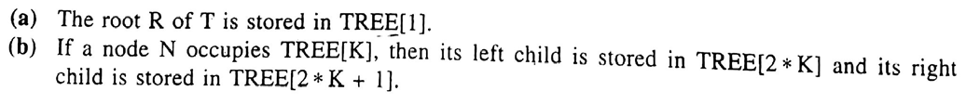
CSE 203: Data Structure
Data Structure
TREE:
Representation of a binary tree in memory
1
2
3
4
5
6
7
8
9
10
11
12
13
14
15
Sequential Representation:
Store items level by level and sequentially in an array
1 | 2 | 3 | 4 | 5 | 6 | 7 | 8 | 9 | 10 | 11 | 12 | 13 | 14 | 15

Slide 22
CSE 203: Data Structure
Data Structure
TREE:
Representation of a binary tree in memory
a
b
c
d
e
f
g
h
i
j
k
l
m
n
o
Sequential Representation:
Store items level by level and sequentially in an array
a | b | c | d | e | f | g | h | i | j | k | l | m | n | o
1 | 2 | 3 | 4 | 5 | 6 | 7 | 8 | 9 | 10 | 11 | 12 | 13 | 14 | 15

Slide 23
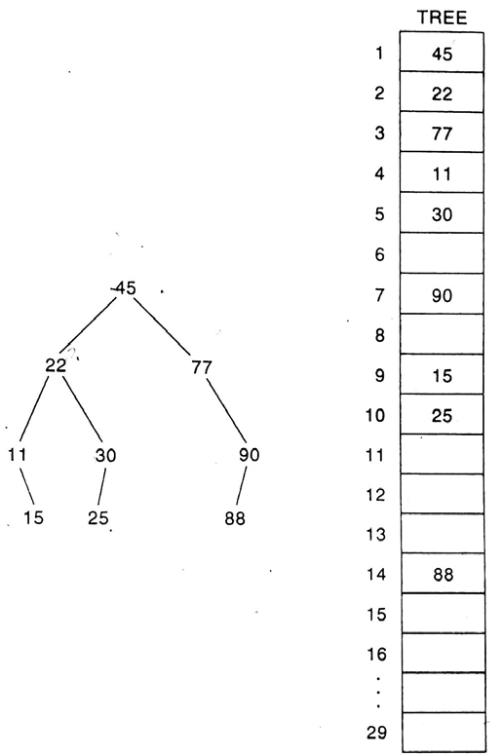
CSE 203: Data Structure
Data Structure
TREE:
Representation of a binary tree in memory
Sequential Representation:

Slide 24
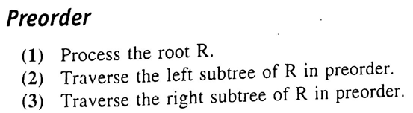
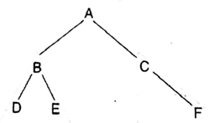
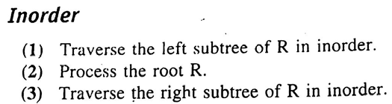
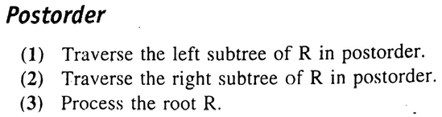
CSE 203: Data Structure
Data Structure
TREE:
Traversing
Preorder
Inorder
Postorder
Preorder: A, B, D, E, C, F
Inorder: D, B, E, A, C, F
Postorder: D, E, B, F, C, A

Slide 25
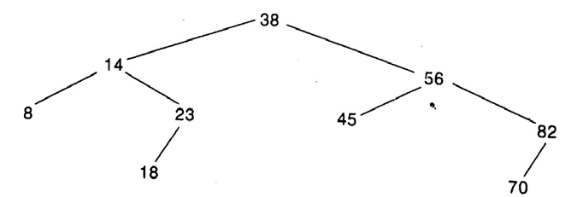
CSE 203: Data Structure
Data Structure
TREE:
Binary Search Tree
A tree T is a binary search tree if each node N contains a value that is greater than the nodes in the left sub-tree and smaller than the nodes in the right sub-tree.

Slide 26
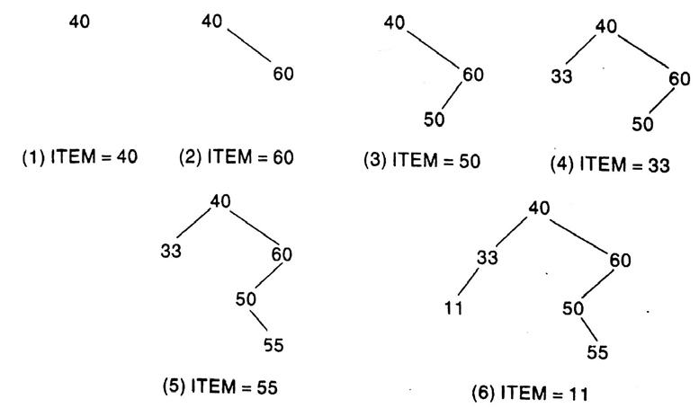
CSE 203: Data Structure
Data Structure
TREE:
Binary Search Tree
Items: 40, 60, 50, 33, 55, 11

Slide 27
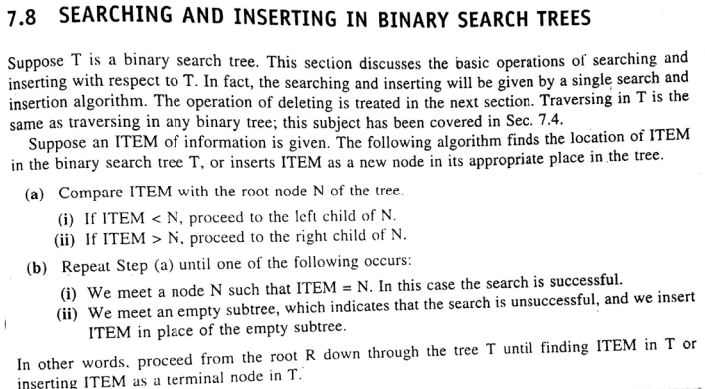
CSE 203: Data Structure
Data Structure
TREE:
Binary Search Tree
Items: 40, 60, 50, 33, 55, 11

Slide 28
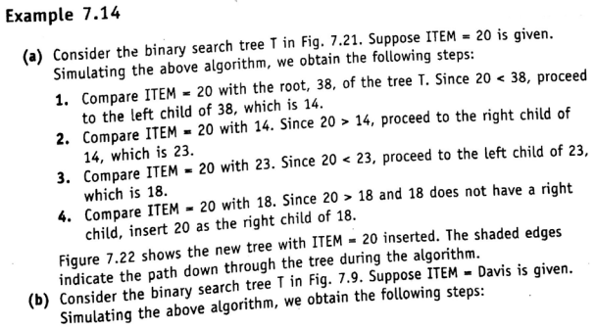
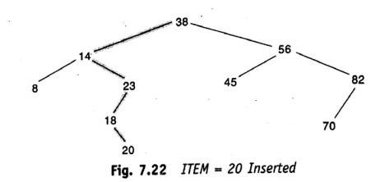
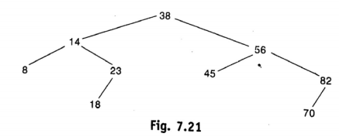
CSE 203: Data Structure
Data Structure
TREE:
Binary Search Tree
Insert ITEM=20

Slide 29
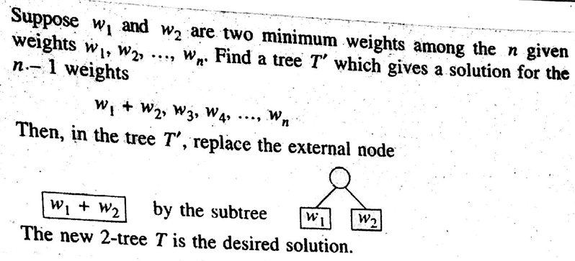

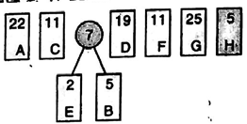

CSE 203: Data Structure
Data Structure
TREE:

Slide 30
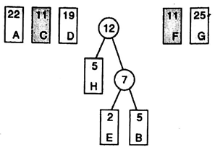
CSE 203: Data Structure
Data Structure
TREE:

Slide 31
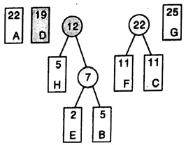
CSE 203: Data Structure
Data Structure
TREE:

Slide 32
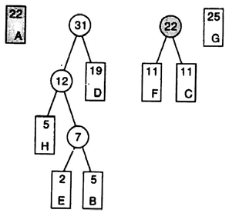
CSE 203: Data Structure
Data Structure
TREE:

Slide 33
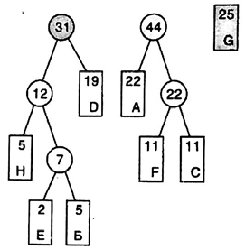
CSE 203: Data Structure
Data Structure
TREE:

Slide 34
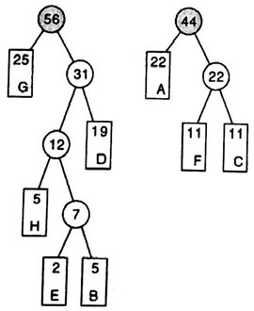
CSE 203: Data Structure
Data Structure
TREE:

Slide 35
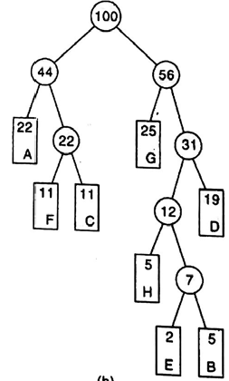
CSE 203: Data Structure
Data Structure
TREE:

Slide 36
CSE 203: Data Structure
Data Structure
TREE:
Application to coding
Label each edge to a left child by 0
Label each edge to a right child by 1
Huffman’s Code:
Traverse from root to leaf and print the traversed edge labels
Example:
A: 00
B: 11011
C: 011
D: 111
E: 11010
F: 010
G: 10
H: 1100
0
1
0
1
0
1
0
1
1
0
0
1
0
1

Slide 37

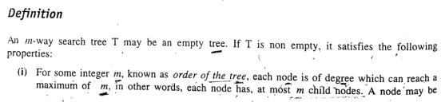
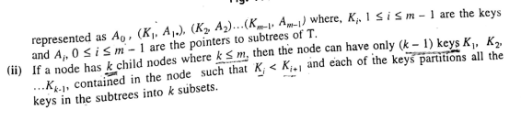

CSE 203: Data Structure
Data Structure
TREE:

Slide 38
CSE 203: Data Structure
Data Structure
TREE:

Slide 39

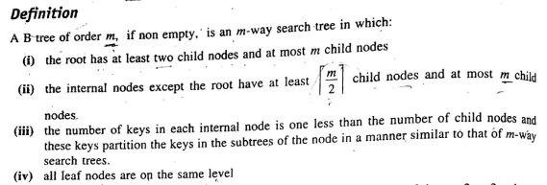
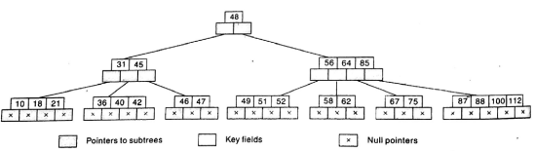
CSE 203: Data Structure
Data Structure
TREE:

Slide 40
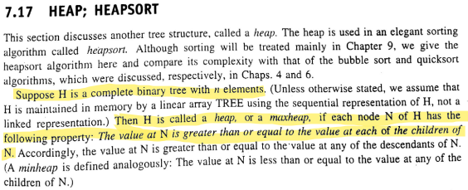
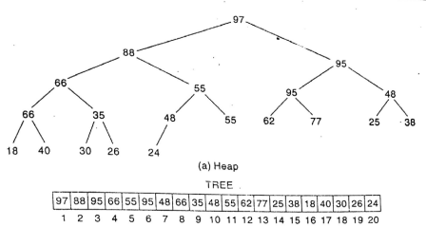
CSE 203: Data Structure
Data Structure
TREE:

