Slide 1
CSE 203: Data Structure
Data Structure
Data Structure
Linear: Elements form a sequence, i.e., liner list
Nonlinear: Elements do not form a sequence
Array: Elements in sequential memory locations
Link list: Relationship between elements by means of pointer.
Tree
Graph
These two will be defined later.

Slide 2
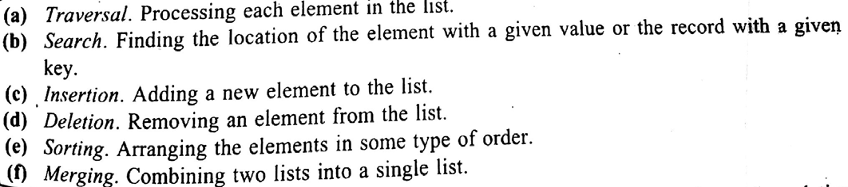
CSE 203: Data Structure
Data Structure
Data Structure
Linear: Elements form a sequence, i.e., liner list
Nonlinear: Elements do not form a sequence
Array: Elements in sequential memory locations
Link list: Relationship between elements by means of pointer.
Tree
Graph
These two will be defined later.
Operations that are performed on liner data structure.

Slide 3
CSE 203: Data Structure
Data Structure
Data Structure
Linear: Elements form a sequence, i.e., liner list
Nonlinear: Elements do not form a sequence
Array: Elements in sequential memory locations
Link list: Relationship between elements by means of pointer.
Tree
Graph
These two will be defined later.
Our target is to explain it first.

Slide 4
CSE 203: Data Structure
Data Structure
Data Structure
Linear: Elements form a sequence, i.e., liner list
Nonlinear: Elements do not form a sequence
Array: Elements in sequential memory locations
Link list: Relationship between elements by means of pointer.
Tree
Graph
These two will be defined later.
Liner Array
Multi-dimensional Array

Slide 5



CSE 203: Data Structure
Data Structure
Linear Array:
This is an one dimensional array.
List of finite n homogenous data elements.
Representation style

Slide 6
CSE 203: Data Structure
Data Structure
Linear Array:
This one dimensional array.
List of finite n homogenous data elements.
A[1]=15, A[2]=12, ..... A[9]=33
Elements | 15 | 12 | 0 | 11 | 20 | 11 | 9 | 28 | 33
Index | 1 | 2 | 3 | 4 | 5 | 6 | 7 | 8 | 9
Elements | 15 | 12 | 0 | A | 20 | 11 | 9 | D | 33
Index | 1 | 2 | 3 | 4 | 5 | 6 | 7 | 8 | 9
Is it an Array?

Slide 7
CSE 203: Data Structure
Data Structure
Linear Array:
This one dimensional array.
List of finite n homogenous data elements.
Elements | 15 | 12 | 0 | 11 | 20 | 11 | 9 | 28 | 33
Index | 1 | 2 | 3 | 4 | 5 | 6 | 7 | 8 | 9
Elements | 15 | 12 | 0 | A | 20 | 11 | 9 | D | 33
Index | 1 | 2 | 3 | 4 | 5 | 6 | 7 | 8 | 9
Not array

Slide 8
CSE 203: Data Structure
Data Structure
Linear Array:
This one dimensional array.
List of finite n homogenous data elements.
Elements | 15 | 12 | 0 | 11 | 20 | 11 | 9 | 28 | 33
Index | 1 | 2 | 3 | 4 | 5 | 6 | 7 | 8 | 9
Lower bound (LB)
Upper bound (UB)
: Smallest index
: Largest index
Length=UB-LB+1

Slide 9
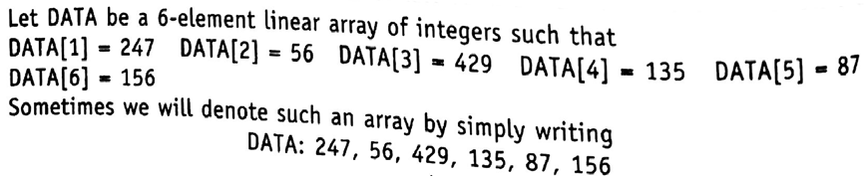
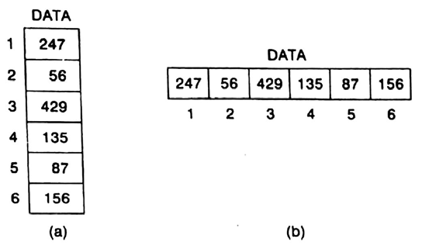
CSE 203: Data Structure
Data Structure
Linear Array:
This one dimensional array.

Slide 10
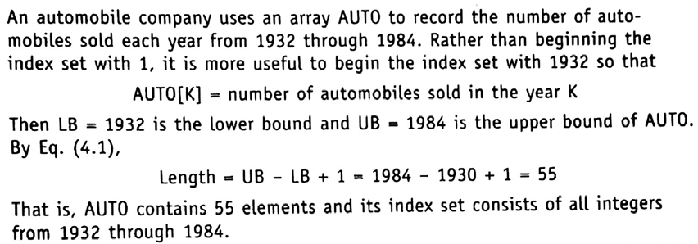
CSE 203: Data Structure
Data Structure
Linear Array:
This one dimensional array.
Sold Auto | 15 | 12 | 50 | 11 | 20 | 11 | 19 | 28 | 33
Year | 1932 | 1933 | … | … | … | … | … | 1983 | 1984
Lower bound (LB)
Upper bound (UB)
Length=UB-LB+1=1984-1932+1=53

Slide 11

CSE 203: Data Structure
Data Structure
Linear Array:
Representation in memory
Memory of the computer is simply sequence of address.
Hence, linear array holds a block of contiguous memory cells.
Let LA is a linear array
  Start at memory location 1000, that is, first data at 1000
  Second data at 1001
  Third data at 1002
  and so on.
. LA
1000 | 1
1001 | 2
1002 | 3
1003 | 4
LA[K]= Element in the K^{th} location of the array LA. Here, K ϵ {1, 2, 3, 4, …, …}
LOC(LA[K})= Address of the element LA[K] in the array LA.
Computer keeps track only of the first element of the array LA
Address of the first element of the array LA=

Slide 12

CSE 203: Data Structure
Data Structure
Linear Array:
Representation in memory
. LA
1000 | 1
1001 | 2
1002 | 3
1003 | 4
Address of the first element of the array LA=
Loc(LA[K])=Base(LA)+K-LB)
Where w is the number of words per memory cell.

Slide 13
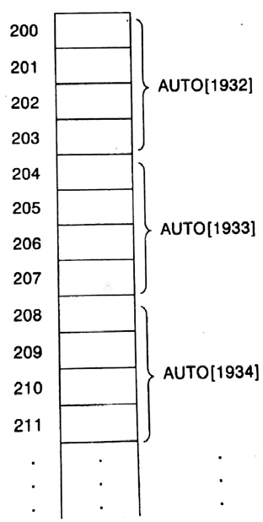
CSE 203: Data Structure
Data Structure
Linear Array:
Representation in memory
Address of the first element of the array LA=
Here w=4

Slide 14
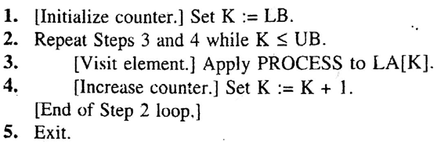
CSE 203: Data Structure
Data Structure
Linear Array:
Traversing
Accessing and processing of each element of array LA
    exactly once and
    sequentially
. | LA
1
2
3
4
N
Algorithm 1: Here LA is a linear array with lower bound LB
upper bound UB. The algorithm traverses LA
by applying PROCESS to each element of LA.

Slide 15
CSE 203: Data Structure
Data Structure
Linear Array:
Traversing
Accessing and processing of each element of array LA
    exactly once and
    sequentially
. | LA
1
2
3
4
N
Algorithm 1: Here LA is a linear array with lower bound LB
upper bound UB. The algorithm traverses LA
by applying PROCESS to each element of LA.
K=LB=1

Slide 16
CSE 203: Data Structure
Data Structure
Linear Array:
Traversing
Accessing and processing of each element of array LA
    exactly once and
    sequentially
. | LA
1
2
3
4
N
Algorithm 1: Here LA is a linear array with lower bound LB
upper bound UB. The algorithm traverses LA
by applying PROCESS to each element of LA.
K=1
If N=10, UB=10
Then K≤UB means 1 ≤10 and thus, it is true

Slide 17
CSE 203: Data Structure
Data Structure
Linear Array:
Traversing
Accessing and processing of each element of array LA
    exactly once and
    sequentially
. | LA
1
2
3
4
N
Algorithm 1: Here LA is a linear array with lower bound LB
upper bound UB. The algorithm traverses LA
by applying PROCESS to each element of LA.
K=1
If N=10, UB=10
Then K≤UB means 1 ≤10 and thus, it is true

Slide 18
CSE 203: Data Structure
Data Structure
Linear Array:
Traversing
Accessing and processing of each element of array LA
    exactly once and
    sequentially
. | LA
1
2
3
4
N
Algorithm 1: Here LA is a linear array with lower bound LB
upper bound UB. The algorithm traverses LA
by applying PROCESS to each element of LA.
K=1
K=K+1 means K=2
If N=10, UB=10
Then K≤UB means 1 ≤10 and thus, it is true

Slide 19
CSE 203: Data Structure
Data Structure
Linear Array:
Traversing
Accessing and processing of each element of array LA
    exactly once and
    sequentially
. | LA
1
2
3
4
N
Algorithm 1: Here LA is a linear array with lower bound LB
upper bound UB. The algorithm traverses LA
by applying PROCESS to each element of LA.
K=2
K≤UB means 2 ≤10 and thus, it is true

Slide 20
CSE 203: Data Structure
Data Structure
Linear Array:
Traversing
Accessing and processing of each element of array LA
    exactly once and
    sequentially
. | LA
1
2
3
4
N
Algorithm 1: Here LA is a linear array with lower bound LB
upper bound UB. The algorithm traverses LA
by applying PROCESS to each element of LA.
K=2
K≤UB means 2 ≤10 and thus, it is true

Slide 21
CSE 203: Data Structure
Data Structure
Linear Array:
Traversing
Accessing and processing of each element of array LA
    exactly once and
    sequentially
. | LA
1
2
3
4
N
Algorithm 1: Here LA is a linear array with lower bound LB
upper bound UB. The algorithm traverses LA
by applying PROCESS to each element of LA.
This way it will continue and consider that the repetition is done for 9 times, that is K=10
K=2
K=K+1 means K=3
K≤UB means 2 ≤10 and thus, it is true

Slide 22
CSE 203: Data Structure
Data Structure
Linear Array:
Traversing
Accessing and processing of each element of array LA
    exactly once and
    sequentially
. | LA
1
2
3
4
N
Algorithm 1: Here LA is a linear array with lower bound LB
upper bound UB. The algorithm traverses LA
by applying PROCESS to each element of LA.
K=10
10 ≤10 and thus, it is true

Slide 23
CSE 203: Data Structure
Data Structure
Linear Array:
Traversing
Accessing and processing of each element of array LA
    exactly once and
    sequentially
. | LA
1
2
3
4
N
Algorithm 1: Here LA is a linear array with lower bound LB
upper bound UB. The algorithm traverses LA
by applying PROCESS to each element of LA.
K=10
10 ≤10 and thus, it is true

Slide 24
CSE 203: Data Structure
Data Structure
Linear Array:
Traversing
Accessing and processing of each element of array LA
    exactly once and
    sequentially
. | LA
1
2
3
4
N
Algorithm 1: Here LA is a linear array with lower bound LB
upper bound UB. The algorithm traverses LA
by applying PROCESS to each element of LA.
K=10
K=K+1 means K=11
10 ≤10 and thus, it is true

Slide 25
CSE 203: Data Structure
Data Structure
Linear Array:
Traversing
Accessing and processing of each element of array LA
    exactly once and
    sequentially
. | LA
1
2
3
4
N
Algorithm 1: Here LA is a linear array with lower bound LB
upper bound UB. The algorithm traverses LA
by applying PROCESS to each element of LA.
K=11
11 ≤10 and thus, it is false

Slide 26
CSE 203: Data Structure
Data Structure
Linear Array:
Traversing
Accessing and processing of each element of array LA
    exactly once and
    sequentially
. | LA
1
2
3
4
N
Algorithm 1: Here LA is a linear array with lower bound LB
upper bound UB. The algorithm traverses LA
by applying PROCESS to each element of LA.
K=11
11 ≤10 and thus, it is false

Slide 27
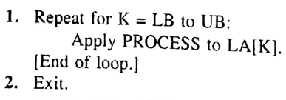
CSE 203: Data Structure
Data Structure
Linear Array:
Traversing
Algorithm 1: Here LA is a linear array with lower bound LB
upper bound UB. The algorithm traverses LA
by applying PROCESS to each element of LA.
. | LA
1
2
3
4
N
Algorithm 1: Here LA is a linear array with lower bound LB
upper bound UB. The algorithm traverses LA
by applying PROCESS to each element of LA.
Alternate Algorithm

Slide 28
CSE 203: Data Structure
Data Structure
Linear Array:
Algorithm Traverse
Traversing
. | SL
Roll | CGPA
1 | 3.5
2 | 3.25
3 | 3.5
4
 | 3.75
 | 3.9
N | 3.00
Is it possible to use traversing algorithm (Algorithm Traverse) in counting the number of students in JKKNIU whose CGPA is greater than 3.5 in 2018?
Algorithm CGPA:
Let SL of size N is an array of student list. Its index means the roll no of a student and the value of each index contains their CGPA till 2018. Use T to count the number of students whose CGPA>=3.5. Here, LB=1 and UB=N.
Step 1: T=0 [Initialization]
Step 2: Repeat for K=LB to UB
Step 3: If SL[K]>=3.5 then T=T+1;
[End of loop]
Step 4: Return;

Slide 29
CSE 203: Data Structure
Data Structure
Linear Array:
Algorithm Traverse
Traversing
. | SL
Roll | CGPA
1 | 3.5
2 | 3.25
3 | 3.5
4
 | 3.75
 | 3.9
N | 3.00
Let results of all the departments are stored in SL sequentially and the Dept’s LB (DLB) and Dept’s UB (DUB) of each dept is known. How to process for a specific dept?
Algorithm CGPA:
Let SL of size N is an array of student list. Its index means the roll no of a student and the value of each index contains their CGPA till 2018. Use T to count the number of students whose CGPA>=3.5. Here, LB=1 and UB=N.
Step 1: T=0 [Initialization]
Step 2: Read the value of DLB and DUB
Step 3: Repeat for K=DLB to DUB
Step 4: If SL[K]>=3.5 then T=T+1;
[End of loop]
Step 5: Return;

Slide 30
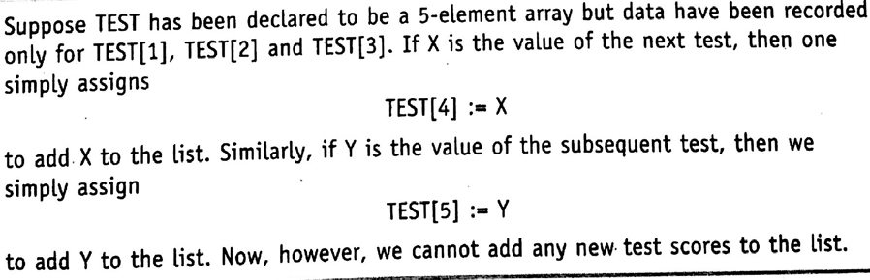
CSE 203: Data Structure
Data Structure
Linear Array:
Insertion and Deletion
Scenario 1: Simply adding at the end of the array

Slide 31
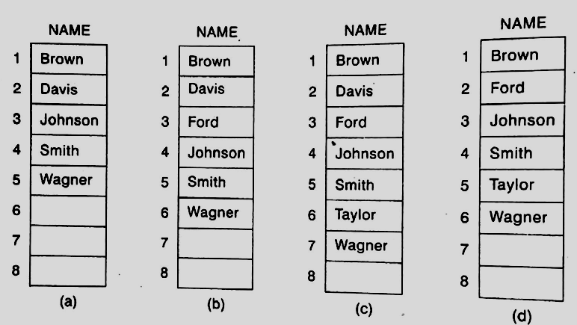
CSE 203: Data Structure
Data Structure
Linear Array:
Insertion and Deletion
Scenario 1: Simply adding at the end of the array
Scenario 2: Insertion and deletion in/from a sorted list.

Slide 32
CSE 203: Data Structure
Data Structure
Linear Array:
Insertion and Deletion
. | LA
1 | 10
2 | 12
3 | 11
4 | 15
5 | 21
6 | 22
7 | 19
8 | 20
N | 14
Algorithm INSERT (LA, N, K, ITEM)
Here LA is a linear array with N elements and 1≤K≤N
The algorithm inserts an element ITEM into the Kth position in LA.
Step 1: Set J:=N
Step 2: Repeat Steps 3 and 4 while J≥K
//Move J to N^{th} elements to their next position and start it from the last
Step 3: Set LA[J+1]=La[J]
Step 4: Set J=J-1
Step 5: Set LA[K]=ITEM
Step 6: Set N=N+1
Step 7: Exit

Slide 33
CSE 203: Data Structure
Data Structure
Linear Array:
Insertion and Deletion
. | LA
1 | 10
2 | 12
3 | 11
4 | 15
5 | 21
6 | 22
7 | 19
8 | 20
N | 14
Algorithm INSERT (LA, N, K, ITEM)
Here LA is a linear array with N elements and 1≤K≤N
The algorithm inserts an element ITEM into the Kth position in LA.
Step 1: Set J:=N
Step 2: Repeat Steps 3 and 4 while J≥K
//Move J to N^{th} elements to their next position and start it from the last
Step 3: Set LA[J+1]=La[J]
Step 4: Set J=J-1
Step 5: Set LA[K]=ITEM
Step 6: Set N=N+1
Step 7: Exit
While executing
N=9
J=9
For example K=7

Slide 34
CSE 203: Data Structure
Data Structure
Linear Array:
Insertion and Deletion
. | LA
1 | 10
2 | 12
3 | 11
4 | 15
5 | 21
6 | 22
7 | 19
8 | 20
N | 14
Algorithm INSERT (LA, N, K, ITEM)
Here LA is a linear array with N elements and 1≤K≤N
The algorithm inserts an element ITEM into the Kth position in LA.
Step 1: Set J:=N
Step 2: Repeat Steps 3 and 4 while J≥K
//Move J to N^{th} elements to their next position and start it from the last
Step 3: Set LA[J+1]=La[J]
Step 4: Set J=J-1
Step 5: Set LA[K]=ITEM
Step 6: Set N=N+1
Step 7: Exit
While executing
N=9
J=9
K=7
J ≥K means 9 ≥7 is true

Slide 35
CSE 203: Data Structure
Data Structure
Linear Array:
Insertion and Deletion
. | LA
1 | 10
2 | 12
3 | 11
4 | 15
5 | 21
6 | 22
7 | 19
8 | 20
N | 14
Algorithm INSERT (LA, N, K, ITEM)
Here LA is a linear array with N elements and 1≤K≤N
The algorithm inserts an element ITEM into the Kth position in LA.
Step 1: Set J:=N
Step 2: Repeat Steps 3 and 4 while J≥K
//Move J to N^{th} elements to their next position and start it from the last
Step 3: Set LA[J+1]=La[J]
Step 4: Set J=J-1
Step 5: Set LA[K]=ITEM
Step 6: Set N=N+1
Step 7: Exit
While executing
N=9
J=9
K=7
J
J ≥K means 9 ≥7 is true
J+1

Slide 36
CSE 203: Data Structure
Data Structure
Linear Array:
Insertion and Deletion
. | LA
1 | 10
2 | 12
3 | 11
4 | 15
5 | 21
6 | 22
7 | 19
8 | 20
N | 14
 | 14
Algorithm INSERT (LA, N, K, ITEM)
Here LA is a linear array with N elements and 1≤K≤N
The algorithm inserts an element ITEM into the Kth position in LA.
Step 1: Set J:=N
Step 2: Repeat Steps 3 and 4 while J≥K
//Move J to N^{th} elements to their next position and start it from the last
Step 3: Set LA[J+1]=La[J]
Step 4: Set J=J-1
Step 5: Set LA[K]=ITEM
Step 6: Set N=N+1
Step 7: Exit
While executing
N=9
J=9
K=7
J
J+1
J ≥K means 9 ≥7 is true

Slide 37
CSE 203: Data Structure
Data Structure
Linear Array:
Insertion and Deletion
. | LA
1 | 10
2 | 12
3 | 11
4 | 15
5 | 21
6 | 22
7 | 19
8 | 20
N | 14
 | 14
Algorithm INSERT (LA, N, K, ITEM)
Here LA is a linear array with N elements and 1≤K≤N
The algorithm inserts an element ITEM into the Kth position in LA.
Step 1: Set J:=N
Step 2: Repeat Steps 3 and 4 while J≥K
//Move J to N^{th} elements to their next position and start it from the last
Step 3: Set LA[J+1]=La[J]
Step 4: Set J=J-1
Step 5: Set LA[K]=ITEM
Step 6: Set N=N+1
Step 7: Exit
N=9
J=9-1=8
K=7
While executing
J
J+1
J ≥K means 9 ≥7 is true

Slide 38
CSE 203: Data Structure
Data Structure
Linear Array:
Insertion and Deletion
. | LA
1 | 10
2 | 12
3 | 11
4 | 15
5 | 21
6 | 22
7 | 19
8 | 20
N | 14
 | 14
Algorithm INSERT (LA, N, K, ITEM)
Here LA is a linear array with N elements and 1≤K≤N
The algorithm inserts an element ITEM into the Kth position in LA.
Step 1: Set J:=N
Step 2: Repeat Steps 3 and 4 while J≥K
//Move J to N^{th} elements to their next position and start it from the last
Step 3: Set LA[J+1]=La[J]
Step 4: Set J=J-1
Step 5: Set LA[K]=ITEM
Step 6: Set N=N+1
Step 7: Exit
N=9
J=9-1=8
K=7
While executing
J
J+1
J ≥K means 9 ≥7 is true

Slide 39
CSE 203: Data Structure
Data Structure
Linear Array:
Insertion and Deletion
. | LA
1 | 10
2 | 12
3 | 11
4 | 15
5 | 21
6 | 22
7 | 19
8 | 20
N | 14
 | 14
Algorithm INSERT (LA, N, K, ITEM)
Here LA is a linear array with N elements and 1≤K≤N
The algorithm inserts an element ITEM into the Kth position in LA.
Step 1: Set J:=N
Step 2: Repeat Steps 3 and 4 while J≥K
//Move J to N^{th} elements to their next position and start it from the last
Step 3: Set LA[J+1]=La[J]
Step 4: Set J=J-1
Step 5: Set LA[K]=ITEM
Step 6: Set N=N+1
Step 7: Exit
While executing
N=9
J=9-1=8
K=7
J
J+1
J ≥K means 8 ≥7 is true

Slide 40
CSE 203: Data Structure
Data Structure
Linear Array:
Insertion and Deletion
. | LA
1 | 10
2 | 12
3 | 11
4 | 15
5 | 21
6 | 22
7 | 19
8 | 20
N | 14
 | 14
Algorithm INSERT (LA, N, K, ITEM)
Here LA is a linear array with N elements and 1≤K≤N
The algorithm inserts an element ITEM into the Kth position in LA.
Step 1: Set J:=N
Step 2: Repeat Steps 3 and 4 while J≥K
//Move J to N^{th} elements to their next position and start it from the last
Step 3: Set LA[J+1]=La[J]
Step 4: Set J=J-1
Step 5: Set LA[K]=ITEM
Step 6: Set N=N+1
Step 7: Exit
While executing
N=9
J=9-1=8
K=7
J
J+1
J ≥K means 8 ≥7 is true

Slide 41
CSE 203: Data Structure
Data Structure
Linear Array:
Insertion and Deletion
. | LA
1 | 10
2 | 12
3 | 11
4 | 15
5 | 21
6 | 22
7 | 19
8 | 20
N | 20
 | 14
Algorithm INSERT (LA, N, K, ITEM)
Here LA is a linear array with N elements and 1≤K≤N
The algorithm inserts an element ITEM into the Kth position in LA.
Step 1: Set J:=N
Step 2: Repeat Steps 3 and 4 while J≥K
//Move J to N^{th} elements to their next position and start it from the last
Step 3: Set LA[J+1]=La[J]
Step 4: Set J=J-1
Step 5: Set LA[K]=ITEM
Step 6: Set N=N+1
Step 7: Exit
While executing
N=9
J=9-1=8
K=7
J
J+1
J ≥K means 8 ≥7 is true

Slide 42
CSE 203: Data Structure
Data Structure
Linear Array:
Insertion and Deletion
. | LA
1 | 10
2 | 12
3 | 11
4 | 15
5 | 21
6 | 22
7 | 19
8 | 20
N | 20
 | 14
Algorithm INSERT (LA, N, K, ITEM)
Here LA is a linear array with N elements and 1≤K≤N
The algorithm inserts an element ITEM into the Kth position in LA.
Step 1: Set J:=N
Step 2: Repeat Steps 3 and 4 while J≥K
//Move J to N^{th} elements to their next position and start it from the last
Step 3: Set LA[J+1]=La[J]
Step 4: Set J=J-1
Step 5: Set LA[K]=ITEM
Step 6: Set N=N+1
Step 7: Exit
N=9
J=8-1=7
K=7
While executing
J
J+1
J ≥K means 8 ≥7 is true

Slide 43
CSE 203: Data Structure
Data Structure
Linear Array:
Insertion and Deletion
. | LA
1 | 10
2 | 12
3 | 11
4 | 15
5 | 21
6 | 22
7 | 19
8 | 20
N | 20
 | 14
Algorithm INSERT (LA, N, K, ITEM)
Here LA is a linear array with N elements and 1≤K≤N
The algorithm inserts an element ITEM into the Kth position in LA.
Step 1: Set J:=N
Step 2: Repeat Steps 3 and 4 while J≥K
//Move J to N^{th} elements to their next position and start it from the last
Step 3: Set LA[J+1]=La[J]
Step 4: Set J=J-1
Step 5: Set LA[K]=ITEM
Step 6: Set N=N+1
Step 7: Exit
N=9
J=8-1=7
K=7
While executing
J
J+1
J ≥K means 8 ≥7 is true

Slide 44
CSE 203: Data Structure
Data Structure
Linear Array:
Insertion and Deletion
. | LA
1 | 10
2 | 12
3 | 11
4 | 15
5 | 21
6 | 22
7 | 19
8 | 20
N | 20
 | 14
Algorithm INSERT (LA, N, K, ITEM)
Here LA is a linear array with N elements and 1≤K≤N
The algorithm inserts an element ITEM into the Kth position in LA.
Step 1: Set J:=N
Step 2: Repeat Steps 3 and 4 while J≥K
//Move J to N^{th} elements to their next position and start it from the last
Step 3: Set LA[J+1]=La[J]
Step 4: Set J=J-1
Step 5: Set LA[K]=ITEM
Step 6: Set N=N+1
Step 7: Exit
While executing
N=9
J=7
K=7
J
J+1
J ≥K means 7 ≥7 is true

Slide 45
CSE 203: Data Structure
Data Structure
Linear Array:
Insertion and Deletion
. | LA
1 | 10
2 | 12
3 | 11
4 | 15
5 | 21
6 | 22
7 | 19
8 | 20
N | 20
 | 14
Algorithm INSERT (LA, N, K, ITEM)
Here LA is a linear array with N elements and 1≤K≤N
The algorithm inserts an element ITEM into the Kth position in LA.
Step 1: Set J:=N
Step 2: Repeat Steps 3 and 4 while J≥K
//Move J to N^{th} elements to their next position and start it from the last
Step 3: Set LA[J+1]=La[J]
Step 4: Set J=J-1
Step 5: Set LA[K]=ITEM
Step 6: Set N=N+1
Step 7: Exit
While executing
N=9
J=7
K=7
J
J+1
J ≥K means 7 ≥7 is true

Slide 46
CSE 203: Data Structure
Data Structure
Linear Array:
Insertion and Deletion
. | LA
1 | 10
2 | 12
3 | 11
4 | 15
5 | 21
6 | 22
7 | 19
8 | 19
N | 20
 | 14
Algorithm INSERT (LA, N, K, ITEM)
Here LA is a linear array with N elements and 1≤K≤N
The algorithm inserts an element ITEM into the Kth position in LA.
Step 1: Set J:=N
Step 2: Repeat Steps 3 and 4 while J≥K
//Move J to N^{th} elements to their next position and start it from the last
Step 3: Set LA[J+1]=La[J]
Step 4: Set J=J-1
Step 5: Set LA[K]=ITEM
Step 6: Set N=N+1
Step 7: Exit
While executing
N=9
J=7
K=7
J
J+1
J ≥K means 7 ≥7 is true

Slide 47
CSE 203: Data Structure
Data Structure
Linear Array:
Insertion and Deletion
. | LA
1 | 10
2 | 12
3 | 11
4 | 15
5 | 21
6 | 22
7 | 19
8 | 19
N | 20
 | 14
Algorithm INSERT (LA, N, K, ITEM)
Here LA is a linear array with N elements and 1≤K≤N
The algorithm inserts an element ITEM into the Kth position in LA.
Step 1: Set J:=N
Step 2: Repeat Steps 3 and 4 while J≥K
//Move J to N^{th} elements to their next position and start it from the last
Step 3: Set LA[J+1]=La[J]
Step 4: Set J=J-1
Step 5: Set LA[K]=ITEM
Step 6: Set N=N+1
Step 7: Exit
N=9
J=7-1=6
K=7
While executing
J
J+1
J ≥K means 7 ≥7 is true

Slide 48
CSE 203: Data Structure
Data Structure
Linear Array:
Insertion and Deletion
. | LA
1 | 10
2 | 12
3 | 11
4 | 15
5 | 21
6 | 22
7 | 19
8 | 19
N | 20
 | 14
Algorithm INSERT (LA, N, K, ITEM)
Here LA is a linear array with N elements and 1≤K≤N
The algorithm inserts an element ITEM into the Kth position in LA.
Step 1: Set J:=N
Step 2: Repeat Steps 3 and 4 while J≥K
//Move J to N^{th} elements to their next position and start it from the last
Step 3: Set LA[J+1]=La[J]
Step 4: Set J=J-1
Step 5: Set LA[K]=ITEM
Step 6: Set N=N+1
Step 7: Exit
N=9
J=7-1=6
K=7
While executing
J
J+1
J ≥K means 7 ≥7 is true

Slide 49
CSE 203: Data Structure
Data Structure
Linear Array:
Insertion and Deletion
. | LA
1 | 10
2 | 12
3 | 11
4 | 15
5 | 21
6 | 22
7 | 19
8 | 19
N | 20
 | 14
Algorithm INSERT (LA, N, K, ITEM)
Here LA is a linear array with N elements and 1≤K≤N
The algorithm inserts an element ITEM into the Kth position in LA.
Step 1: Set J:=N
Step 2: Repeat Steps 3 and 4 while J≥K
//Move J to N^{th} elements to their next position and start it from the last
Step 3: Set LA[J+1]=La[J]
Step 4: Set J=J-1
Step 5: Set LA[K]=ITEM
Step 6: Set N=N+1
Step 7: Exit
While executing
N=9
J=6
K=7
J
J+1
J ≥K means 6 ≥7 is False

Slide 50
CSE 203: Data Structure
Data Structure
Linear Array:
Insertion and Deletion
. | LA
1 | 10
2 | 12
3 | 11
4 | 15
5 | 21
6 | 22
7 | 19
8 | 19
N | 20
 | 14
Algorithm INSERT (LA, N, K, ITEM)
Here LA is a linear array with N elements and 1≤K≤N
The algorithm inserts an element ITEM into the Kth position in LA.
Step 1: Set J:=N
Step 2: Repeat Steps 3 and 4 while J≥K
//Move J to N^{th} elements to their next position and start it from the last
Step 3: Set LA[J+1]=La[J]
Step 4: Set J=J-1
Step 5: Set LA[K]=ITEM
Step 6: Set N=N+1
Step 7: Exit
ITEM=18
N=9
J=6
K=7
While executing
J ≥K means 6 ≥7 is False

Slide 51
CSE 203: Data Structure
Data Structure
Linear Array:
Insertion and Deletion
. | LA
1 | 10
2 | 12
3 | 11
4 | 15
5 | 21
6 | 22
7 | 18
8 | 19
N | 20
 | 14
Algorithm INSERT (LA, N, K, ITEM)
Here LA is a linear array with N elements and 1≤K≤N
The algorithm inserts an element ITEM into the Kth position in LA.
Step 1: Set J:=N
Step 2: Repeat Steps 3 and 4 while J≥K
//Move J to N^{th} elements to their next position and start it from the last
Step 3: Set LA[J+1]=La[J]
Step 4: Set J=J-1
Step 5: Set LA[K]=ITEM
Step 6: Set N=N+1
Step 7: Exit
ITEM=18
N=9
J=6
K=7
While executing
J ≥K means 6 ≥7 is False

Slide 52
CSE 203: Data Structure
Data Structure
Linear Array:
Insertion and Deletion
. | LA
1 | 10
2 | 12
3 | 11
4 | 15
5 | 21
6 | 22
7 | 18
8 | 19
N | 20
 | 14
Algorithm INSERT (LA, N, K, ITEM)
Here LA is a linear array with N elements and 1≤K≤N
The algorithm inserts an element ITEM into the Kth position in LA.
Step 1: Set J:=N
Step 2: Repeat Steps 3 and 4 while J≥K
//Move J to N^{th} elements to their next position and start it from the last
Step 3: Set LA[J+1]=La[J]
Step 4: Set J=J-1
Step 5: Set LA[K]=ITEM
Step 6: Set N=N+1
Step 7: Exit
ITEM=18
N=9+1=10
J=6
K=7
While executing
J ≥K means 6 ≥7 is False

Slide 53
CSE 203: Data Structure
Data Structure
Linear Array:
Insertion and Deletion
. | LA
1 | 10
2 | 12
3 | 11
4 | 15
5 | 21
6 | 22
7 | 18
8 | 19
9 | 20
N | 14
Algorithm INSERT (LA, N, K, ITEM)
Here LA is a linear array with N elements and 1≤K≤N
The algorithm inserts an element ITEM into the Kth position in LA.
Step 1: Set J:=N
Step 2: Repeat Steps 3 and 4 while J≥K
//Move J to N^{th} elements to their next position and start it from the last
Step 3: Set LA[J+1]=La[J]
Step 4: Set J=J-1
Step 5: Set LA[K]=ITEM
Step 6: Set N=N+1
Step 7: Exit
ITEM=18
N=10
J=6
K=7
While executing
J ≥K means 6 ≥7 is False

Slide 54
CSE 203: Data Structure
Data Structure
Linear Array:
Insertion and Deletion
. | LA
1 | 10
2 | 12
3 | 11
4 | 15
5 | 21
6 | 22
7 | 18
8 | 19
9 | 20
N | 14
Algorithm INSERT (LA, N, K, ITEM)
Here LA is a linear array with N elements and 1≤K≤N
The algorithm inserts an element ITEM into the Kth position in LA.
Step 1: Set J:=N
Step 2: Repeat Steps 3 and 4 while J≥K
//Move J to N^{th} elements to their next position and start it from the last
Step 3: Set LA[J+1]=La[J]
Step 4: Set J=J-1
Step 5: Set LA[K]=ITEM
Step 6: Set N=N+1
Step 7: Exit
ITEM=18
N=10
J=6
K=7
While executing
J ≥K means 6 ≥7 is False

Slide 55
CSE 203: Data Structure
Data Structure
Linear Array:
Insertion and Deletion
C Program of Algorithm INSERT
Algorithm INSERT:
Algorithm INSERT (LA, N, K, ITEM)
Here LA is a linear array with N elements and 1≤K≤N
The algorithm inserts an element ITEM into the Kth position in LA.
Step 1: Set J:=N
Step 2: Repeat Steps 3 and 4 while J≥K
Step 3: Set LA[J+1]=La[J]
Step 4: Set J=J-1
Step 5: Set LA[K]=ITEM
Step 6: Set N=N+1
Step 7: Exit
int INSERT(int LA, int N, int K, int ITEM)
{
int J;
J=N-1; //Step 1
while(J≥K) //Step 2
{
LA[J+1]=LA[J]; //Step 3
J=J-1; //Step 4
}
LA[K]=ITEM; //Step 5
N=N-1; //Step 6
for(int I=0;I<N;I++)
printf(“%d, “,LA[I]);
return N; //Step 7
}

Slide 56
CSE 203: Data Structure
Data Structure
Linear Array:
Insertion and Deletion
. | LA
1 | 10
2 | 12
3 | 11
4 | 15
5 | 21
6 | 22
7 | 19
8 | 20
N | 14
Algorithm DELETE (LA, N, K, ITEM)
Here LA is a linear array with N elements and 1≤K≤N
The algorithm deletes Kth element from LA.
Step 1: Set ITEM=LA[K]
Step 2: Print the value of ITEM
Step 3: Repeat for J=K to N-1
Step 4: Set LA[J]=La[J+1]
Step 5: Set N=N-1
Step 6: Exit

Slide 57
CSE 203: Data Structure
Data Structure
Linear Array:
Insertion and Deletion
. | LA
1 | 10
2 | 12
3 | 11
4 | 15
5 | 21
6 | 22
7 | 19
8 | 20
N | 14
Algorithm DELETE (LA, N, K, ITEM)
Here LA is a linear array with N elements and 1≤K≤N
The algorithm deletes Kth element from LA.
Step 1: Set ITEM=LA[K]
Step 2: Print the value of ITEM
Step 3: Repeat for J=K to N-1
Step 4: Set LA[J]=La[J+1]
Step 5: Set N=N-1
Step 6: Exit
While executing
N=9
For example, K=7
ITEM=19

Slide 58
CSE 203: Data Structure
Data Structure
Linear Array:
Insertion and Deletion
. | LA
1 | 10
2 | 12
3 | 11
4 | 15
5 | 21
6 | 22
7 | 19
8 | 20
N | 14
Algorithm DELETE (LA, N, K, ITEM)
Here LA is a linear array with N elements and 1≤K≤N
The algorithm deletes Kth element from LA.
Step 1: Set ITEM=LA[K]
Step 2: Print the value of ITEM
Step 3: Repeat for J=K to N-1
Step 4: Set LA[J]=La[J+1]
Step 5: Set N=N-1
Step 6: Exit
While executing
N=9
For example, K=7
ITEM=19

Slide 59
CSE 203: Data Structure
Data Structure
Linear Array:
Insertion and Deletion
. | LA
1 | 10
2 | 12
3 | 11
4 | 15
5 | 21
6 | 22
7 | 19
8 | 20
N | 14
Algorithm DELETE (LA, N, K, ITEM)
Here LA is a linear array with N elements and 1≤K≤N
The algorithm deletes Kth element from LA.
Step 1: Set ITEM=LA[K]
Step 2: Print the value of ITEM
Step 3: Repeat for J=K to N-1
Step 4: Set LA[J]=La[J+1]
Step 5: Set N=N-1
Step 6: Exit
While executing
N=9
For example, K=7
ITEM=19
J=K=7
J ≤ N-1 is true

Slide 60
CSE 203: Data Structure
Data Structure
Linear Array:
Insertion and Deletion
. | LA
1 | 10
2 | 12
3 | 11
4 | 15
5 | 21
6 | 22
7 | 19
8 | 20
N | 14
Algorithm DELETE (LA, N, K, ITEM)
Here LA is a linear array with N elements and 1≤K≤N
The algorithm deletes Kth element from LA.
Step 1: Set ITEM=LA[K]
Step 2: Print the value of ITEM
Step 3: Repeat for J=K to N-1
Step 4: Set LA[J]=La[J+1]
Step 5: Set N=N-1
Step 6: Exit
While executing
N=9
K=7
ITEM=19
J=7
J
J+1

Slide 61
CSE 203: Data Structure
Data Structure
Linear Array:
Insertion and Deletion
. | LA
1 | 10
2 | 12
3 | 11
4 | 15
5 | 21
6 | 22
7 | 20
8 | 20
N | 14
Algorithm DELETE (LA, N, K, ITEM)
Here LA is a linear array with N elements and 1≤K≤N
The algorithm deletes Kth element from LA.
Step 1: Set ITEM=LA[K]
Step 2: Print the value of ITEM
Step 3: Repeat for J=K to N-1
Step 4: Set LA[J]=La[J+1]
Step 5: Set N=N-1
Step 6: Exit
While executing
N=9
K=7
ITEM=19
J=7
J
J+1

Slide 62
CSE 203: Data Structure
Data Structure
Linear Array:
Insertion and Deletion
. | LA
1 | 10
2 | 12
3 | 11
4 | 15
5 | 21
6 | 22
7 | 20
8 | 20
N | 14
Algorithm DELETE (LA, N, K, ITEM)
Here LA is a linear array with N elements and 1≤K≤N
The algorithm deletes Kth element from LA.
Step 1: Set ITEM=LA[K]
Step 2: Print the value of ITEM
Step 3: Repeat for J=K to N-1
Step 4: Set LA[J]=La[J+1]
Step 5: Set N=N-1
Step 6: Exit
While executing
N=9
K=7
ITEM=19
J=7+1=8
J
J+1

Slide 63
CSE 203: Data Structure
Data Structure
Linear Array:
Insertion and Deletion
. | LA
1 | 10
2 | 12
3 | 11
4 | 15
5 | 21
6 | 22
7 | 20
8 | 20
N | 14
Algorithm DELETE (LA, N, K, ITEM)
Here LA is a linear array with N elements and 1≤K≤N
The algorithm deletes Kth element from LA.
Step 1: Set ITEM=LA[K]
Step 2: Print the value of ITEM
Step 3: Repeat for J=K to N-1
Step 4: Set LA[J]=La[J+1]
Step 5: Set N=N-1
Step 6: Exit
While executing
N=9
K=7
ITEM=19
J=7+1=8
J ≤ N-1
is True
J
J+1

Slide 64
CSE 203: Data Structure
Data Structure
Linear Array:
Insertion and Deletion
. | LA
1 | 10
2 | 12
3 | 11
4 | 15
5 | 21
6 | 22
7 | 20
8 | 20
N | 14
Algorithm DELETE (LA, N, K, ITEM)
Here LA is a linear array with N elements and 1≤K≤N
The algorithm deletes Kth element from LA.
Step 1: Set ITEM=LA[K]
Step 2: Print the value of ITEM
Step 3: Repeat for J=K to N-1
Step 4: Set LA[J]=La[J+1]
Step 5: Set N=N-1
Step 6: Exit
While executing
N=9
K=7
ITEM=19
J=8
J
J+1

Slide 65
CSE 203: Data Structure
Data Structure
Linear Array:
Insertion and Deletion
. | LA
1 | 10
2 | 12
3 | 11
4 | 15
5 | 21
6 | 22
7 | 20
8 | 14
N | 14
Algorithm DELETE (LA, N, K, ITEM)
Here LA is a linear array with N elements and 1≤K≤N
The algorithm deletes Kth element from LA.
Step 1: Set ITEM=LA[K]
Step 2: Print the value of ITEM
Step 3: Repeat for J=K to N-1
Step 4: Set LA[J]=La[J+1]
Step 5: Set N=N-1
Step 6: Exit
While executing
N=9
K=7
ITEM=19
J=8
J
J+1

Slide 66
CSE 203: Data Structure
Data Structure
Linear Array:
Insertion and Deletion
. | LA
1 | 10
2 | 12
3 | 11
4 | 15
5 | 21
6 | 22
7 | 20
8 | 14
N | 14
Algorithm DELETE (LA, N, K, ITEM)
Here LA is a linear array with N elements and 1≤K≤N
The algorithm deletes Kth element from LA.
Step 1: Set ITEM=LA[K]
Step 2: Print the value of ITEM
Step 3: Repeat for J=K to N-1
Step 4: Set LA[J]=La[J+1]
Step 5: Set N=N-1
Step 6: Exit
While executing
N=9
K=7
ITEM=19
J=8+1=9
J
J+1

Slide 67
CSE 203: Data Structure
Data Structure
Linear Array:
Insertion and Deletion
. | LA
1 | 10
2 | 12
3 | 11
4 | 15
5 | 21
6 | 22
7 | 20
8 | 14
N | 14
Algorithm DELETE (LA, N, K, ITEM)
Here LA is a linear array with N elements and 1≤K≤N
The algorithm deletes Kth element from LA.
Step 1: Set ITEM=LA[K]
Step 2: Print the value of ITEM
Step 3: Repeat for J=K to N-1
Step 4: Set LA[J]=La[J+1]
Step 5: Set N=N-1
Step 6: Exit
While executing
N=9
K=7
ITEM=19
J=9
J ≤N-1 is False
J
J+1

Slide 68
CSE 203: Data Structure
Data Structure
Linear Array:
Insertion and Deletion
. | LA
1 | 10
2 | 12
3 | 11
4 | 15
5 | 21
6 | 22
7 | 20
8 | 14
N | 14
Algorithm DELETE (LA, N, K, ITEM)
Here LA is a linear array with N elements and 1≤K≤N
The algorithm deletes Kth element from LA.
Step 1: Set ITEM=LA[K]
Step 2: Print the value of ITEM
Step 3: Repeat for J=K to N-1
Step 4: Set LA[J]=La[J+1]
Step 5: Set N=N-1
Step 6: Exit
N=9-1=8
K=7
ITEM=19
J=9
While executing

Slide 69
CSE 203: Data Structure
Data Structure
Linear Array:
Insertion and Deletion
. | LA
1 | 10
2 | 12
3 | 11
4 | 15
5 | 21
6 | 22
7 | 20
N | 14
 | 14
Algorithm DELETE (LA, N, K, ITEM)
Here LA is a linear array with N elements and 1≤K≤N
The algorithm deletes Kth element from LA.
Step 1: Set ITEM=LA[K]
Step 2: Print the value of ITEM
Step 3: Repeat for J=K to N-1
Step 4: Set LA[J]=La[J+1]
Step 5: Set N=N-1
Step 6: Exit
N=10
K=7
ITEM=19
J=9
N=9-1=8
While executing

Slide 70
CSE 203: Data Structure
Data Structure
Linear Array:
Insertion and Deletion
. | LA
1 | 10
2 | 12
3 | 11
4 | 15
5 | 21
6 | 22
7 | 20
N | 14
 | 14
Algorithm DELETE (LA, N, K, ITEM)
Here LA is a linear array with N elements and 1≤K≤N
The algorithm deletes Kth element from LA.
Step 1: Set ITEM=LA[K]
Step 2: Print the value of ITEM
Step 3: Repeat for J=K to N-1
Step 4: Set LA[J]=La[J+1]
Step 5: Set N=N-1
Step 6: Exit
N=10
K=7
ITEM=19
J=9
N=9-1=8
While executing

Slide 71
CSE 203: Data Structure
Data Structure
Linear Array:
Insertion and Deletion
C Program of Algorithm DELETE
Algorithm DELETE:
Algorithm DELETE (LA, N, K, ITEM)
Here LA is a linear array with N elements and 1≤K≤N
The algorithm deletes Kth element from LA.
Step 1: Set ITEM=LA[K]
Step 2: Print the value of ITEM
Step 3: Repeat for J=K to N-1
Step 4: Set LA[J]=La[J+1]
Step 5: Set N=N-1
Step 6: Exit
int DELETE(int LA, int N, int K, int ITEM)
{
int J;
ITEM=LA[K]; //Step 1
printf(“%d”, ITEM) //Step 2
for(J=K;J<N-1;J++) //Step 3
LA[J]=LA[J+1]; //Step 4
N=N-1; //Step 5
return N; //Step 6
}

Slide 72
CSE 203: Data Structure
Data Structure
Linear Array:
Sorting
. | LA
1 | 10
2 | 12
3 | 11
4 | 15
5 | 21
6 | 22
7 | 19
8 | 20
N | 14
Given an array LA. It contains N elements. The values of the elements are not stored in the array in any sorting order. Our task is to sort the elements in the array LA.

Slide 73

CSE 203: Data Structure
Data Structure
Linear Array:
Sorting
Bubble Sort Strategy:
. | LA
1 | 10
2 | 12
3 | 11
4 | 15
5 | 21
6 | 22
7 | 19
8 | 20
N | 14

Slide 74
CSE 203: Data Structure
Data Structure
Linear Array:
Sorting
Bubble Sort Strategy:
. | LA
1 | 10
2 | 12
3 | 11
4 | 15
5 | 21
6 | 22
7 | 19
8 | 20
N | 14
. | LA
1
2
3
4
5
6
7
8
N | 22
After doing that
Checking all N elements, move the largest one to upward index position and finally put it here.

Slide 75
CSE 203: Data Structure
Data Structure
Linear Array:
Sorting
Bubble Sort Strategy:
. | LA
1 | 10
2 | 12
3 | 11
4 | 15
5 | 21
6 | 22
7 | 19
8 | 20
N | 14
. | LA
1
2
3
4
5
6
7
8
N | 22
. | LA
1
2
3
4
5
6
7
8 | 21
N | 22
After doing that
Checking first N-1 elements, move the largest one to upward index position and finally put here the 2nd highest.
After 1st cycle

Slide 76
CSE 203: Data Structure
Data Structure
Linear Array:
Sorting
Bubble Sort Strategy:
. | LA
1 | 10
2 | 12
3 | 11
4 | 15
5 | 21
6 | 22
7 | 19
8 | 20
N | 14
. | LA
1
2
3
4
5
6
7
8
N | 22
. | LA
1
2
3
4
5
6
7
8 | 21
N | 22
. | LA
1
2
3
4
5
6
7 | 20
8 | 21
N | 22
After doing that
Checking first N-2 elements, move the largest one to upward index position and finally put here the 3rd highest.
After 1st cycle
After 2nd cycle

Slide 77
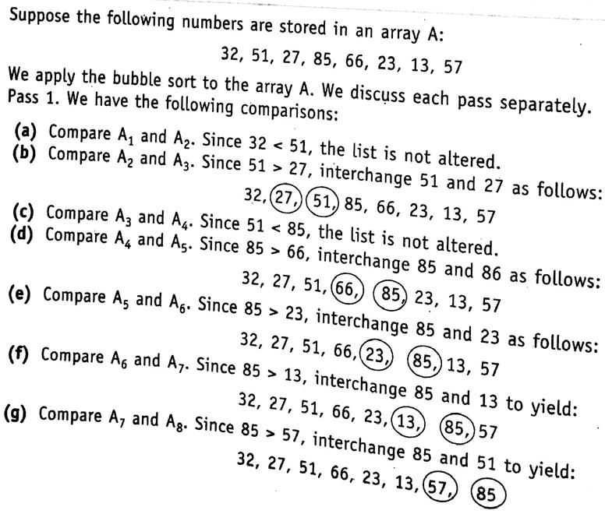
CSE 203: Data Structure
Data Structure
Linear Array:
Sorting

Slide 78
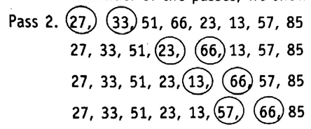




CSE 203: Data Structure
Data Structure
Linear Array:
Sorting

Slide 79

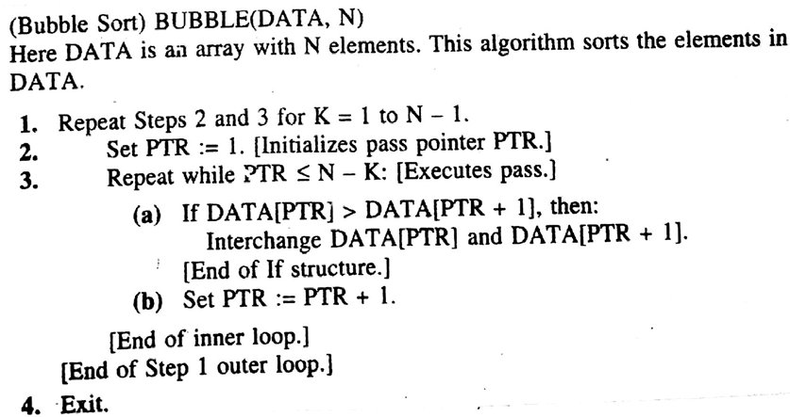
CSE 203: Data Structure
Data Structure
Linear Array:
Sorting

Slide 80
CSE 203: Data Structure
Data Structure
Linear Array:
Searching
Searching refers to the operation of finding an ITEM in a location LOC in an array DATA.
Output:
Successful
Unsuccessful
The algorithm that one chooses depends on the way the information in the DATA is organized.
Example:
Linear search
Binary search

Slide 81
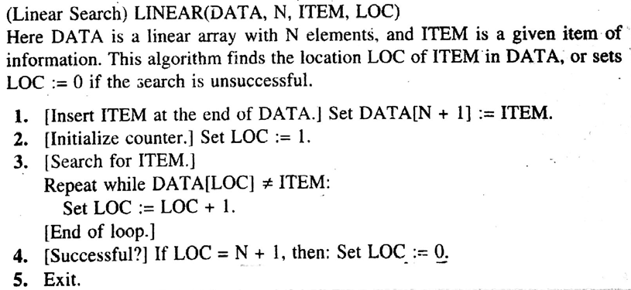


CSE 203: Data Structure
Data Structure
Linear Array:
Searching
O(n)=n

Slide 82
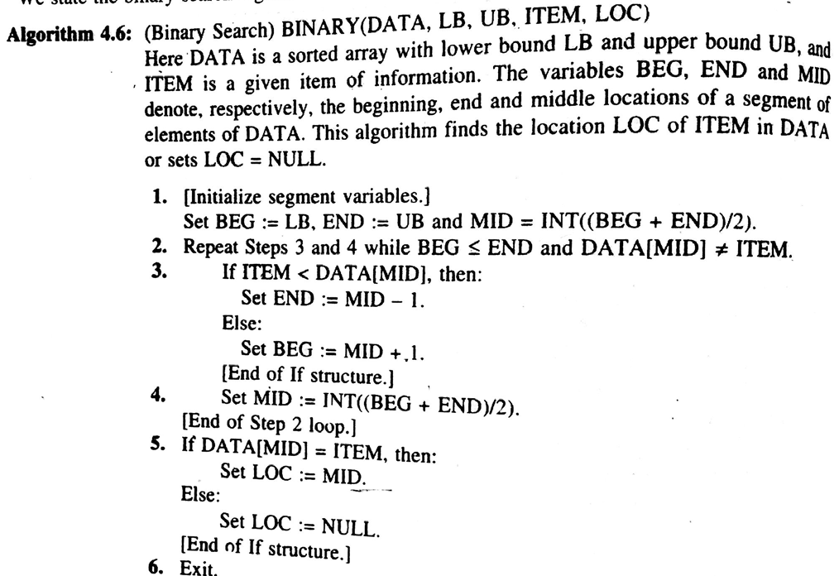


CSE 203: Data Structure
Data Structure
Linear Array:
Searching
O(n)=└ log₂n ┘

Slide 83

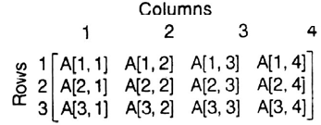
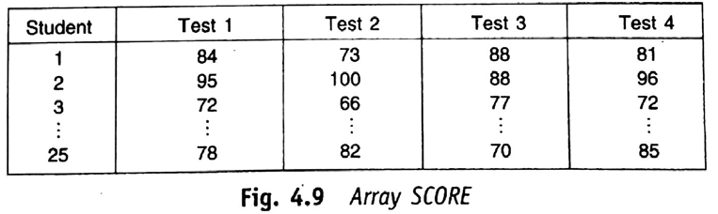
CSE 203: Data Structure
Data Structure
Linear Array:
Searching
Two-dimensional array A of size m x n.
Each element of the array is specified by A[J, K] where
1≤J ≤m, 1 ≤K ≤n

Slide 84
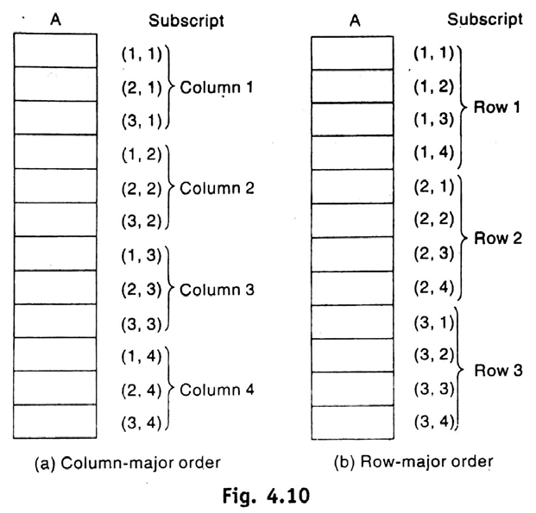
CSE 203: Data Structure
Data Structure
Linear Array:
Searching
Two-dimensional array A of size m x n.
Each element of the array is specified by A[J, K] where
1≤J ≤m, 1 ≤K ≤n
Memory Representation:

Slide 85

CSE 203: Data Structure
Data Structure
Linear Array:
Searching
Two-dimensional array A of size m x n.
Each element of the array is specified by A[J, K] where
1≤J ≤m, 1 ≤K ≤n

