Slide 1
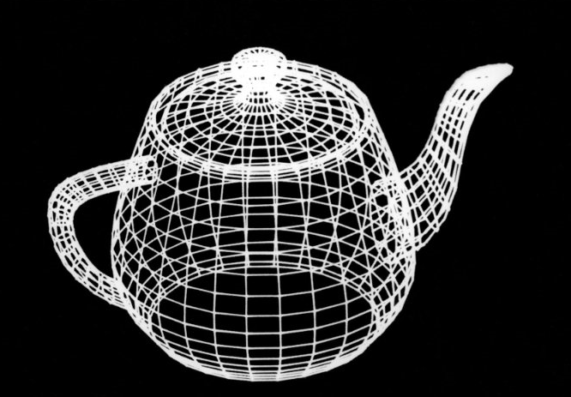
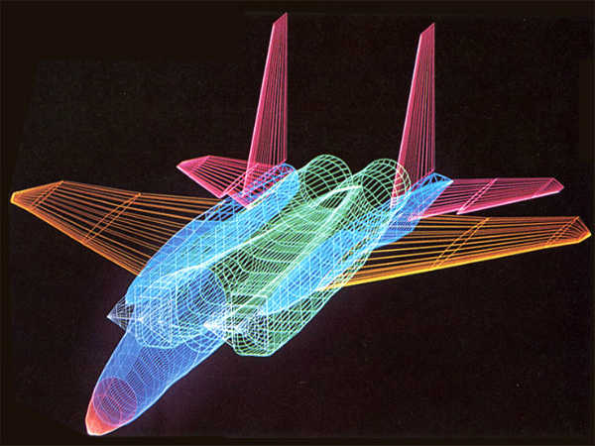
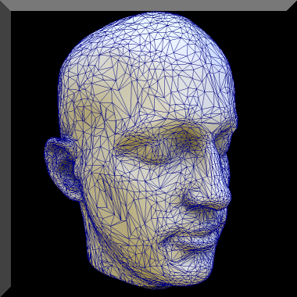
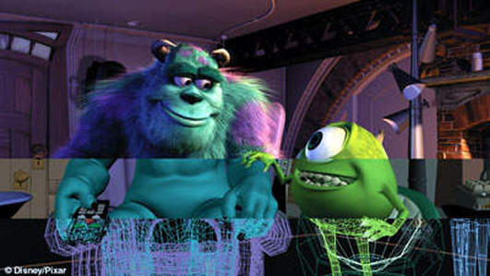
CSE 403: Computer Graphics
Graphics Application
Some Sample Graphics Applications:
Prof. Dr. A. H. M. Kamal, CSE, JKKNIU

Slide 2
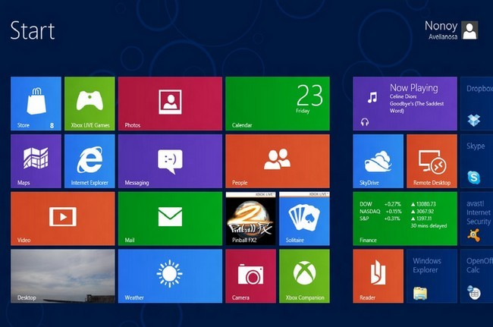
Computer Graphics
Tour to Graphics
Computer Graphics Applications:
1. User Interface:
Prof. Dr. A. H. M. Kamal, CSE, JKKNIU

Slide 3
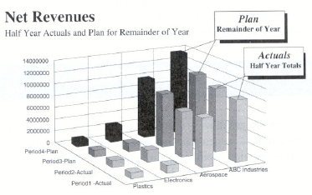
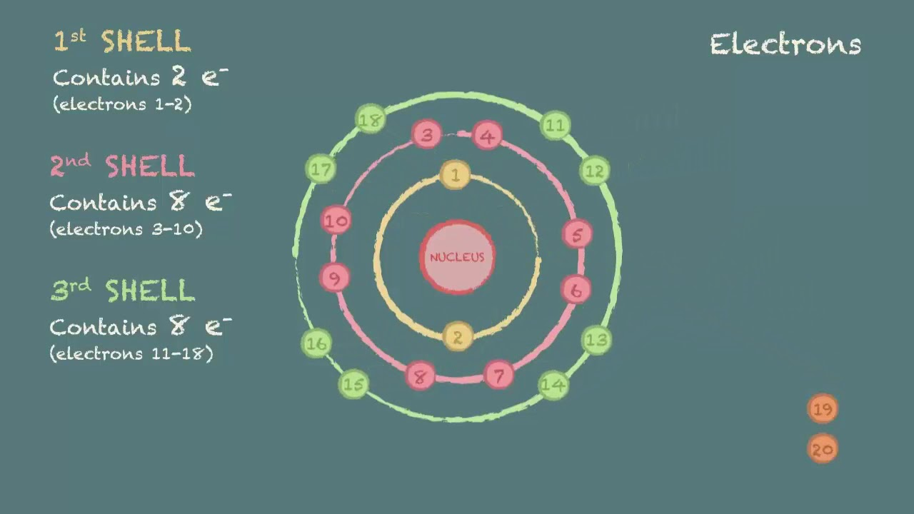
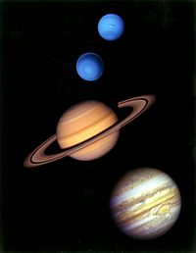
Computer Graphics
Tour to Graphics
Computer Graphics Applications:
2. Interactive Plotting in Business, Science and Technology:
Prof. Dr. A. H. M. Kamal, CSE, JKKNIU

Slide 4
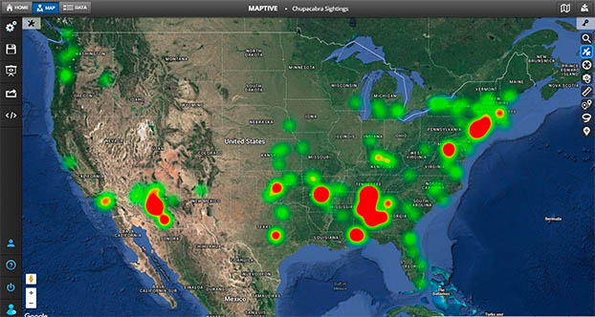
Computer Graphics
Tour to Graphics
Computer Graphics Applications:
3. Cartography:
To produce accurate and schematic representation of geographical objects and natural other phenomena from measurement data. Example: Geographical map, relief map, etc.
Prof. Dr. A. H. M. Kamal, CSE, JKKNIU

Slide 5
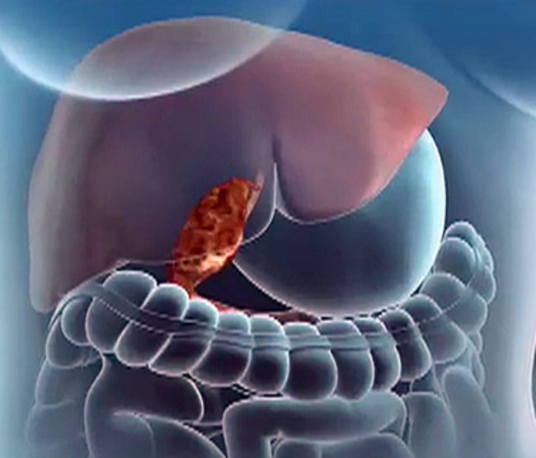
Computer Graphics
Tour to Graphics
Computer Graphics Applications:
4. Medicine:
Used in diagnostic medicine and surgery planning.
Prof. Dr. A. H. M. Kamal, CSE, JKKNIU

Slide 6
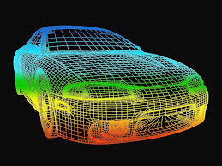
Computer Graphics
Tour to Graphics
Computer Graphics Applications:
5. Computer aided drafting and design:
To design components and system of mechanical, electrical.
Prof. Dr. A. H. M. Kamal, CSE, JKKNIU

Slide 7
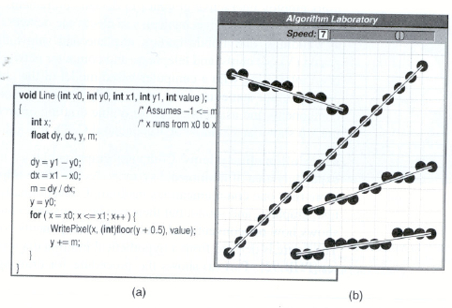
Computer Graphics
Tour to Graphics
Computer Graphics Applications:
6. Multimedia System:
Prof. Dr. A. H. M. Kamal, CSE, JKKNIU

Slide 8

Computer Graphics
Tour to Graphics
Computer Graphics Applications:
7. Simulation and animation for scientific visualization and animation:
Prof. Dr. A. H. M. Kamal, CSE, JKKNIU

Slide 9
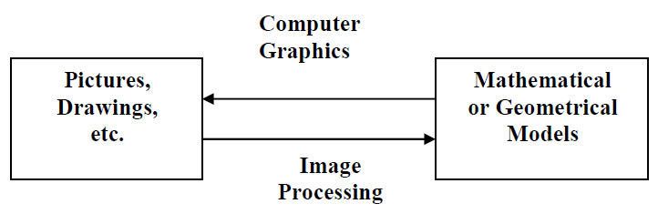
CSE 403: Computer Graphics
Tour to Graphics
Difference between Computer Graphics and Image Processing:
 | Computer Graphics | Image processing
1 | refers to processing of creating a new image from Geometry , Lighting parameters , Materials and Textures using a Computer or any other digital media. | is the process of manipulating an image acquired through some device. The image too often will be acquired from photograph, scanner, medical equipments.
2 | synthesize pictures from mathematical or geometrical models. | analyze pictures to derive descriptions of objects appeared in the pictures.
Prof. Dr. A. H. M. Kamal, CSE, JKKNIU

Slide 10
CSE 403: Computer Graphics
Graphics Basics
Reference Books:
1. Computer Graphics
- Shaume’s Outline
- 2nd Edition
2. Introduction to Computer Graphics
- Foley
Evaluation System:
Attendance 10
Mid Term I 10
Mid Term II 10
Project work 10
Final 60
Total 100
Prof. Dr. A. H. M. Kamal, CSE, JKKNIU

Slide 11
CSE 403: Computer Graphics
Tour to Graphics
Basic Terminologies:
Resolution | Maximum number of points that can be displayed in the output. It is often represented by wxh, where w and h are the width and height of a display device.
Aspect Ratio | Gives the ratio of vertical points to horizontal points of a screen.
Pixel | Each screen point is referred to as a pixel, called picture element.
Color | Each pixel is represented by a color. The color can be of black-and-white, gray and RGB model. Black-and-while color is represented by 0 and 1 (black and white). Hence, it is a 2-bit color. Gray pixel contains a value within 0 to 255. It is an 8-bit color. Hence, a Black and White pixel can hold a value of 0 and 255 also. RGB model presents a pixel value by mixing red (R) green (G) and blue (B) light with different intensities. Each of R, G and B color varies from 0 to 255. Thus RGB presents 256*256*256 different colors. It is a 24-bit color. An RGB color system with 24 bits of storage per pixel is generally referred to as a full-color or true-color system
Prof. Dr. A. H. M. Kamal, CSE, JKKNIU

Slide 12
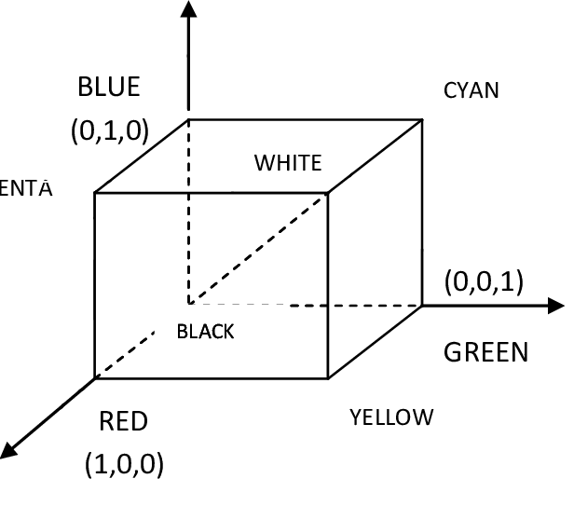
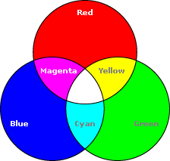
CSE 403: Computer Graphics
Tour to Graphics
RGB Color Model:
Prof. Dr. A. H. M. Kamal, CSE, JKKNIU

Slide 13

CSE 403: Computer Graphics
Tour to Graphics
CMY Color Model:
Prof. Dr. A. H. M. Kamal, CSE, JKKNIU

Slide 14
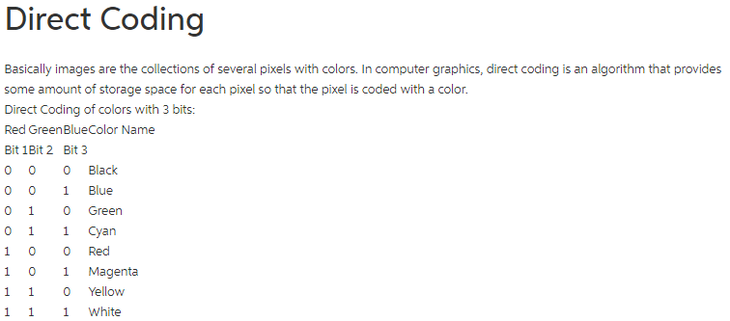
CSE 403: Computer Graphics
Tour to Graphics
Direct coding:
Prof. Dr. A. H. M. Kamal, CSE, JKKNIU

Slide 15
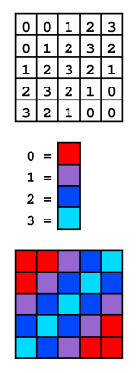



CSE 403: Computer Graphics
Tour to Graphics
Indexed Color:
The palette itself stores a limited number of distinct colors; 4, 16 or 256 are the most common cases.
A 2-bit indexed color image. The color of each pixel is represented by a number; each number (the index) corresponds to a color in the color table (the palette).
Here is a typical indexed 256-color image and its own palette (shown as a rectangle of swatches)
A 4-bit indexed color image and its palette.
Prof. Dr. A. H. M. Kamal, CSE, JKKNIU

Slide 16
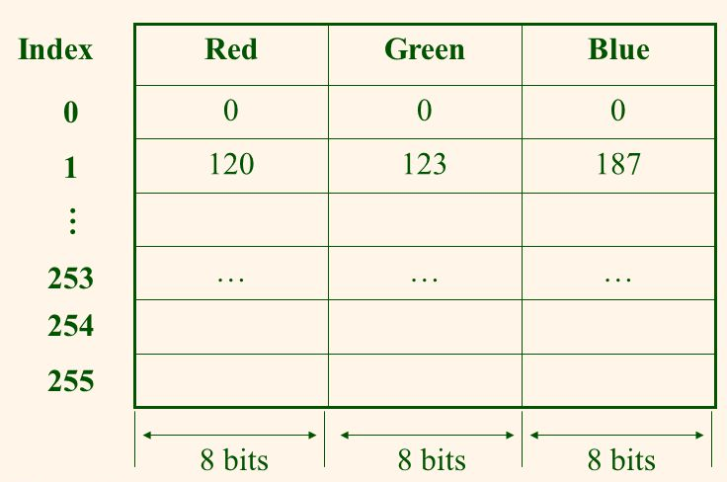
CSE 403: Computer Graphics
Tour to Graphics
Lookup Table for Color Grading:
A color lookup table, CLUT is a way to transform a range of input colors into another range of colors. For example, it could be a software function incorporated into an image processing application. The device takes the colors stored in each pixel of video memory, and convert them into physical colors that are visible on a computer monitor or display device.
8-bit pixel value
Prof. Dr. A. H. M. Kamal, CSE, JKKNIU

Slide 17
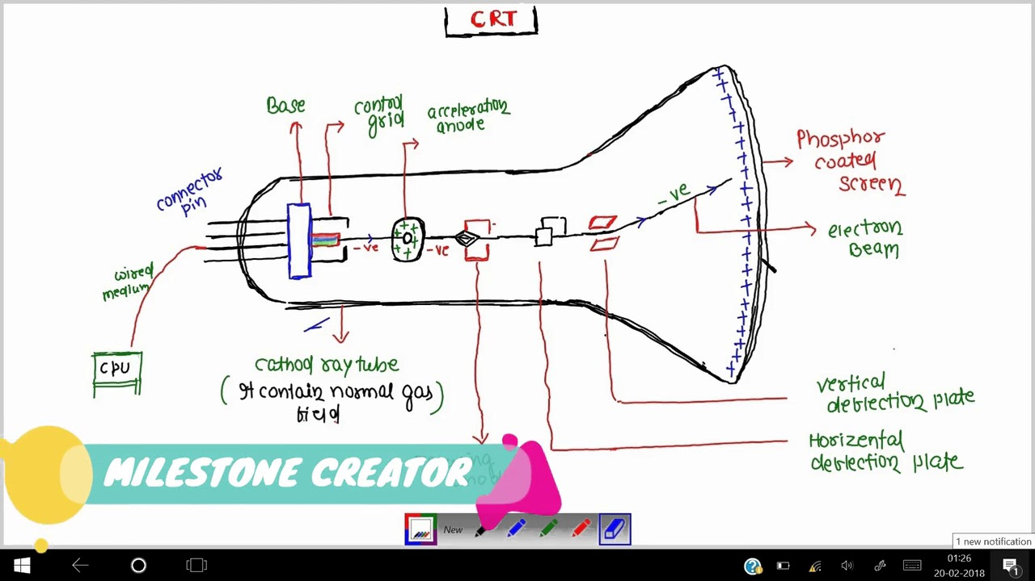
CSE 403: Computer Graphics
Tour to Graphics
Display Devices:
Three types
Emissive Displays
Non-emissive Displays
Hard Display
1. Emissive Displays:
Cathode Ray Tube (CRT): In the cathode ray tube, electrons are ejected from the cathode and accelerated through a voltage, gaining some 600 km/s for every volt they are accelerated through. Some of these fast-moving electrons crash into the gas inside the tube, causing it to glow, which allows us to see the path of the beam.
Plasma Panels: is controlled by filling the region between two glass plates with mixture of gasses.
Thin Film Electroluminescent Display: is controlled by filling the region between two glass plates with a phosphor.
Light Emitting Diode (LED): A mixture of diode forms the pixels.
Prof. Dr. A. H. M. Kamal, CSE, JKKNIU

Slide 18
CSE 403: Computer Graphics
Tour to Graphics
Display Devices:
Three types
Emissive Displays
Non-emissive Displays
Hard Display
1. Emissive Displays:
Cathode Ray Tube (CRT):
Plasma Panels:
Thin Film Electroluminescent Display:
Light Emitting Diode (LED):
2. Non-Emissive Displays:
Liquid Crystal Display: Produces a picture by passing polarized light from the surroundings through a liquid crystal material.
3. Hard Displays:
Printer:
Prof. Dr. A. H. M. Kamal, CSE, JKKNIU

Slide 19
CSE 403: Computer Graphics
Tour to Graphics
Refresh Buffer or Frame Buffer:
Pictured definition is stored in a memory area called the frame buffer or refresh buffer.
This memory area holds the set of intensity values for all the screen points.
Stored intensity values are then retrieved from the refresh buffer and painted on the screen one row (scan line) at a time.
On a Black and White system with one bit per pixel, the frame buffer is commonly called a bitmap.
For system with multiple bits per pixel, the frame buffer is often referred to as a pixmap.
Rendering:
The process of generating a pixel image from a three dimensional virtual scene is called rendering.
Prof. Dr. A. H. M. Kamal, CSE, JKKNIU

Slide 20
CSE 403: Computer Graphics
Tour to Graphics
Display Method:
Two types
Raster Scan
Random Scan
Want to draw a line
Method 1: Scan row by row
Method 2: Scan for object only
Prof. Dr. A. H. M. Kamal, CSE, JKKNIU

Slide 21
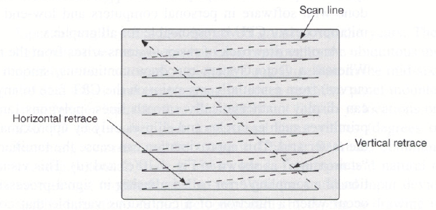
CSE 403: Computer Graphics
Tour to Graphics
Raster Scan:
The complete image on a raster display is formed from the raster, which is a set of horizontal scan lines, each a row of individual pixels.
The raster is thus stored as a matrix of pixels representing the entire screen area.
Video controller scanned out sequentially one scan line at a time from top to bottom. And then back to the top.
Prof. Dr. A. H. M. Kamal, CSE, JKKNIU

Slide 22
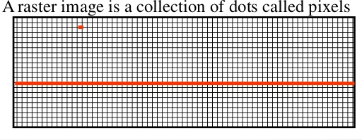
CSE 403: Computer Graphics
Tour to Graphics
Raster Scan:
The complete image on a raster display is formed from the raster, which is a set of horizontal scan lines, each a row of individual pixels.
The raster is thus stored as a matrix of pixels representing the entire screen area.
Video controller scanned out sequentially one scan line at a time from top to bottom. And then back to the top.
Prof. Dr. A. H. M. Kamal, CSE, JKKNIU

Slide 23
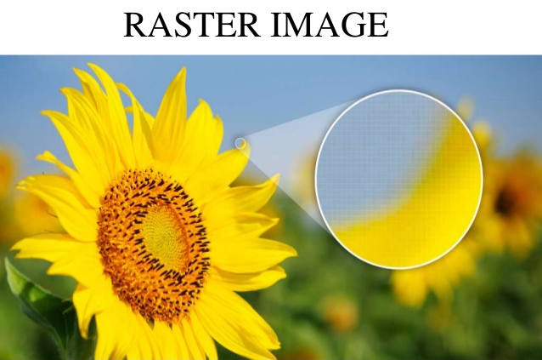
CSE 403: Computer Graphics
Tour to Graphics
Raster Scan:
The complete image on a raster display is formed from the raster, which is a set of horizontal scan lines, each a row of individual pixels.
The raster is thus stored as a matrix of pixels representing the entire screen area.
Video controller scanned out sequentially one scan line at a time from top to bottom. And then back to the top.
Prof. Dr. A. H. M. Kamal, CSE, JKKNIU

Slide 24
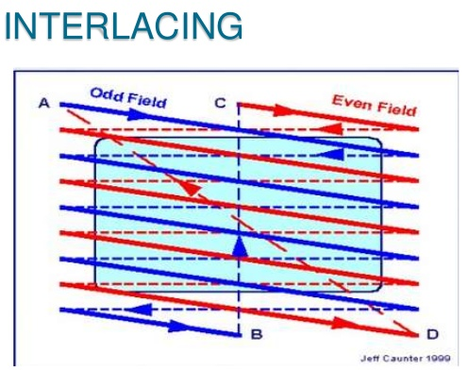
CSE 403: Computer Graphics
Tour to Graphics
Raster Scan:
The complete image on a raster display is formed from the raster, which is a set of horizontal scan lines, each a row of individual pixels.
The raster is thus stored as a matrix of pixels representing the entire screen area.
Video controller scanned out sequentially one scan line at a time from top to bottom. And then back to the top.
Interlaced Refresh Procedure: Each frame is displaced in two passed.
First pass displays even scan lines.
Second pass displays odd scan lines.
Prof. Dr. A. H. M. Kamal, CSE, JKKNIU

Slide 25
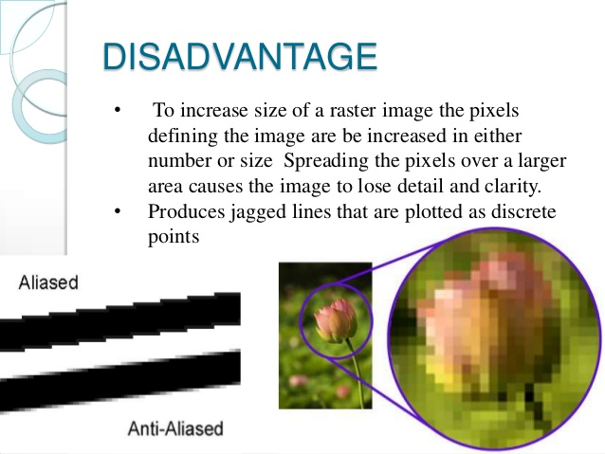
CSE 403: Computer Graphics
Tour to Graphics
Raster Scan:
The complete image on a raster display is formed from the raster, which is a set of horizontal scan lines, each a row of individual pixels.
The raster is thus stored as a matrix of pixels representing the entire screen area.
Video controller scanned out sequentially one scan line at a time from top to bottom. And then back to the top.
Prof. Dr. A. H. M. Kamal, CSE, JKKNIU

Slide 26
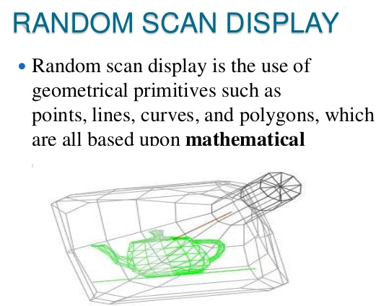
CSE 403: Computer Graphics
Tour to Graphics
Random Scan:
A CRT has a electron beam directed only to the parts of the screen where a picture is to be drawn.
Prof. Dr. A. H. M. Kamal, CSE, JKKNIU

Slide 27
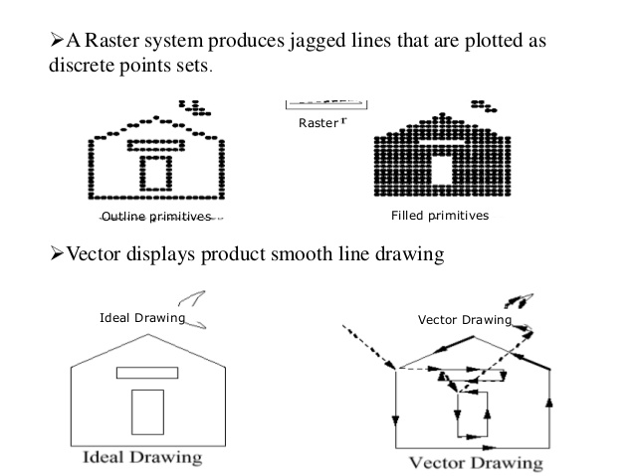
CSE 403: Computer Graphics
Tour to Graphics
Random Scan:
A CRT has a electron beam directed only to the parts of the screen where a picture is to be drawn.
Prof. Dr. A. H. M. Kamal, CSE, JKKNIU

Slide 28
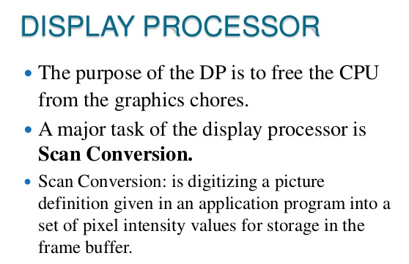
CSE 403: Computer Graphics
Tour to Graphics
Display Processor (DP):
Prof. Dr. A. H. M. Kamal, CSE, JKKNIU

Slide 29
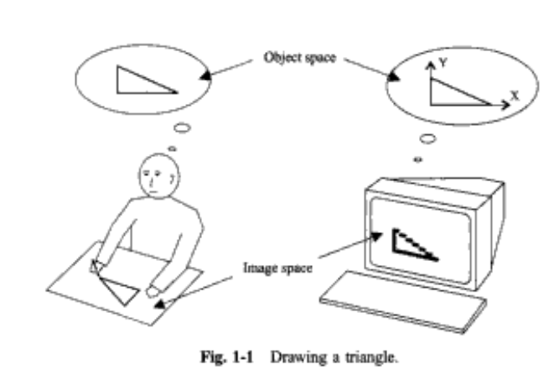
CSE 403: Computer Graphics
Tour to Graphics
Drawing Objects:
Prof. Dr. A. H. M. Kamal, CSE, JKKNIU

Slide 30
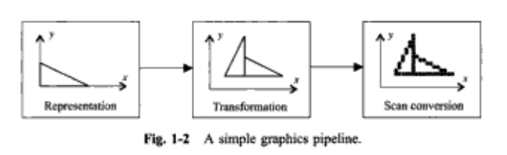
CSE 403: Computer Graphics
Tour to Graphics
Drawing Objects:
Prof. Dr. A. H. M. Kamal, CSE, JKKNIU

Slide 31
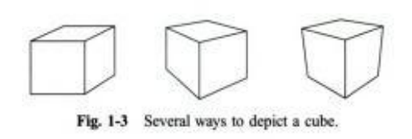
CSE 403: Computer Graphics
Tour to Graphics
Drawing Objects:
Prof. Dr. A. H. M. Kamal, CSE, JKKNIU

Slide 32
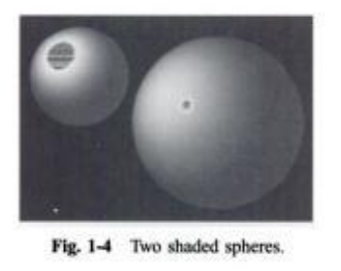
CSE 403: Computer Graphics
Tour to Graphics
Drawing Objects:
Prof. Dr. A. H. M. Kamal, CSE, JKKNIU

Slide 33
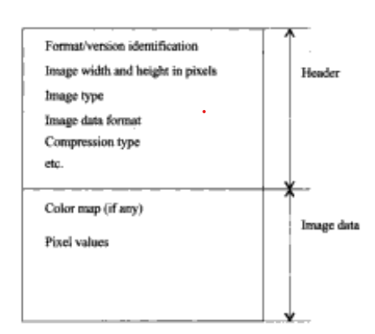
CSE 403: Computer Graphics
Tour to Graphics
Image File:
Format
JPG
PNG
BMP
Prof. Dr. A. H. M. Kamal, CSE, JKKNIU

Slide 34
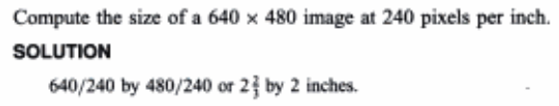
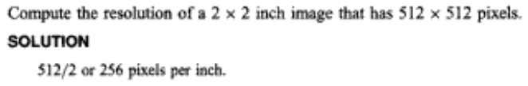
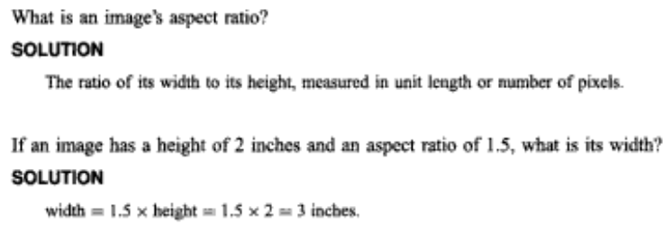
CSE 403: Computer Graphics
Tour to Graphics
Solved Problems:
9
Prof. Dr. A. H. M. Kamal, CSE, JKKNIU

Slide 35
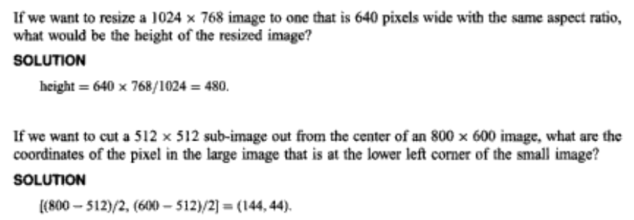
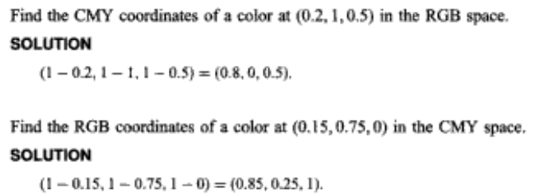
CSE 403: Computer Graphics
Tour to Graphics
Solved Problems:
Prof. Dr. A. H. M. Kamal, CSE, JKKNIU

Slide 36
CSE 403: Computer Graphics
Tour to Graphics
Functions to Drawing and color Point and Objects:
setcolor(c)
setpixel(x,y,c)
c=getpixel(x,y)
line(x1,y1,x2,y2)
rect(x1,y1,x2,y2)
circle(x,y,r)
Prof. Dr. A. H. M. Kamal, CSE, JKKNIU

