Slide 1
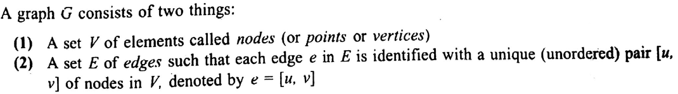
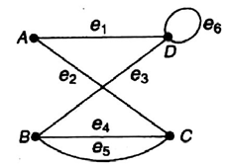

CSE 203: Data Structure
Data Structure
GRAPH:
If e=[u, v] then
e stands for an edge,
u and v are end points of e
u and v are vertex
u and v are adjacent nodes or neighbors
A graph G is represented by:
Where,
V=(A, B, C, D) and
E=(e1, e2, e3, e4, e5, e6)
e1=[A, D], e2=[A, C], e3=[B, D], e4=[B, C], e5=[B, C], e6=[D, D]

Slide 2

CSE 203: Data Structure
Data Structure
GRAPH:
Degree of a node u, written as deg(u), is the number of edges that meet at u.
Here, deg(A)=2, deg(B)=3
Again deg(u)=0 means that u is isolated and has no edge

Slide 3
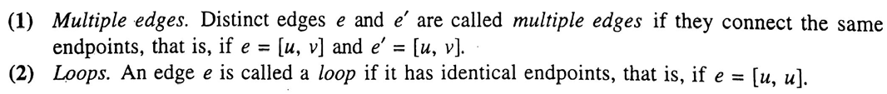
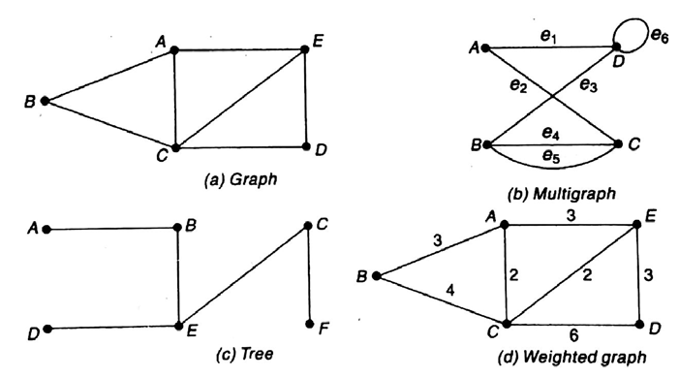
CSE 203: Data Structure
Data Structure
GRAPH:

Slide 4

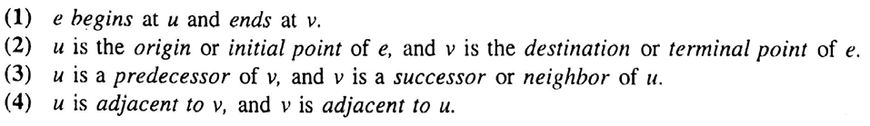


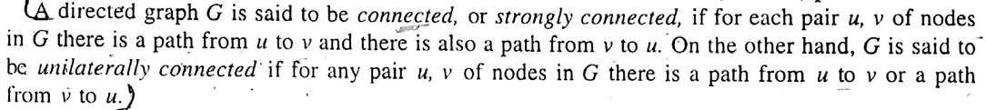
CSE 203: Data Structure
Data Structure
GRAPH:

Slide 5


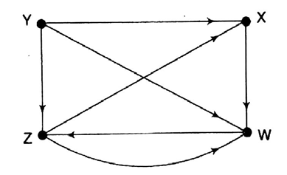
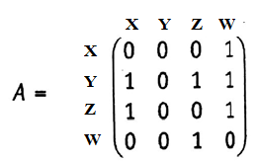
CSE 203: Data Structure
Data Structure
GRAPH:
Sequential representation of a Graph
Adjacent matrix
Path matrix
Weighted matrix

Slide 6
CSE 203: Data Structure
Data Structure
GRAPH:
Sequential representation of a Graph
Adjacent matrix
Path matrix
Weighted matrix

Slide 7
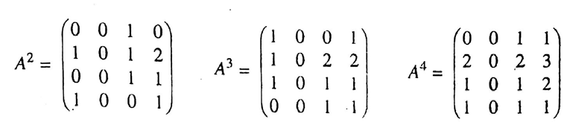

CSE 203: Data Structure
Data Structure
GRAPH:
Sequential representation of a Graph
Adjacent matrix
Path matrix
Weighted matrix

Slide 8


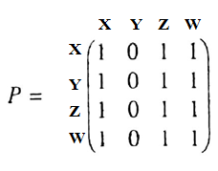
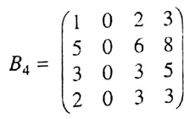
CSE 203: Data Structure
Data Structure
GRAPH:
Sequential representation of a Graph
Adjacent matrix
Path matrix
Weighted matrix

Slide 9
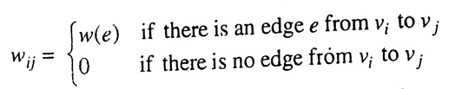
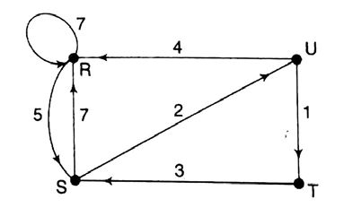
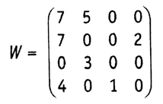
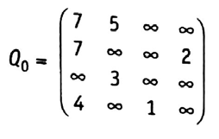
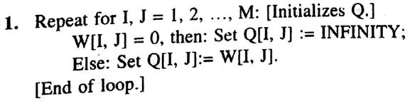
CSE 203: Data Structure
Data Structure
GRAPH:
Sequential representation of a Graph
Adjacent matrix
Path matrix
Weighted matrix
Finding shortest path:

Slide 10
CSE 203: Data Structure
Data Structure
GRAPH:
Sequential representation of a Graph
Adjacent matrix
Path matrix
Weighted matrix
Finding shortest path:
Do for all i and j:

Slide 11
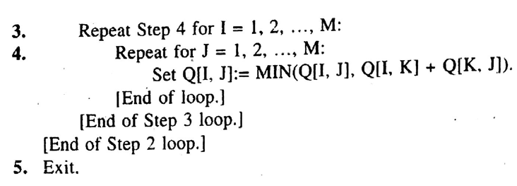
CSE 203: Data Structure
Data Structure
GRAPH:
Sequential representation of a Graph
Adjacent matrix
Path matrix
Weighted matrix
Finding shortest path:

Slide 12

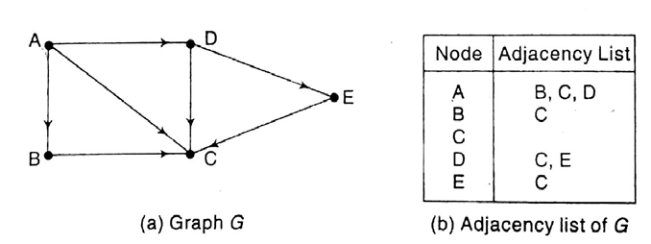
CSE 203: Data Structure
Data Structure
GRAPH:

Slide 13

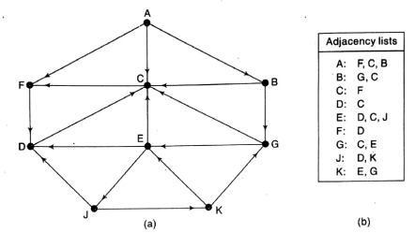
CSE 203: Data Structure
Data Structure
GRAPH:

Slide 14
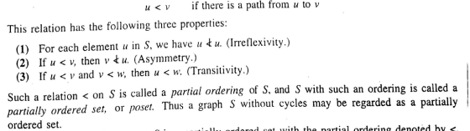
CSE 203: Data Structure
Data Structure
GRAPH:

Slide 15
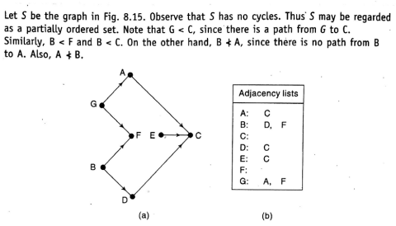
CSE 203: Data Structure
Data Structure
GRAPH:

Slide 16
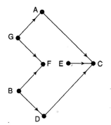
CSE 203: Data Structure
Data Structure
GRAPH:

Slide 17

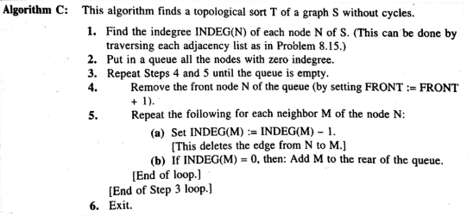
CSE 203: Data Structure
Data Structure
GRAPH:

Slide 18
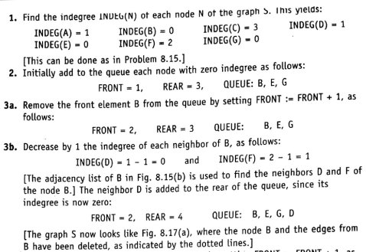
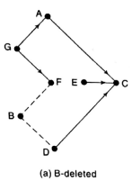
CSE 203: Data Structure
Data Structure
GRAPH:

Slide 19
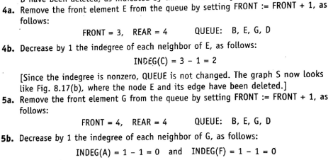
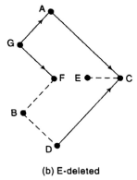
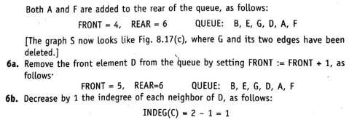
CSE 203: Data Structure
Data Structure
GRAPH:

Slide 20
CSE 203: Data Structure
Data Structure
GRAPH:

Slide 21
CSE 203: Data Structure
Data Structure
GRAPH:

