Slide 1
Machine Learning
Professor Dr. Md. Sujan Ali
Dept. of Computer Science and Engineering
Jatiya Kabi Kazi Nazrul Islam University
Trishal, Mymensingh
Notes:
Good morning, everyone. We are about to embark on an exciting journey into the world of Machine Learning. This first slide introduces us to the core subject, setting the stage for what promises to be a fascinating exploration. We'll begin by acknowledging the esteemed Professor Dr. Md. Sujan Ali, from the Department of Computer Science and Engineering at Jatiya Kabi Kazi Nazrul Islam University, who is leading us through this insightful course. This is more than just a title slide; it's our gateway into understanding how machines can learn and adapt, transforming industries and our daily lives. As we move forward, we will delve into the intricacies of this field, from fundamental concepts to real-world applications.

Slide 2
Course Information
Course Code: | CSE 425
Course Title: | Machine Learning
Credit Hours : | 3
Contact Hours: | 3
Total Marks: | 100
Category: | Both Science and Engineering
Prerequisites: | Data Structure Algorithms Computer Programming Data Science Artificial Intelligence (AI) Probability and Statistics Python
Notes:
This slide introduces the foundational information for this course, starting with the Course Code. The specific code will be provided to ensure accurate identification and enrollment for administrative purposes. This essential detail helps everyone track the course within the university's system. Following this, we delve into the broader "Course Information." This section will outline key aspects such as prerequisites, learning outcomes, and perhaps a brief overview of the course structure. We will explore what you can expect to learn and how the course is organized to facilitate your understanding of machine learning principles.

Slide 3


Course Assessment Methods
Midterms/
Assignment
Examinations
Presentation
Notes:
This course employs a multifaceted approach to assess your understanding and mastery of the material. Your performance will be evaluated through midterms and assignments, which aim to gauge your continuous engagement and comprehension of key concepts throughout the semester. Additionally, formal examinations will provide a comprehensive assessment of your accumulated knowledge. Finally, presentation components will allow you to demonstrate your ability to articulate and apply machine learning principles in a structured and effective manner.

Slide 4
Recommended Books
Pattern Recognition and Machine Learning
- by Christopher M. Bishop
2. Machine Learning
- by Tom M. Mitchell
Hands-On Machine Learning with Scikit-Learn, Keras &
TensorFlow
- by Aurélien Géron
Notes:
We delve into the core literature for this course, establishing a strong foundation in machine learning. Our primary reference, "Pattern Recognition and Machine Learning" by Christopher M. Bishop, provides a comprehensive and theoretically rigorous approach to the subject. This book is invaluable for understanding the mathematical underpinnings and foundational concepts. Supplementing this, "Machine Learning" by Tom M. Mitchell offers a classic and widely respected perspective, focusing on fundamental algorithms and practical applications. Finally, for a hands-on experience, we will utilize "Hands-On Machine Learning with Scikit-Learn, Keras & TensorFlow" by Aurélien Géron. This resource is excellent for implementing models using popular Python libraries, bridging theory with practical coding skills essential for real-world problem-solving.

Slide 5
Course Objectives
Understand core machine learning algorithms.
Implement ML models using Python.
Evaluate and improve predictive performance.
Solve real-world classification and regression problems.
Notes:
Our course objectives are designed to provide a comprehensive understanding of machine learning. First, you will gain a deep understanding of core machine learning algorithms, forming the foundational knowledge necessary for this field. Second, we will move beyond theory into practical application, as you learn to implement various ML models using Python, a leading language in data science. Third, a crucial aspect of machine learning involves evaluating and enhancing the predictive performance of your models, ensuring they are robust and accurate. Finally, we will equip you with the skills to solve real-world classification and regression problems, directly applying what you've learned to practical scenarios.

Slide 6
Introduction to Machine Learning
Example:
Traditional programming:
  Rules + Data = Output
Machine learning:
  Data + Correct Answers (training data) → Model (?)
  Model + New Data = Prediction
Notes:
This slide highlights a fundamental distinction between traditional programming and machine learning, which serves as a crucial starting point for understanding our course objectives. In traditional programming, we explicitly define rules and combine them with data to produce a specific output. For instance, if you write a program to calculate taxes, you provide the tax rules and the income data, and the program outputs the tax amount. The developer dictates every step and logic.
However, machine learning operates differently. Instead of providing explicit rules, we feed the system data along with the correct answers—this is known as training data. Through this process, the machine learning system learns to infer a "model," which is essentially a set of underlying patterns or relationships. Once this model is developed, we can then introduce new, unseen data to it, and the model will generate predictions based on the patterns it has learned. This approach allows systems to adapt and perform tasks without being explicitly programmed for every possible scenario, making it incredibly powerful for complex problems where defining explicit rules would be impossible or impractical.

Slide 7
Introduction to Machine Learning
Machine Learning (ML) is a branch of Artificial Intelligence (AI)
Enables computers to learn from data
Make predictions or decisions without being explicitly programmed for every task.
Machine identifies patterns in the given data and uses those patterns to make predictions or decisions.
ML teaches systems to think and understand like humans by learning from the data.
Notes:
Machine Learning, or ML, stands as a prominent branch within the broader field of Artificial Intelligence, representing a significant evolution in how computers process information and execute tasks. Its fundamental capability lies in empowering machines to learn directly from data, moving beyond explicit programming. This means we do not need to write specific instructions for every conceivable scenario. Instead, we provide the machine with data, and it autonomously develops the ability to perform tasks.
A core principle of ML involves identifying patterns within given datasets. Once these patterns are recognized, the machine leverages them to make accurate predictions or informed decisions in new, unseen situations. This process essentially teaches systems to emulate human-like thought and understanding. By learning from vast amounts of data, machine learning algorithms allow computers to adapt and improve their performance over time, making them incredibly powerful tools for solving complex problems across various domains.

Slide 8
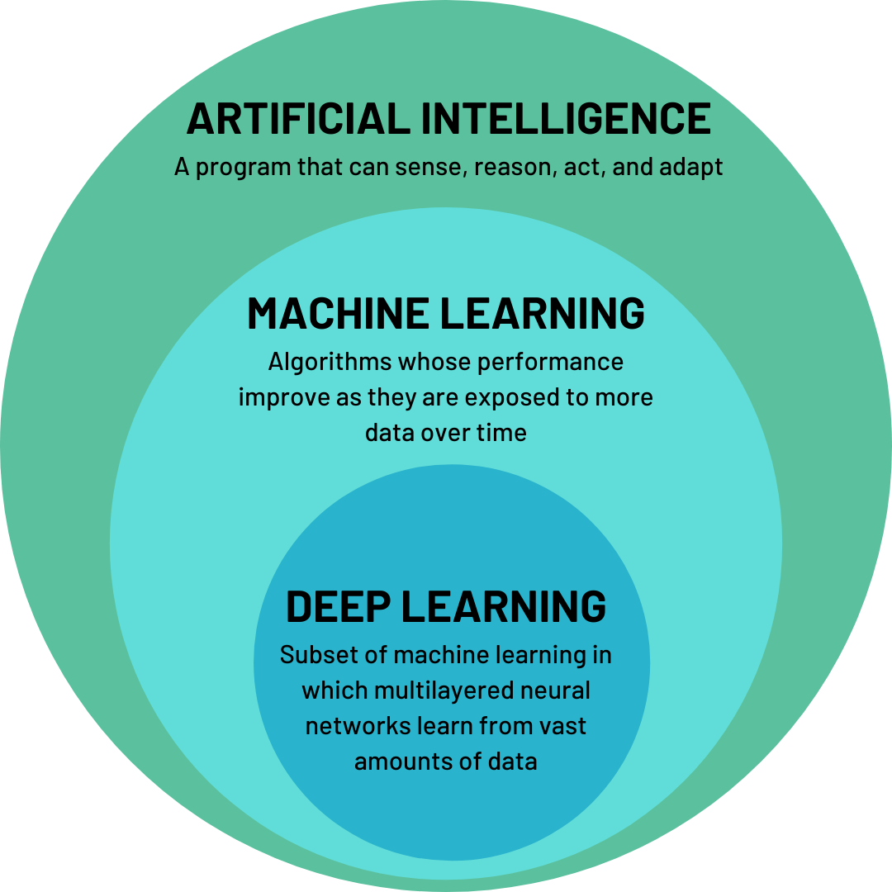
Introduction to Machine Learning
Notes:
This slide, while appearing blank, serves a crucial purpose in our journey into Machine Learning. It functions as a reflective pause, allowing us to absorb the foundational definitions and concepts we have just discussed. Before delving deeper into practical applications and model building, it is essential to internalize the core principles introduced on the previous slides. This moment of whitespace encourages us to consider the implications of ML as a branch of Artificial Intelligence, how it enables computers to learn from data, and its capacity to make predictions or decisions without explicit programming. This brief interlude is an opportunity to consolidate our understanding of how ML identifies and utilizes patterns, mimicking human learning from data.

Slide 9
Model
A model is the part that learns patterns from data
Uses those patterns to make predictions on new data.
A mathematical function or a set of learned rules.
Notes:
Today we're delving into the concept of a "model" within machine learning. Essentially, a model represents the core intelligence of our system. It's the critical component responsible for learning intricate patterns and relationships directly from the data we feed it. Through this learning process, the model develops an understanding of the underlying structure of the data. This understanding then enables it to make informed predictions or decisions on new, unseen data. Think of it as the brain of your machine learning application. A model can manifest in various forms. It could be a complex mathematical function, meticulously crafted to capture statistical relationships, or it might consist of a refined set of learned rules. These rules are derived iteratively as the model processes more data, constantly improving its ability to generalize and predict. This adaptability allows machine learning systems to address a wide array of problems, from image recognition to predictive analytics.

Slide 10
Example of Model
Example 1: House Price Prediction
Suppose you have this training data:
House Size (sq ft) | Price (TK)
1000 | 50,00000
1500 | 75,00000
2000 | 1,0000000
Notes:
Here, we delve into a practical application of machine learning, focusing on house price prediction. Imagine you are trying to estimate the value of a house. Instead of relying on a human expert, we can use a machine learning model. To train this model, we first need data. This slide illustrates a common starting point: a dataset comprising various houses and their corresponding sizes. This "training data" is crucial, as it provides the model with examples from which to learn. For instance, we might have several entries showing specific house sizes and the prices at which those houses were sold. The model then analyzes these examples to identify underlying patterns and relationships between features like house size and the target variable, which is the house price. This initial step of gathering and presenting the training data sets the foundation for the model to effectively learn and make accurate predictions on new, unseen data.

Slide 11
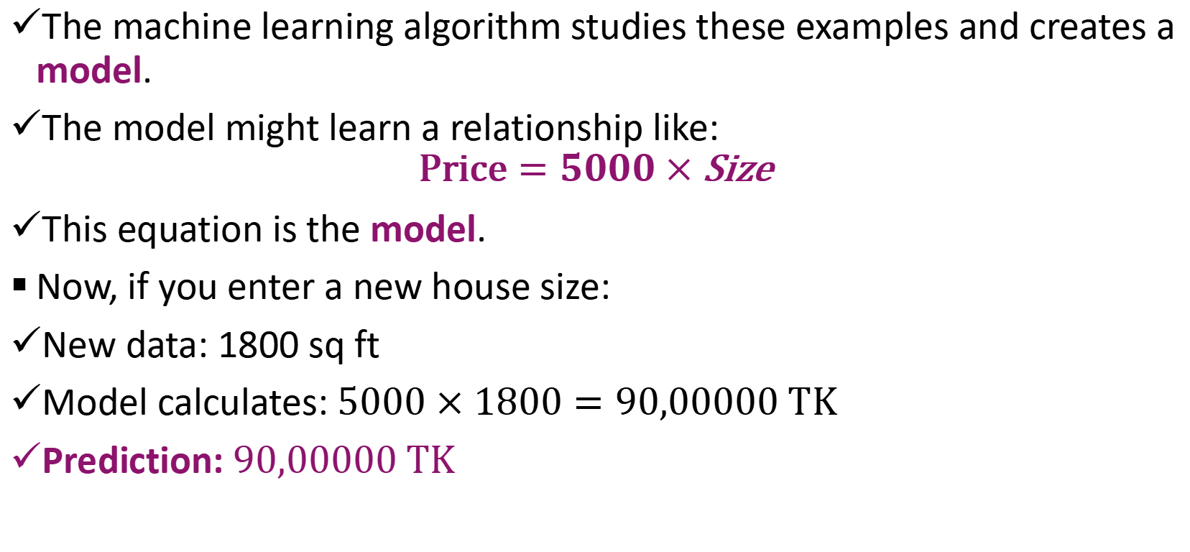
Example 1: House Price Prediction
The machine learning algorithm studies these examples and creates a model.
The model might learn a relationship like:
$$\text{Price}=5000×\text{Size}$$
This equation is the model.
Now, if you enter a new house size:
New data: 1800 sq ft
Model calculates: $5000×1800=90,00000 TK$
Prediction: $90,00000 TK$
Notes:
Here, we dive into a concrete example of how a machine learning model operates for house price prediction. Initially, the algorithm diligently analyzes the provided training data, meticulously searching for underlying relationships. Through this process, it might discover a simple yet effective formula, such as Price equals 5000 multiplied by Size. This equation effectively becomes our model, representing the learned pattern. When presented with new data, like a house size of 1800 square feet, the model applies this learned relationship. It calculates 5000 times 1800, yielding a prediction of 9,000,000 TK for the house price. This demonstrates the model's ability to generalize from previously seen examples and make informed predictions on unseen data, a core capability of machine learning.

Slide 12
Example of Model
Example 2: Email Spam Detection
Training data:
Email | Label
"Win a free iPhone!" | Spam
"Meeting at 3 PM" | Not Spam
"Claim your prize now!" | Spam
Notes:
Here, we transition to another practical example of a machine learning model in action: email spam detection. This slide introduces the concept of providing a model with "training data" to learn from. In this context, the training data consists of various emails, each labeled as either "spam" or "not spam." This labeled data is crucial because it allows the algorithm to identify patterns and characteristics that distinguish between legitimate and unwanted messages. The model effectively learns what attributes an email possesses that categorize it into one of these two classes.

Slide 13
Example of Model
Example 2: Email Spam Detection
The model learns that words like "free," "win," "prize," often appear in spam emails.
New email:
"Win cash prize today!“
The model predicts: Spam
Notes:
Here, we continue with our second example, email spam detection. This illustration highlights how a machine learning model discerns patterns within textual data. The model specifically learns to identify keywords and phrases frequently associated with spam emails. When words like "free," "win," or "prize" appear, they trigger a higher probability of an email being categorized as spam. Consequently, upon receiving a new email containing the phrase "Win cash prize today!", the model applies its learned rules and confidently predicts that this email is indeed spam. This demonstrates the model's ability to classify new, unseen data based on the knowledge it acquired from previous examples.

Slide 14
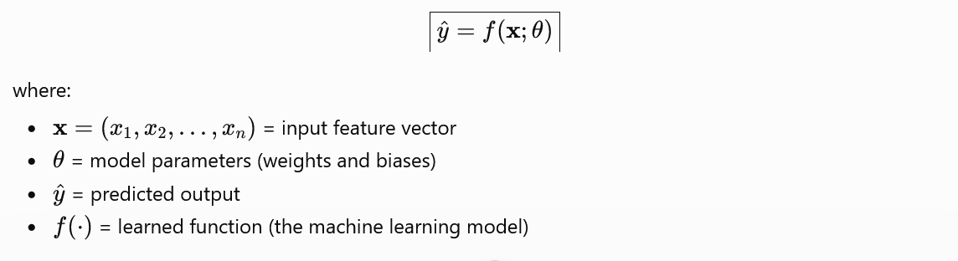
Model
A machine learning model is fundamentally a mathematical function that learns a mapping from input features to an output. The general mathematical representation is:
Notes:
A machine learning model fundamentally acts as a sophisticated mathematical function. It possesses the capability to learn a complex mapping from input features to a desired output. Essentially, it takes raw data, processes it, and then generates predictions or classifications. This process is not random; rather, the model systematically identifies patterns and relationships within the data during its training phase. The general mathematical representation on the slide provides a foundational understanding of this mapping. It symbolizes how various inputs are transformed through mathematical operations to produce a specific output, forming the core logic behind every prediction a machine learning system makes.

Slide 15
Model
Weights
A weight determines how important an input feature is in making a prediction.
Weights (W) scale the influence of each input feature.
Bias
The bias is a constant value added to the prediction.
Bias (b) provides an adjustable offset, allowing the model to fit the data more accurately.
Why are Weights and Biases Called Parameters?
They are called parameters because the learning algorithm automatically adjusts them during training.
Notes:
A machine learning model, as we just discussed, is a mathematical function. Now, let's break down its core components: weights and biases. Think of weights as the model's way of deciding how important each piece of input information is. For instance, in our house price prediction, the 'size' of the house would likely have a high weight, meaning it significantly influences the predicted price. These weights (represented as W) essentially scale the influence of each input feature.
Biases, on the other hand, act as an adjustable offset. They provide a baseline value that the model can tune to better fit the data. Imagine a scenario where even a very small house has a minimum price. The bias would help the model capture this fundamental floor value. Together, weights and biases are called parameters because the learning algorithm actively adjusts these values during the training process, allowing the model to continuously refine its predictions and improve accuracy.

Slide 16
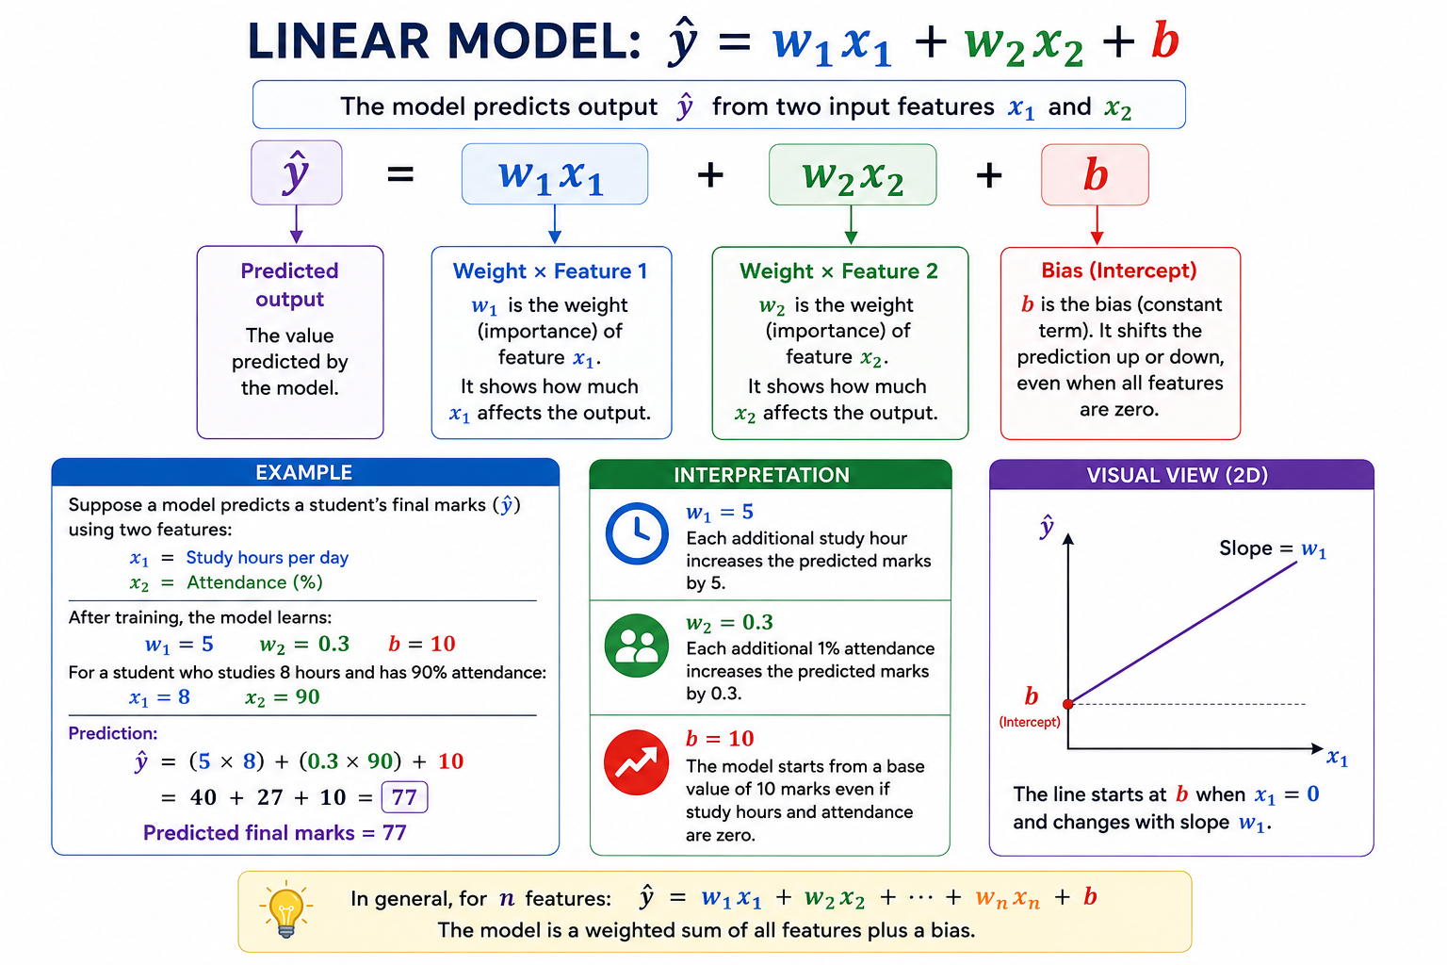
Notes:
This slide serves as a transitional point, acting as a natural pause before we delve into the core types of machine learning. We have covered the fundamental concepts of models and their constituent parameters, such as weights and biases. Now, we prepare to explore how these models are applied across different learning paradigms. This pause allows us to mentally shift gears, moving from the "what" of a model to the "how" it learns and operates within distinct frameworks, ensuring a clear understanding as we progress.

Slide 17
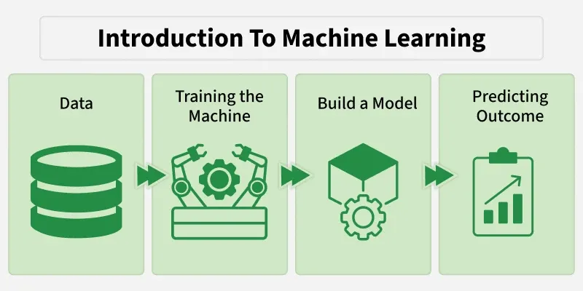
Notes:
This slide is intentionally left blank. It serves as a brief pause or transition point before we delve into the core topic of the different types of machine learning paradigms. Often, such an interstitial slide allows the audience a moment to absorb the previous information or prepare for the next segment. Think of it as a brief mental reset, setting the stage for what is to come.

Slide 18
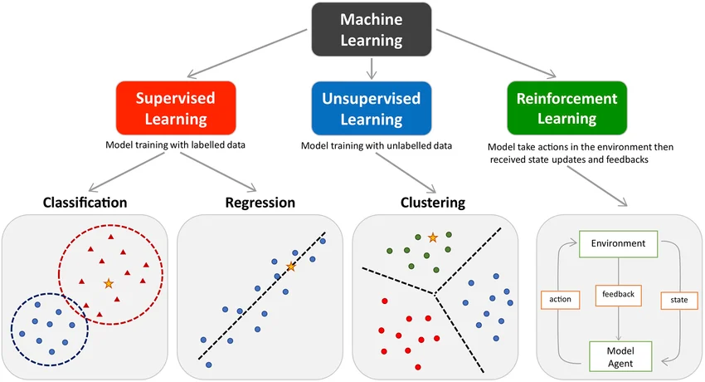
Types of Machine Learning
Notes:
This slide introduces Supervised Learning, a foundational category of machine learning. In supervised learning, the model trains on labeled data, meaning each input has a corresponding correct output. The primary goal is to predict or classify new, unseen data based on these learned relationships. Consider email spam detection; the model learns from emails previously labeled as "spam" or "not spam." Similarly, house price prediction models use historical data containing house features and their actual sale prices. Predicting student grades involves using past academic performance and other relevant data points. The model learns to map input features to a desired output, making it highly effective for tasks requiring direct prediction based on historical examples.

Slide 19
Types of Machine Learning : Supervised Learning
Classification
The left figure shows Classification.
Here, the algorithm predicts a category (class).
Notice in the figure:
    Blue dots belong to one class.
    Red triangles belong to another class.
    The dashed circles represent class boundaries.
    The yellow star is a new data point.
The model predicts which class the new point belongs to.
Notes:
This slide introduces Supervised Learning, a foundational category of machine learning. In supervised learning, the model trains on labeled data, meaning each input has a corresponding correct output. The primary goal is to predict or classify new, unseen data based on these learned relationships. Consider email spam detection; the model learns from emails previously labeled as "spam" or "not spam." Similarly, house price prediction models use historical data containing house features and their actual sale prices. Predicting student grades involves using past academic performance and other relevant data points. The model learns to map input features to a desired output, making it highly effective for tasks requiring direct prediction based on historical examples.

Slide 20
Types of Machine Learning : Supervised Learning
Classification Example : Disease Diagnosis
Input
  Fever
  Blood Pressure
  Oxygen Level
  Age
Output
  COVID Positive
  COVID Negative
The model classifies the patient.
Notes:
This slide introduces Supervised Learning, a foundational category of machine learning. In supervised learning, the model trains on labeled data, meaning each input has a corresponding correct output. The primary goal is to predict or classify new, unseen data based on these learned relationships. Consider email spam detection; the model learns from emails previously labeled as "spam" or "not spam." Similarly, house price prediction models use historical data containing house features and their actual sale prices. Predicting student grades involves using past academic performance and other relevant data points. The model learns to map input features to a desired output, making it highly effective for tasks requiring direct prediction based on historical examples.

Slide 21
Types of Machine Learning : Supervised Learning
Regression
The second picture represents Regression.
Unlike classification,
  Regression predicts a continuous numerical value.
The blue points represent historical data.
The dotted line is the best-fit regression line.
The yellow star represents a new input.
The model predicts its numerical value.
Notes:
This slide introduces Supervised Learning, a foundational category of machine learning. In supervised learning, the model trains on labeled data, meaning each input has a corresponding correct output. The primary goal is to predict or classify new, unseen data based on these learned relationships. Consider email spam detection; the model learns from emails previously labeled as "spam" or "not spam." Similarly, house price prediction models use historical data containing house features and their actual sale prices. Predicting student grades involves using past academic performance and other relevant data points. The model learns to map input features to a desired output, making it highly effective for tasks requiring direct prediction based on historical examples.

Slide 22
Types of Machine Learning : Supervised Learning
Regression Example : Temperature Forecast
Input
Humidity
Pressure
Wind Speed
Output
Tomorrow's temperature
Notes:
This slide introduces Supervised Learning, a foundational category of machine learning. In supervised learning, the model trains on labeled data, meaning each input has a corresponding correct output. The primary goal is to predict or classify new, unseen data based on these learned relationships. Consider email spam detection; the model learns from emails previously labeled as "spam" or "not spam." Similarly, house price prediction models use historical data containing house features and their actual sale prices. Predicting student grades involves using past academic performance and other relevant data points. The model learns to map input features to a desired output, making it highly effective for tasks requiring direct prediction based on historical examples.

Slide 23
Types of Machine Learning : Unsupervised Learning
There are no labels.
The computer only receives the input data.
Its job is to discover hidden patterns.
Notes:
This slide introduces Supervised Learning, a foundational category of machine learning. In supervised learning, the model trains on labeled data, meaning each input has a corresponding correct output. The primary goal is to predict or classify new, unseen data based on these learned relationships. Consider email spam detection; the model learns from emails previously labeled as "spam" or "not spam." Similarly, house price prediction models use historical data containing house features and their actual sale prices. Predicting student grades involves using past academic performance and other relevant data points. The model learns to map input features to a desired output, making it highly effective for tasks requiring direct prediction based on historical examples.

Slide 24
Types of Machine Learning : Unsupervised Learning
Example : News Article Grouping
Thousands of articles are automatically grouped into topics such as:
Sports
Politics
Business
Technology
without manually labeling them.
Notes:
This slide introduces Supervised Learning, a foundational category of machine learning. In supervised learning, the model trains on labeled data, meaning each input has a corresponding correct output. The primary goal is to predict or classify new, unseen data based on these learned relationships. Consider email spam detection; the model learns from emails previously labeled as "spam" or "not spam." Similarly, house price prediction models use historical data containing house features and their actual sale prices. Predicting student grades involves using past academic performance and other relevant data points. The model learns to map input features to a desired output, making it highly effective for tasks requiring direct prediction based on historical examples.

Slide 25
Types of Machine Learning : Reinforcement Learning
The green section represents Reinforcement Learning.
This is completely different from supervised learning.
The model learns by trial and error.
The image shows a continuous interaction between:
  Environment
  Agent (Model)
  Action
  Feedback (Reward/Penalty)
  State
Notes:
This slide introduces Supervised Learning, a foundational category of machine learning. In supervised learning, the model trains on labeled data, meaning each input has a corresponding correct output. The primary goal is to predict or classify new, unseen data based on these learned relationships. Consider email spam detection; the model learns from emails previously labeled as "spam" or "not spam." Similarly, house price prediction models use historical data containing house features and their actual sale prices. Predicting student grades involves using past academic performance and other relevant data points. The model learns to map input features to a desired output, making it highly effective for tasks requiring direct prediction based on historical examples.

Slide 26
Types of Machine Learning : Reinforcement Learning
Example : Self-Driving Cars
State
  Road condition
  Traffic lights
  Speed
Action
  Turn left
  Brake
  Accelerate
Reward
  Safe driving
Penalty
  Collision
  Traffic violation
The car improves its driving strategy through repeated interactions.
Notes:
This slide introduces Supervised Learning, a foundational category of machine learning. In supervised learning, the model trains on labeled data, meaning each input has a corresponding correct output. The primary goal is to predict or classify new, unseen data based on these learned relationships. Consider email spam detection; the model learns from emails previously labeled as "spam" or "not spam." Similarly, house price prediction models use historical data containing house features and their actual sale prices. Predicting student grades involves using past academic performance and other relevant data points. The model learns to map input features to a desired output, making it highly effective for tasks requiring direct prediction based on historical examples.

Slide 27
Types of Machine Learning : Reinforcement Learning
Agent
An Agent is an intelligent learner that interacts with an environment
Takes actions
Receives rewards or penalties and
Continuously improves its decision-making strategy to maximize long-term rewards.

Slide 28
Summary of the Machine Learning Types
Type | Training Data | Goal | Output | Real-Life Example
Supervised Learning | Labelled data | Learn input-output mapping | Class or numeric value | Spam detection, disease diagnosis, house price prediction
Unsupervised Learning | Unlabelled data | Discover hidden patterns | Clusters or associations | Customer segmentation, movie recommendation, face grouping
Reinforcement Learning | Interaction with environment | Learn optimal actions through rewards | Best action/policy | Self-driving cars, robotics, game-playing AI
Notes:
This slide introduces Supervised Learning, a foundational category of machine learning. In supervised learning, the model trains on labeled data, meaning each input has a corresponding correct output. The primary goal is to predict or classify new, unseen data based on these learned relationships. Consider email spam detection; the model learns from emails previously labeled as "spam" or "not spam." Similarly, house price prediction models use historical data containing house features and their actual sale prices. Predicting student grades involves using past academic performance and other relevant data points. The model learns to map input features to a desired output, making it highly effective for tasks requiring direct prediction based on historical examples.

Slide 29
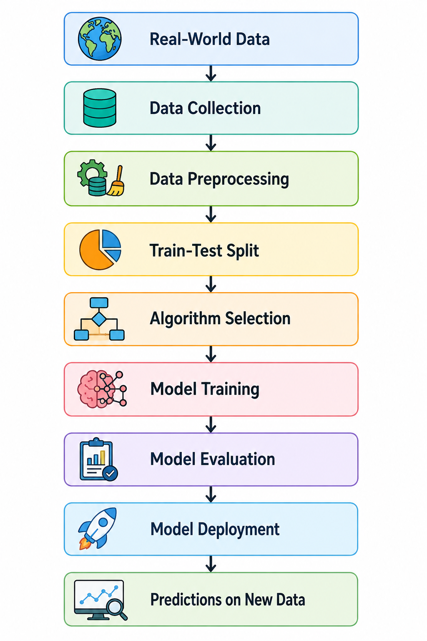
How Machine Learning Works?
Notes:
Machine learning operates through a systematic process, beginning with the crucial step of data collection. Businesses gather vast amounts of information from various sources, forming the foundation for any AI endeavor. Subsequently, cleaning and preprocessing this data become paramount, as raw data often contains inconsistencies or missing values that can hinder model performance. Once the data is prepared, engineers select an appropriate machine learning algorithm, considering the specific problem they aim to solve and the nature of the data. This chosen algorithm then trains the model, iteratively adjusting its internal parameters to learn patterns and relationships within the cleaned data. Following training, thorough testing and evaluation of the model ensure its accuracy and reliability against unseen data. Finally, the deployed model leverages its learned intelligence to make predictions or decisions, fulfilling its intended purpose and providing actionable insights.

Slide 30
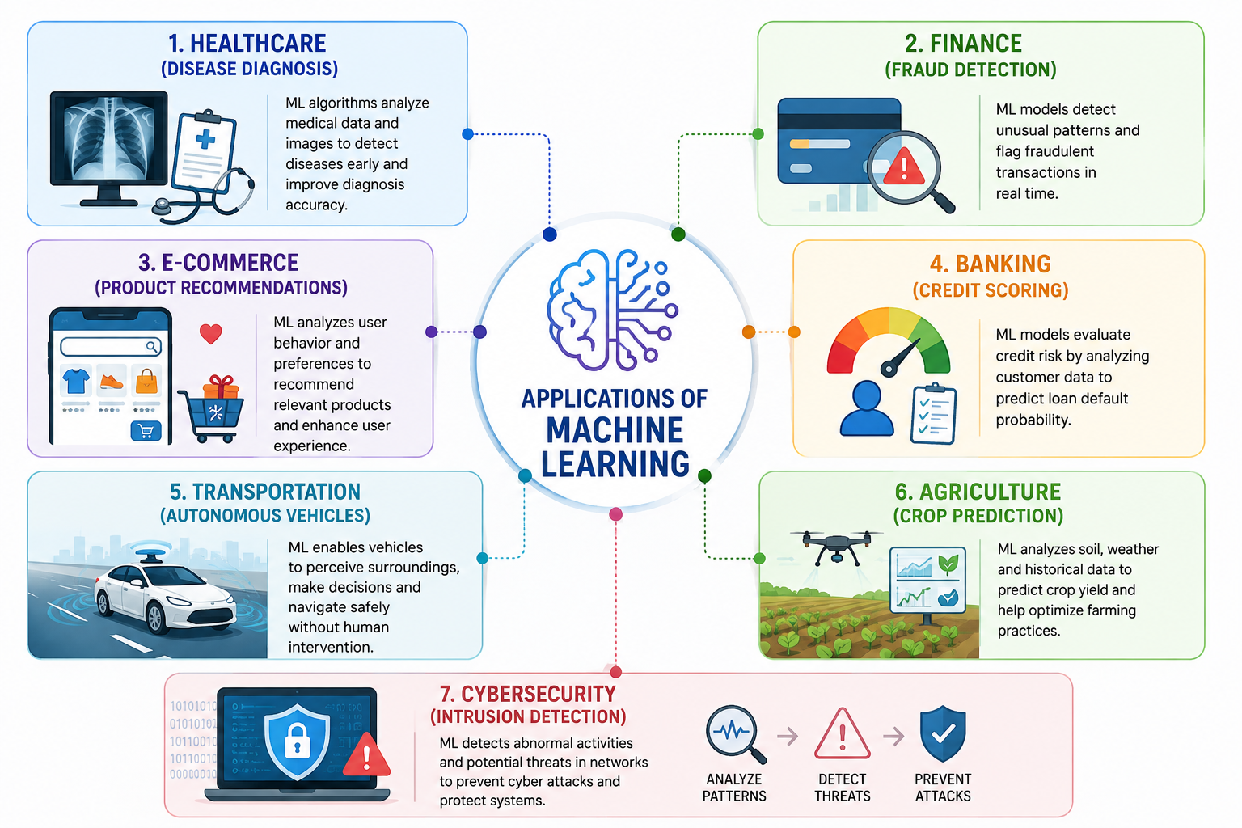
Applications of Machine Learning
Notes:
Machine learning has profoundly transformed various industries, extending its reach far beyond theoretical concepts. Healthcare leverages machine learning for early and accurate disease diagnosis, enabling personalized treatment plans and improving patient outcomes. Financial institutions employ these sophisticated algorithms for fraud detection, meticulously analyzing transaction patterns to identify and prevent illicit activities, thus safeguarding assets and maintaining trust.
E-commerce platforms heavily rely on machine learning for product recommendations, creating highly personalized shopping experiences that anticipate customer needs and preferences, thereby driving sales and enhancing user engagement. Banking sectors utilize machine learning for credit scoring, assessing risk profiles with greater accuracy and efficiency, which facilitates informed lending decisions. Transportation systems integrate machine learning into autonomous vehicles, paving the way for safer and more efficient modes of travel through continuous learning and adaptation.
Agriculture benefits from machine learning through crop prediction, optimizing planting and harvesting schedules, and enhancing yield management by analyzing environmental factors and historical data. Cybersecurity applications also harness machine learning for intrusion detection, identifying and neutralizing threats with increased speed and precision, consequently strengthening digital defenses. These diverse applications collectively demonstrate the pervasive and impactful nature of machine learning in addressing complex challenges across numerous domains.

Slide 31
THE END
Notes:
Well, here we are at "The End" of our journey through the fascinating world of Machine Learning. We've demystified models, explored the roles of weights and biases, and journeyed through the diverse landscapes of supervised, unsupervised, and reinforcement learning. We also uncovered the systematic process of how ML works and its transformative applications across countless industries, from healthcare to finance, and even agriculture. As we conclude, I urge you to look beyond these slides. Machine Learning isn't just a technical concept; it's a powerful lens through which we can understand and reshape our world. It's an invitation to innovate, to solve complex problems, and to build a future where data-driven intelligence enhances every aspect of our lives. So, as you leave today, remember that the end of this presentation is merely the beginning of your own exploration. Embrace the potential of Machine Learning, and let's together unlock a future of unparalleled possibilities. Thank you.

