Slide 1
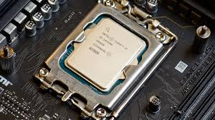
Chapter 2
Processor Design

Slide 2
Processor design
Processor design is about building the brain of a computer that can represent information and perform operations efficiently.

Slide 3
Introduction
When you run a program, how does the processor actually understand numbers and perform calculations?

Slide 4
Processor Organization
(How CPU is structured)
Basic components:
ALU (Arithmetic Logic Unit) → performs calculations
Control Unit → directs operations
Registers → fast storage inside CPU
Buses → data movement pathways
Processor organization defines how these components are connected and work together.

Slide 5
Information Representation
Before a processor computes anything, it must represent data in binary.
Key Concepts:
Binary numbers (0s and 1s)
Bits, bytes, words

Slide 6
Number Formats
How does a computer represent negative numbers if it only understands 0 and 1?
A number format defines how numbers (positive, negative, fractional) are represented using binary.

Slide 7
Number Formats
Integer Representation
Unsigned numbers
Signed numbers:
  Sign-magnitude
  1’s complement
  2’s complement (most important)

Slide 8
Number Formats
Unsigned Binary Numbers
Concept:
Only non-negative numbers (0 and positive) are represented
All bits are used for magnitude
Example (4-bit):
Binary | Decimal
0000 | 0
0001 | 1
0101 | 5
1111 | 15

Slide 9
Number Formats
Signed Number Representations
Unsigned cannot represent negative numbers—so we need signed formats.

Slide 10
Number Formats
Signed Number Representations
Sign-Magnitude Representation
Concept:
MSB (Most Significant Bit) = sign
  0 → positive
  1 → negative
Remaining bits → magnitude
Example (4-bit):
Binary | Meaning
0101 | +5
1101 | -5

Slide 11
Number Formats
Signed Number Representations
1’s Complement
Concept:
Negative number = invert all bits of positive number
Example:
+5 = 0101
-5 = 1010 (invert bits)

Slide 12
Number Formats
Signed Number Representations
2’s Complement (Most Important)
Concept:
Negative number = invert bits + 1
Example: Represent -5 (4-bit)
Step 1: +5 = 0101
Step 2: Invert → 1010
Step 3: Add 1 → 1011
So, -5 = 1011

Slide 13
Instruction
A processor cannot understand human language or even high-level programming languages. It only understands instructions in binary form.
An instruction is a command given to the CPU to perform a specific operation.
Example:
ADD A, B → Add contents of A and B
Internally → converted into binary machine code

Slide 14
Basic Structure of an Instruction
Opcode (Operation Code) → What to do
Operand(s) → On which data
Example:
ADD A, B
Opcode → ADD
Operands → A, B

Slide 15
Types of Instruction
1. Data Transfer Instructions
Purpose:
Move data from one place to another
Examples:
MOV A, B → Copy data from B to A
LOAD A, 1000 → Load data from memory address 1000
STORE A, 2000 → Store A into memory

Slide 16
Types of Instruction
2. Arithmetic Instructions
Purpose:
Perform mathematical operations
Examples:
ADD A, B → A = A + B
SUB A, B → A = A - B
MUL A, B → A = A × B
DIV A, B → A = A ÷ B

Slide 17
Types of Instruction
3. Logical Instructions
Purpose:
Perform bitwise operations
Examples:
AND A, B
OR A, B
NOT A
XOR A, B
Example (Binary):
A = 1010
B = 1100
AND → 1000
OR → 1110

Slide 18
Types of Instruction
4. Control Flow Instructions
Purpose:
Change the normal sequence of execution
Examples:
JUMP 200 → Go to instruction at address 200
CALL FUNC → Call a function
RETURN → Go back after function ends
BRANCH if ZERO → Conditional jump

Slide 19
Types of Instruction
Summary
Type | Purpose | Example | Analogy
Data Transfer | Move data | MOV A, B | Moving objects
Arithmetic | Calculate | ADD, SUB | Calculator
Logical | Bit operations | AND, OR | Filtering rules
Control Flow | Change execution | JUMP, CALL | Navigating a book

Slide 20
Instruction
A program is nothing but a sequence of instructions, and these instruction types together enable the CPU to perform everything—from simple calculations to complex applications like AI or video processing

Slide 21
Instruction
If a program had no control flow instructions, what would happen?

Slide 22
Fixed-Point Arithmetic
What is Fixed-Point Arithmetic?
Fixed-point representation means numbers are stored in binary where the position of the decimal (binary point) is fixed.
It’s different from floating-point, where the decimal point “floats”

Slide 23
Fixed-Point Arithmetic
How Numbers are Represented
Suppose we have n bits total. We decide how many bits are for the integer part and how many for the fractional part.
Example: Qm.n format
Qm.n → m bits for integer, n bits for fraction.
Total bits = m + n.
The binary point is always fixed after m bits.
🔹 Example (Q4.4 → 8-bit fixed-point):

Slide 24
Fixed-Point Arithmetic
Fixed at 4th position
Suppose we have 8-bit numbers, and we decide:
First 4 bits = integer part
Last 4 bits = fractional part
So the binary point is always between bit 4 and bit 5:
xxxx.xxxx ← binary point fixed here

Slide 25
Fixed-Point Arithmetic
Addition in Fixed-Point Arithmetic
Rule
Both numbers must be in the same fixed-point format (same number of integer and fractional bits).
Align the binary point.
Perform normal binary addition.
If result exceeds bit range → overflow occurs.

Slide 26
Fixed-Point Arithmetic
Addition in Fixed-Point Arithmetic
Example – Q3.2 format (3 integer bits, 2 fractional bits)
iii.ff (total 5 bits: 3 integer + 2 fraction)
Add 3.25 and 1.75
Step 1: Convert to binary (Q3.2)
3.25 = 11.01₂ → 011.01
1.75 = 01.11₂ → 001.11
Step 2: Add
011.01 (3.25)
+ 001.11 (1.75)
-----------
101.00 (5.00)
Result = 5.0

Slide 27
Fixed-Point Arithmetic
Example – Overflow Case
Add 7.50 and 2.75 in Q3.2 format
Step 1: Convert to Binary
7.50 = 111.10
2.75 = 010.11
Step 2: Add
111.10 (7.50)
+ 010.11 (2.75)
-----------
1010.01 (Invalid in Q3.2, overflow!)

Slide 28
Fixed-Point Arithmetic
Fixed-Point Subtraction
Rule
Both numbers must be in the same fixed-point format.
Subtraction is usually performed using Two’s Complement:
A−B=A+(Two’s Complement of B)
Align the binary point.
Perform binary addition.
Check for overflow.

Slide 29
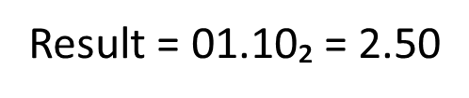
Fixed-Point Arithmetic
Example – Q3.2 format (3 integer bits, 2 fractional bits)
Subtract 3.25 – 1.75
Step 1: Convert operands
3.25 = 11.01₂ → 011.01
1.75 = 01.11₂ → 001.11
Step 2: Take two’s complement of 001.11
Step 3: Add
001.11 → 110.01 (two’s complement)
011.01 (3.25)
+ 110.01 (-1.75)
----------
1001.10 → 001.10 (after ignoring carry)

Slide 30
Fixed-Point Arithmetic
Fixed-Point Multiplication
Rule of Multiplication
Multiply the two binary numbers as integers (ignore binary point at first).
The binary point in the result is placed by adding the number of fractional bits from both operands.
If operands are in Qm.n and Qp.q → result is in Q(m+p).(n+q).
Overflow can occur if result needs more bits than available.

Slide 31
Fixed-Point Arithmetic
Fixed-Point Multiplication
Example – Q3.2 × Q3.2
Multiply 1.50 × 0.75
Step 1: Convert numbers
1.50 = 01.10
0.75 = 00.11
Step 2: Multiply as integers (remove binary point)
0110 (decimal 6)× 0011 (decimal 3)= 00010010 (decimal 18)
Step 3: Adjust binary point
Each operand has 2 fractional bits → total 4 fractional bits.
So 00010010 → 0001.0010
Result = 1.125

Slide 32
ALU Design
ALU is the core unit where all arithmetic and logical operations happen.
Operations:
Addition, subtraction
AND, OR, XOR
Comparisons

Slide 33
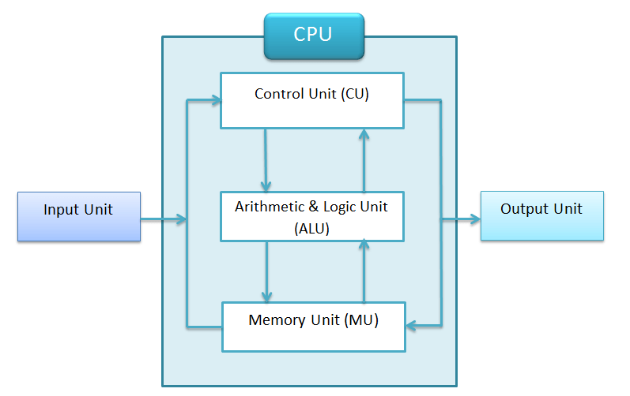
Arithmetic Logic Unit (ALU)
What is ALU?
The Arithmetic Logic Unit (ALU) is the part of a microprocessor (or CPU) that performs mathematical (arithmetic) and decision-making (logic) operations

Slide 34
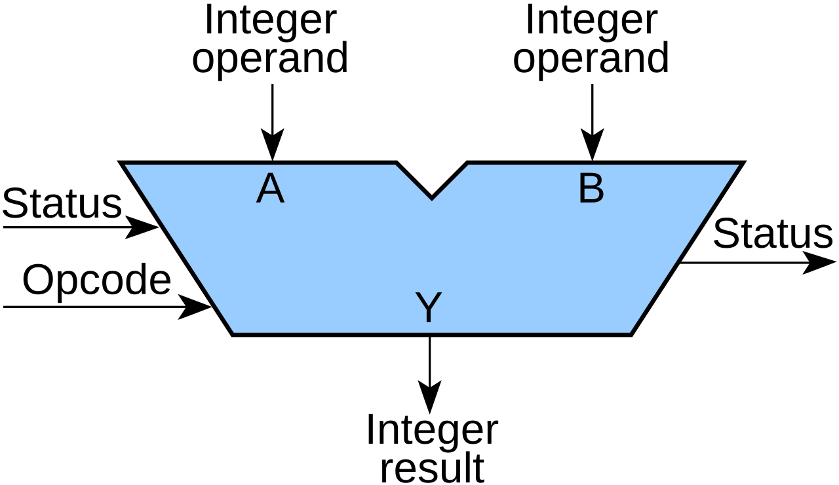
Basic ALU Organization

Slide 35
Floating-Point Arithmetic
Floating Point
The term “floating point” in floating-point arithmetic refers to the way numbers are represented, where the decimal (or binary) point “floats” rather than being fixed.

Slide 36
Floating-Point Arithmetic
Fixed-point vs Floating-point
Fixed-point number: The decimal (or binary) point is at a fixed position. Example: 123.45 in a fixed-point system might always have 2 digits after the decimal.
Floating-point number: The decimal point can “float” to different positions depending on the magnitude of the number. Example:
  123.45 = 1.2345×10²
  0.00123 = 1.23×10⁻³
In both cases, the mantissa stores the significant digits, and the exponent indicates where the decimal (or binary) point is.

Slide 37
Floating-Point Arithmetic
Example : Simple Binary Floating Point Operation
Add : A=1.01×2³, B=1.11×2²
Step 1: Align exponents
A exponent = 3, B exponent = 2 → shift B right by 1 bit B = 0.111×2³
Step 2: Add mantissas
1.01+0.111=10.001(binary)
Step 3: Normalize
10.001×23=1.0001×2⁴
Result: R=1.0001×2⁴

Slide 38
Arithmetic Processors
If a CPU can already add and subtract, why do we need special arithmetic processors?

Slide 39
Arithmetic Processors
Arithmetic processors are specialized hardware units designed to perform arithmetic operations (especially complex ones) faster and more efficiently than a basic ALU.
They are optimized for:
Speed
Parallelism
Precision

Slide 40
Arithmetic Processors
Why Are Arithmetic Processors Needed?
Problem with Basic ALU
Handles simple operations well (ADD, SUB)
Slower for:
  Multiplication
  Division
  Floating-point operations

Slide 41
Arithmetic Processors
Solution
Use dedicated hardware units:
Faster execution
Reduced CPU workload
Better performance for scientific and multimedia tasks

Slide 42
Stack Processor
What is a Stack?
A stack is a data structure that follows:
LIFO (Last In, First Out)
Basic Operations:
PUSH → Insert data into stack
POP → Remove data from stack

Slide 43
Stack Processor
Do we always need registers like A, B, C to perform operations?

Slide 44
Stack Processor
A stack processor is a CPU design where all operations are performed using a stack instead of explicitly named registers.
Key point:
Operands are implicitly taken from the stack
Results are pushed back to the stack

Slide 45
Stack Processor
Example :
Expression:
(A+B)×C
Step-by-step Execution: Stack Visualization:
PUSH A
PUSH B
ADD → (A+B)
PUSH C
MUL → (A+B) × C
Step | Stack
PUSH A | A
PUSH B | A, B
ADD | A+B
PUSH C | A+B, C
MUL | Result

Slide 46


