Slide 1
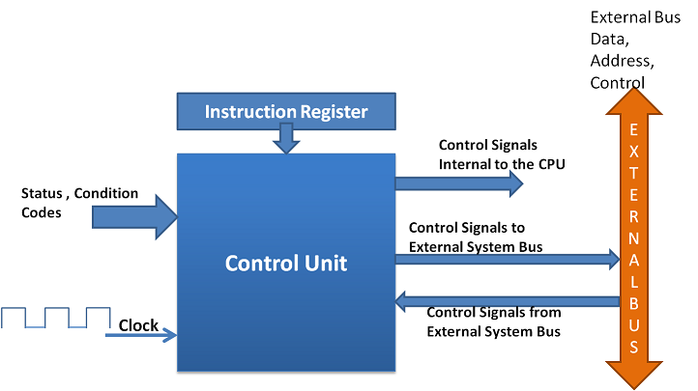
Chapter 3
Control Design

Slide 2
Control Design: Introduction
The control unit (CU) is the brain of the CPU that directs all operations.
Definition
Control design refers to the method of generating control signals that coordinate:
Data movement
Arithmetic/logic operations
Instruction execution

Slide 3
Control Design: Introduction
Main Responsibilities
Fetch instructions from memory
Decode instructions
Generate control signals
Coordinate ALU, registers, memory, and I/O
Control unit = Traffic controller of the CPU

Slide 4
Instruction Sequence
Instruction execution follows a sequence of micro-operations.
Basic Instruction Cycle
Fetch
  Instruction is fetched from memory
  PC → MAR → Memory → IR
Decode
  Instruction is interpreted
  Identify opcode and operands
Execute
  Perform required operation
Store (Write-back)
  Save result (if needed)

Slide 5
Instruction Sequence
Example
Instruction:
ADD R1, R2
Sequence:
Fetch instruction
Decode (ADD operation)
Execute: R1 ← R1 + R2
Store result in R1

Slide 6
Instruction Interpretation
Instruction interpretation means translating an instruction into control signals.
Steps
Identify opcode
Determine addressing mode
Generate micro-operations

Slide 7
Instruction Interpretation
Example
Instruction:
LOAD R1, [100]
Interpretation:
MAR ← 100
MDR ← Memory[100]
R1 ← MDR
Each step is controlled by specific control signals.

Slide 8
Hardwired Control
Hardware control is a control unit that uses fixed electronic circuits to generate control signals for executing CPU instructions.
Example
If the CPU receives the instruction ADD R1, R2, the hardwired control unit immediately generates the required control signals through its logic circuits to:
Read R1.
Read R2.
Perform addition in the ALU.
Store the result in R1.
No microprogram or control memory is used.

Slide 9
Components Hardwired Control Unit
Instruction Register (IR) – Holds the current instruction to be executed.
Opcode Decoder – Decodes the operation code (opcode) of the instruction.
Sequence Counter (SC) – Keeps track of the execution steps (timing sequence).
Control Logic Gates – Generate the required control signals using combinational logic circuits.
Timing/Clock Circuit – Produces clock pulses to synchronize all operations.
Flip-Flops – Store temporary control states and status information.
Control Signal Generator – Sends control signals to the ALU, registers, memory, and input/output devices.

Slide 10
Advantages of Hardwired Control Unit
Very fast – Control signals are generated directly by hardware, so instructions execute quickly.
High performance – Suitable for processors that require high-speed operation.
Efficient for simple instruction sets – Works well with processors that have a small and simple instruction set (such as RISC processors).
No control memory needed – It does not require a separate memory to store microinstructions.

Slide 11
Disadvantages of Hardwired Control Unit
Difficult to modify – Any change in the instruction set requires redesigning the hardware.
Complex design – Becomes complicated as the instruction set grows larger.
Less flexible – New instructions or features cannot be added easily.
Time-consuming to develop – Designing and debugging the hardware control logic

Slide 12
Hardwired Control Unit
Design Methods
Step-by-step
Identify instruction set
Define micro-operations
Create control signals
Design logic circuits (using Boolean expressions)

Slide 13
Micro-programmed Control
Definition
A micro-programmed control unit is a control unit in which the control signals are generated by executing microinstructions stored in a special memory called control memory.

Slide 14
Instructions and Microinstructions
Definition
Instruction: A machine-level command given by a programmer that tells the CPU to perform a specific task (e.g., ADD, MOV).
Microinstruction: A low-level control signal instruction used inside the CPU to execute a machine instruction step by step.

Slide 15
Microinstruction
The Control Unit (CU) is the part of the CPU that interprets (understands) an instruction and breaks it into a series of small steps called microinstructions.
These microinstructions tell different parts of the computer exactly what to do, one step at a time.

Slide 16
Microinstruction
Simple Example
ADD R1, R2
The control unit does not perform the addition in one big step. Instead, it converts the instruction into several microinstructions, such as:
Read the value from R1.
Read the value from R2.
Send both values to the Arithmetic Logic Unit (ALU).
Tell the ALU to perform addition.
Store the result back into R1.
Update the status flags (such as Zero or Carry).

Slide 17
Microinstruction
Illustration:
ADD R1, R2
Step 1 → Load R1 into ALU input A.
Step 2 → Load R2 into ALU input B.
Step 3 → Perform ADD operation.
Step 4 → Store result in R1.
Step 5 → Update status flags.

Slide 18
Micro-programmed Control
How it works
A machine instruction is fetched from memory.
The control unit translates it into a sequence of microinstructions.
These microinstructions are stored in control memory (ROM or writable control store).
Each microinstruction generates control signals.
These signals direct the CPU operations (ALU operations, data transfer, etc.).

Slide 19
Micro-programmed Control
Components
Control Memory (CM): Stores microinstructions.
Control Address Register (CAR): Holds address of next microinstruction.
Control Data Register (CDR): Holds current microinstruction.
Microprogram Sequencer: Determines the next instruction sequence.

Slide 20
Micro-programmed Control
Advantages
Flexible (easy to modify control logic)
Easier to design and debug
Suitable for complex instruction sets (CISC)
Disadvantages
Slower than hardwired control (because of memory access)
Requires extra memory for control storage

Slide 21

Thank You

