Slide 1
Chapter 4
Memory Organization

Slide 2
Memory Organization
Memory organization defines how data is:
Stored
Accessed
Managed
Goal: Balance speed, cost, and capacity

Slide 3
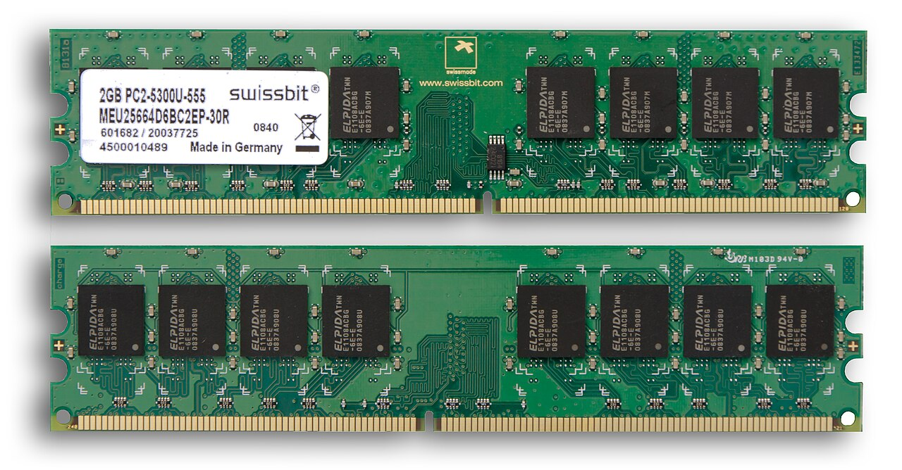
RAM (Random Access Memory)

Slide 4
RAM (Random Access Memory)
Volatile memory: Data is lost when power is turned off.
Types:
  SRAM (Static RAM) – Faster, uses flip-flops, costly, used in cache.
  DRAM (Dynamic RAM) – Slower, cheaper, uses capacitors, used in main memory.
Characteristics:
  High speed
  Limited capacity
  Read/Write capability

Slide 5
RAM Organization
1. Introduction
RAM (Random Access Memory) is the primary volatile memory in a computer system.
It temporarily stores data and instructions currently in use by the CPU.
The organization of RAM defines how data is arranged, addressed, and accessed inside the memory chip.

Slide 6
RAM Organization
2. Basic Structure of RAM
A RAM chip is organized as an array of memory cells, where:
Rows = Word lines (address lines)
Columns = Bit lines (data lines)
Each cell stores 1 bit (0 or 1), usually implemented using a flip-flop (SRAM) or capacitor (DRAM).
A RAM can be described as having m words of n bits each.
Example: A 1K × 8 RAM has 1024 memory locations (words), each storing 8 bits.

Slide 7
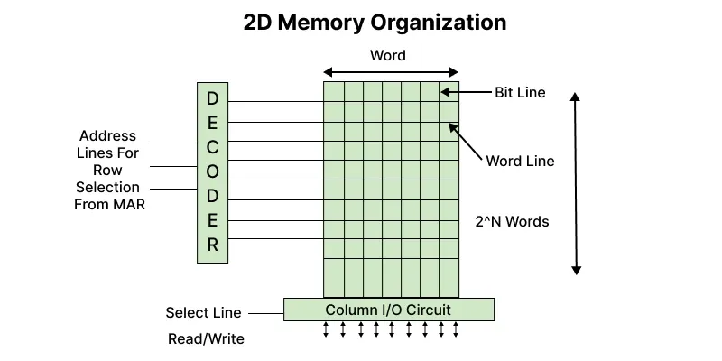
RAM Organization

Slide 8
RAM Organization
3. Addressing in RAM
Each memory word has a unique address.
The address bus selects which word (row) is active.
The data bus is used to read/write the content of the selected word.
Address lines calculation:
If a RAM has N locations, the number of address lines required = log₂(N).
Example: For 1K = 1024 = 2¹⁰ locations, we need 10 address lines.

Slide 9
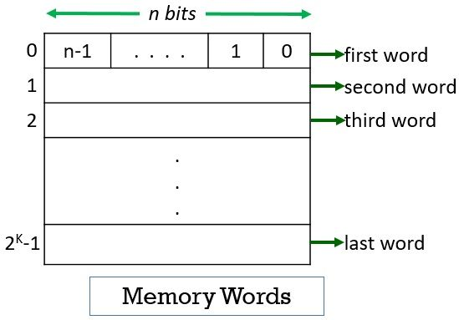
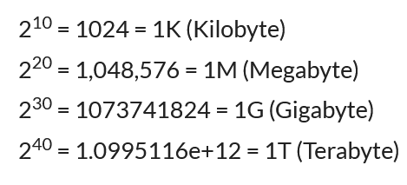
Memory Locations and Addresses

Slide 10
RAM Organization
4. RAM Cell Organization
a) SRAM Cell
Built using 6 transistors (bistable flip-flop).
Holds data as long as power is ON.
Faster, but costly and takes more space.
Used in cache memory.

Slide 11
RAM Organization
4. RAM Cell Organization
b) DRAM Cell
Built using 1 transistor + 1 capacitor.
Capacitor stores charge = bit (1), absence of charge = (0).
Must be refreshed periodically (due to leakage).
Cheaper, denser, but slower.
Used in main memory.

Slide 12
RAM Organization
Example
Suppose we have a 4K × 8 RAM chip:
4K = 4096 locations → needs log₂(4096) = 12 address lines.
Each location stores 8 bits (1 byte).
So total storage = 4K × 8 = 32 Kbits = 4 KB.

Slide 13
RAM Organization
A RAM chip has 8K × 16 organization.
Questions:
How many address lines are required?
What is the total storage capacity in bits and bytes?

Slide 14
RAM Organization
Step 1: Convert K to actual value
8K=8×1024=8192=2^13
Step 2: Number of Address Lines
Use the formula:
Number of address lines=log⁡2(N)
log⁡2(8192)=13
Answer: 13 address lines

Slide 15
RAM Organization
Step 3: Total Storage Capacity
Total bits=8192×16=131072 bits
Convert to bytes:
131072/8=16384 bytes =16 KB
Final Answer
Address lines = 13
Capacity = 131072 bits = 16 KB

Slide 16
RAM Organization
A system requires 64 KB memory, and each chip available is 16K × 8.
Questions:
How many chips are needed?
How many address lines are required for the whole memory?
How many lines are used for chip selection?
(Expected thinking)
Each chip = 16K × 8 = 16 KB
Total = 64 KB → need 4 chips
64 KB = 2^16 → 16 address lines
Chip selection = 2 lines (to select 4 chips)

Slide 17
RAM Organization
A memory system has 4 memory banks, each of size 1K × 8.
Questions:
What is the total memory capacity?
How are addresses distributed among banks?
Which bank will store address 2050?
(Expected thinking)
Total memory = 4K × 8
Bank selection = Address mod 4
2050 mod 4=2 → Bank 2

Slide 18
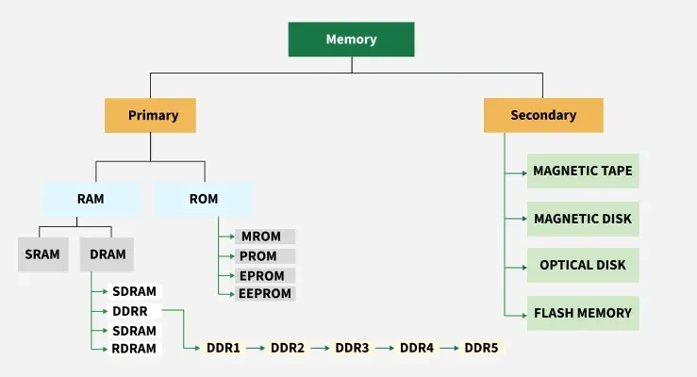
Classification of Memory

Slide 19
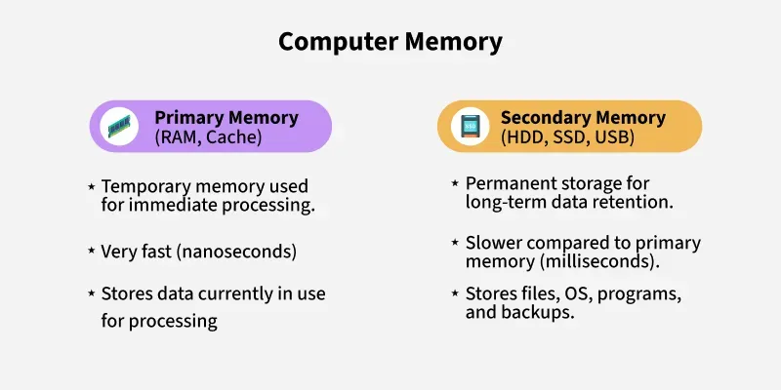
Classification of Memory

Slide 20
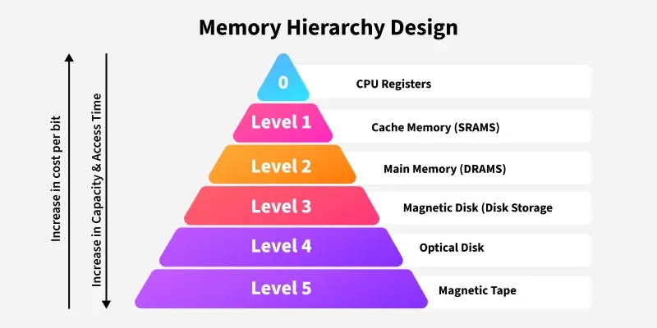
Memory Hierarchy

Slide 21
Classification of Computer Memory
Primary Memory Devices
ROM (Read Only Memory)
Non-volatile: Data retained even without power.
Types:
  PROM (Programmable ROM)
  EPROM (Erasable Programmable ROM)
  EEPROM (Electrically Erasable Programmable ROM)
Characteristics:
  Permanent storage
  Non-volatile
  Read-only (or rarely rewritten)

Slide 22
Classification of Computer Memory
Primary Memory Devices
Cache Memory
Very high-speed memory located between CPU and RAM.
Stores frequently accessed data/instructions.
Levels: L1 (inside CPU), L2, L3.
Characteristics:
  Very fast
  Small capacity
  Expensive
  Used to speed up processing and synchronize with the high-speed CPU.

Slide 23
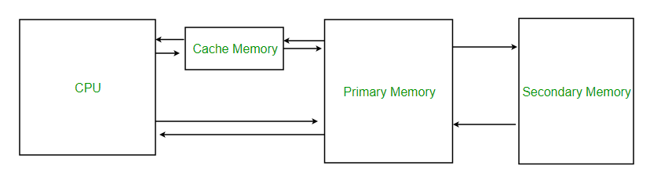
Cache Memory

Slide 24
Cache Performance
When the processor needs to read or write a location in the main memory, it first checks for a corresponding entry in the cache.
If the processor finds that the memory location is in the cache, a Cache Hit has occurred and data is read from the cache.
If the processor does not find the memory location in the cache, a cache miss has occurred.
For a cache miss, the cache allocates a new entry and copies in data from the main memory, then the request is fulfilled from the contents of the cache.

Slide 25
Cache Performance
The performance of cache memory is frequently measured in terms of a quantity called Hit ratio.
Hit Ratio(H) = hit / (hit + miss) = no. of hits/total accesses
Miss Ratio = miss / (hit + miss) = no. of miss/total accesses = 1 - hit ratio(H)
We can improve Cache performance using higher cache block size, and higher associativity, reduce miss rate, reduce miss penalty, and reduce the time to hit in the cache.

Slide 26
Problem 1
A cache memory receives 2,000 memory accesses. Out of these:
Number of cache hits = 1,700
Number of cache misses = 300
Find:
Hit Ratio (H)
Miss Ratio

Slide 27
Solution of Problem 1
Hit Ratio (H)
= Hits / Total Accesses
= 1700 / 2000
= 0.85 = 85%
Miss Ratio
= Misses / Total Accesses
= 300 / 2000
= 0.15 = 15%
Answer:
Hit Ratio = 85%
Miss Ratio = 15%

Slide 28
Problem 2
A processor performs 10,000 memory accesses. The cache has a Hit Ratio of 92%.
Find:
Number of cache hits
Number of cache misses
Miss Ratio

Slide 29
Solution of Problem 2
Hits
= 92% × 10,000
= 9,200 hits
Misses
= 10,000 − 9,200
= 800 misses
Miss Ratio
= 800 / 10,000
= 0.08 = 8%
(or 1 − 0.92 = 0.08)
Answer:
Cache Hits = 9,200
Cache Misses = 800
Miss Ratio = 8%

Slide 30
Classification of Computer Memory
Secondary Memory Devices
Magnetic Storage
Hard Disk Drives (HDDs): Uses spinning disks coated with magnetic material.
Characteristics:
  High storage capacity
  Moderate speed
  Cheaper per GB
  Mechanical (wear & tear)

Slide 31
Classification of Computer Memory
Secondary Memory Devices
Solid State Drives (SSD)
Uses flash memory (no moving parts). (The "flash" in flash memory means fast erasing of data in blocks, as if it happens in a flash.)
Characteristics:
  Faster than HDD
  More durable
  Higher cost per GB
  Lower power consumption

Slide 32
Classification of Computer Memory
Secondary Memory Devices
Optical Discs
CDs, DVDs, Blu-ray: Use lasers to read/write.
Characteristics:
  Portable
  Moderate storage capacity
  Slower access speed
  Useful for media distribution

Slide 33
Classification of Computer Memory
Secondary Memory Devices
Magnetic Tapes
Sequential access storage, used for backup. (Sequential access storage means you must go step by step (like reading a book page by page) to reach your data, instead of jumping directly to it.)
Characteristics:
  Very large storage capacity
  Inexpensive
  Slow (sequential access)

Slide 34
Classification of Computer Memory
Tertiary and Virtual Memory
Tertiary Storage: Automated storage libraries (robotic arms load tapes/discs).
Virtual Memory: Part of secondary storage used as an extension of RAM when RAM is insufficient.

Slide 35
Classification of Computer Memory
Tertiary Memory
Tertiary storage is a level of storage that is used mainly for archiving and backup of very large amounts of data.
Example:
Cloud Archival Storage (modern)
Services like Amazon Glacier, Google Coldline → used for very infrequently accessed archival data.

Slide 36
Classification of Computer Memory
Virtual Memory
Virtual memory is a memory management technique in operating systems that gives the illusion of having more RAM than physically available.

Slide 37
Classification of Computer Memory
How It Works
Programs request memory from the OS.
If physical RAM is full, the OS moves less-used data from RAM to the disk (swap space).
The freed-up RAM can then be used by active programs.
When the swapped-out data is needed again, it is brought back into RAM.
This process is called paging.

Slide 38
Classification of Computer Memory
Example of Virtual Memory
Suppose your computer has 4 GB of RAM.
You open programs that need 6 GB of memory.
The OS keeps the most active 4 GB in RAM and shifts the less active 2 GB to the hard disk’s virtual memory (swap file).
This allows programs to run, though performance may be slower.

Slide 39
Key Characteristics of Memory Devices
Memory Type | Volatility | Speed | Capacity | Cost | Usage
Cache | Volatile | Very High | Very Low | Very High | Speeds up CPU
RAM | Volatile | High | Medium | High | Running programs
ROM | Non-volatile | High | Low | Medium | Boot instructions
HDD | Non-volatile | Moderate | Very High | Low | Mass storage
SSD | Non-volatile | Very High | High | Higher | Faster storage
Optical Disc | Non-volatile | Low | Low-Medium | Low | Media distribution
Magnetic Tape | Non-volatile | Very Low | Very High | Very Low | Backup/archives

Slide 40
Memory Hierarchy
A layered structure of memory types based on:
Speed
Cost
Size
Hierarchy Levels (Top → Bottom)
Registers (fastest, smallest)
Cache memory
Main memory (RAM)
Secondary memory

Slide 41


