Slide 1
Chapter 5
System Organization

Slide 2
Introduction
Key Components of a Computer System?
CPU (Central Processing Unit)
Performs computation and control.
Memory Unit
Stores instructions and data.
Input/Output (I/O) Devices
Interface with the external world.
System Bus
Connects all components.

Slide 3
System organization
How different hardware components of a computer system are interconnected.
How they interact to perform operations.
Goal: Efficient data transfer and coordination among components.

Slide 4
Bus Control
A bus is a shared communication pathway that connects system components.
Types of Buses:
Data Bus – Transfers data
Address Bus – Carries memory addresses
Control Bus – Carries control signals
Bus Control Functions:
Determines who can use the bus at a given time
Ensures proper timing and synchronization
Manages read/write operations

Slide 5
I/O interface
The method that is used to transfer information between internal storage and external I/O devices is known as I/O interface.
The CPU is interfaced using special communication links by the peripherals connected to any computer system.
There exists special hardware components between CPU and peripherals to supervise and synchronize all the input and output transfers that are called interface units.

Slide 6
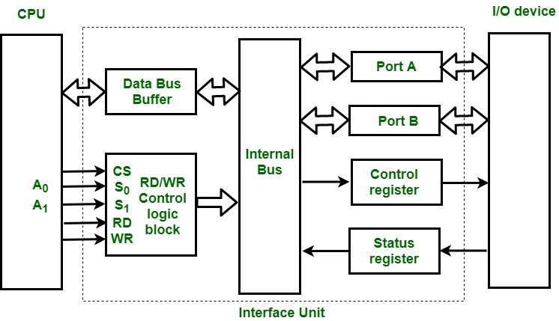
I/O interface

Slide 7
Mode of Transfer
The binary information that is received from an external device is usually stored in the memory unit.
CPU processes the information but the source and target is always the memory unit.
Data transfer between CPU and the I/O devices may be done in different modes:
Programmed I/O.
Interrupt- initiated I/O.
Direct memory access( DMA).

Slide 8
Programmed I/O (PIO)
Programmed I/O is a method of data transfer between the CPU and a peripheral device where the CPU is responsible for managing every aspect of the operation.
CPU continuously check the status of the device to see if it is ready—a process known as polling or busy-waiting.

Slide 9
Polling
Polling is a software technique that uses a program to check the status of devices.
The device can be a disk drive or any other peripheral device in the computer.
The program polls the device for information, such as if it has data available or not.

Slide 10
How Programmed I/O Works
The CPU sends an I/O command to the device interface.
The CPU enters a loop where it repeatedly reads the device's status register.
If the status register indicates the device is not yet ready, the CPU continues to poll.
Once the device is ready, the CPU transfers the data between the device and memory.
The process repeats until all data has been transferred.

Slide 11
Kernel Space
Kernel space is the protected area of a computer’s memory where the operating system kernel runs and performs critical tasks.
Area | Purpose
User space | Where application programs run
Kernel space | Where the operating system kernel runs

Slide 12
Why is kernel space needed?
The kernel needs special privileges to access hardware, memory, files, and other system resources. Keeping it separate from user space:
  Protects the operating system from application errors.
  Prevents applications from directly accessing critical hardware.
  Improves system security and stability.

Slide 13
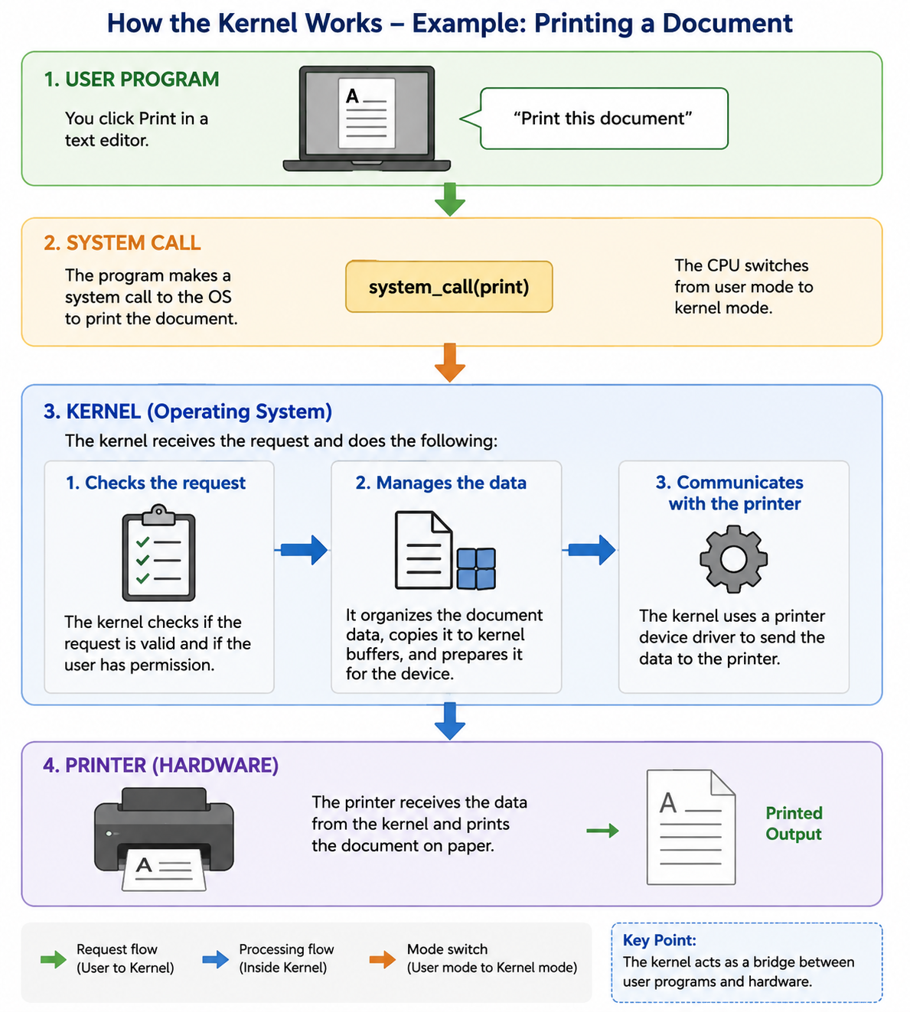
How does the kernel work?

Slide 14
System Call
A system call is a way for a program to request a service from the operating system (OS).
Suppose:
Application (your program) = Customer
Operating System (OS) = Restaurant kitchen
System call = Waiter who takes your order to the kitchen
The application cannot directly access hardware (disk, memory, keyboard, network).
Instead, it asks the OS to perform these tasks through system calls.

Slide 15
Common System Calls
System Call | Purpose
open() | Open a file
read() | Read data from a file
write() | Write data to a file
close() | Close a file
fork() | Create a new process (Unix/Linux)
exec() | Run another program
exit() | Terminate a process

Slide 16
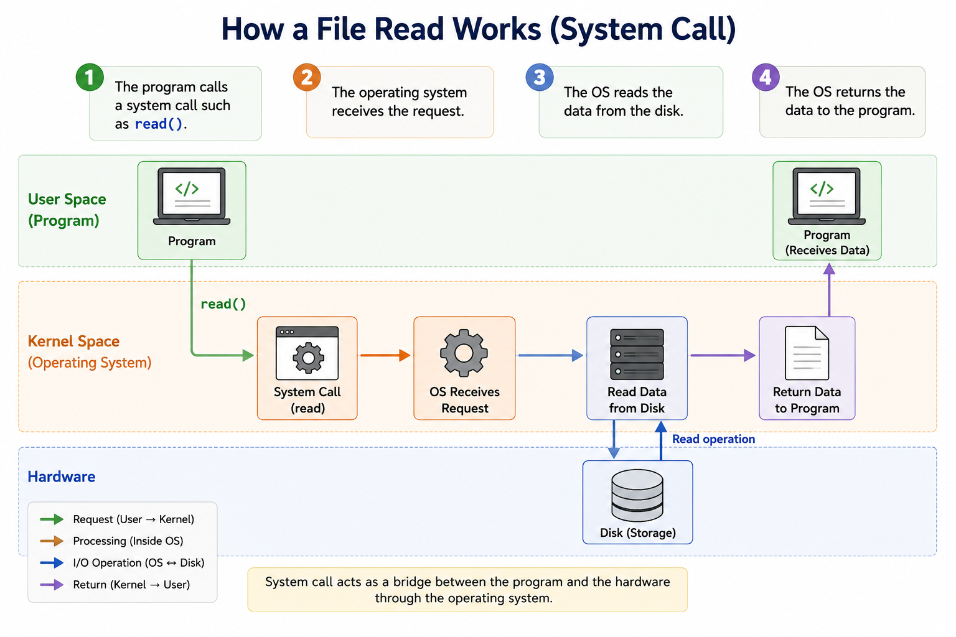
How does System Call work?

Slide 17
Example − Printing “Computer" String
Step-by-Step Execution
Step 1 − The user opens the printer for writing using a system call.
Step 2 − If the printer is busy, the system call either fails with an error code or blocks until the printer becomes available.
Step 3 − Once available, the process makes a system call to print the string.
Step 4 − The OS copies the user buffer into kernel space for processing.
Step 5 − The OS checks printer availability and copies the first character ‘C' to the printer's data register using memory-mapped I/O.
Step 6 − The system marks ‘o' as the next character to be printed and waits.

Slide 18
Example − Printing “Computer" String
Step-by-Step Execution
Step 7 − After copying the character, the OS checks if the printer is ready for the next character.
Step 8 − Writing to the data register sets the printer status to "not ready" in the status register.
Step 9 − When the printer controller finishes processing the current character, it updates the status register to indicate readiness.
Step 10 − The OS continuously polls the status register, waiting for the "ready" status.
Step 11 − Once ready, the OS sends the next character and repeats the process.
Step 12 − This loop continues until all characters in “Computer" have been printed.
Step 13 − Control returns to the user process after completing the entire string transfer.

Slide 19
Real-Life Example of Interrupt-Initiated I/O: Keyboard
Suppose you are typing a document:
1. CPU is working on another task
The CPU may be processing a program or displaying something on the screen.
2. You press a key
For example, you press the letter “A” on the keyboard.
3. Keyboard interface detects the key press
The keyboard controller recognizes that new data is available.
4. Interrupt signal is sent to the CPU
The keyboard interface sends an Interrupt Request (IRQ) to inform the CPU:
  “I have new data for you.”
5. CPU temporarily stops its current task
The CPU pauses its current work for a very short time.
6. CPU executes the Interrupt Service Routine (ISR)
The CPU runs a special program that reads the key information from the keyboard.
7. CPU returns to its previous task
After handling the keyboard input, the CPU returns to exactly where it stopped and continues its original program.

Slide 20
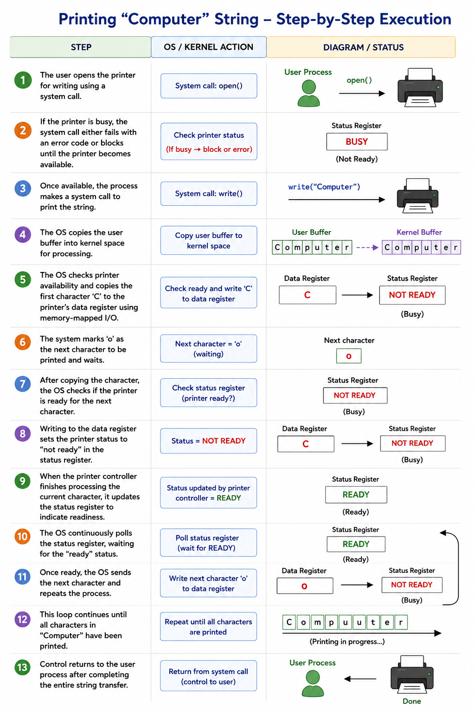

Slide 21
Characteristics of Polling
Aspect | Description
CPU Involvement | High − CPU actively manages every byte transfer
Polling Method | Continuous status checking until device is ready
Efficiency | Low − CPU cycles wasted waiting for slow devices
Implementation | Simple − Direct register access using special instructions

Slide 22
Advantages and Disadvantages of Polling
Advantages:
Simple to implement and understand
No special hardware required beyond basic I/O ports
Direct CPU control over timing and data transfer
Disadvantages:
CPU remains busy during entire I/O operation (busy waiting)
Inefficient for slow devices like printers or disks
Cannot perform other tasks while waiting for I/O completion

Slide 23
Interrupt-Initiated I/O
Since in the above case we saw the CPU is kept busy unnecessarily.
This situation can very well be avoided by using an interrupt driven method for data transfer.
When a device has data ready, the interface sends an interrupt signal to the CPU to get its attention.

Slide 24
How Interrupt-Initiated I/O Works
In the meantime the CPU can proceed for any other program execution.
The interface meanwhile keeps monitoring the device.
Whenever it is determined that the device is ready for data transfer it initiates an interrupt request signal to the computer.
Upon detection of an external interrupt signal the CPU stops momentarily the task that it was already performing, branches to the service program to process the I/O transfer and then return to the task it was originally performing.
The I/O transfer rate is limited by the speed with which the processor can test and service a device.
The processor is tied up in managing an I/O transfer; a number of instructions must be executed for each I/O transfer.

Slide 25
Real-Life Example of Interrupt-Initiated I/O: Keyboard
Suppose you are typing a document:
1. CPU is working on another task
The CPU may be processing a program or displaying something on the screen.
2. You press a key
For example, you press the letter “A” on the keyboard.
3. Keyboard interface detects the key press
The keyboard controller recognizes that new data is available.
4. Interrupt signal is sent to the CPU
The keyboard interface sends an Interrupt Request (IRQ) to inform the CPU:
  “I have new data for you.”
5. CPU temporarily stops its current task
The CPU pauses its current work for a very short time.
6. CPU executes the Interrupt Service Routine (ISR)
The CPU runs a special program that reads the key information from the keyboard.
7. CPU returns to its previous task
After handling the keyboard input, the CPU returns to exactly where it stopped and continues its original program.

Slide 26
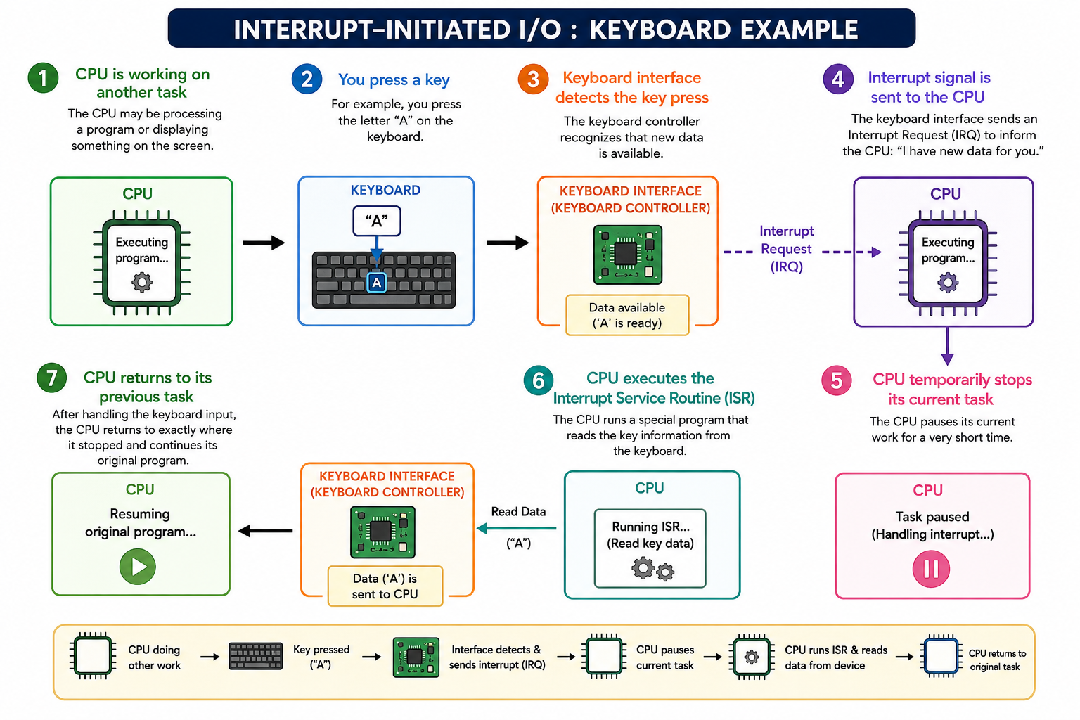

Slide 27
Real-Life Example of Interrupt-Initiated I/O: Simple analogy: Doorbell
Think of the CPU as a person studying and the keyboard as a visitor.
CPU = studying
Keyboard = visitor
Key press = visitor rings the doorbell
Interrupt = doorbell signal
ISR = person opens the door and receives the message
Return from interrupt = person goes back to studying
In short:
Device has data → Interface sends interrupt → CPU temporarily pauses → CPU services the device → CPU resumes its previous task.
This is called Interrupt-Initiated I/O because the device initiates the I/O operation by interrupting the CPU when it is ready.

Slide 28
Direct Memory Access (DMA)
The data transfer between a fast storage media such as magnetic disk and memory unit is limited by the speed of the CPU.
Thus we can allow the peripherals directly communicate with each other using the memory buses, removing the intervention of the CPU.
This type of data transfer technique is known as DMA or direct memory access.

Slide 29
Direct Memory Access (DMA)
During DMA the CPU is idle and it has no control over the memory buses.
The DMA controller takes over the buses to manage the transfer directly between the I/O devices and the memory unit. Bus grant request time.
Transfer the entire block of data at transfer rate of device because the device is usually slow than the speed at which the data can be transferred to CPU.

Slide 30
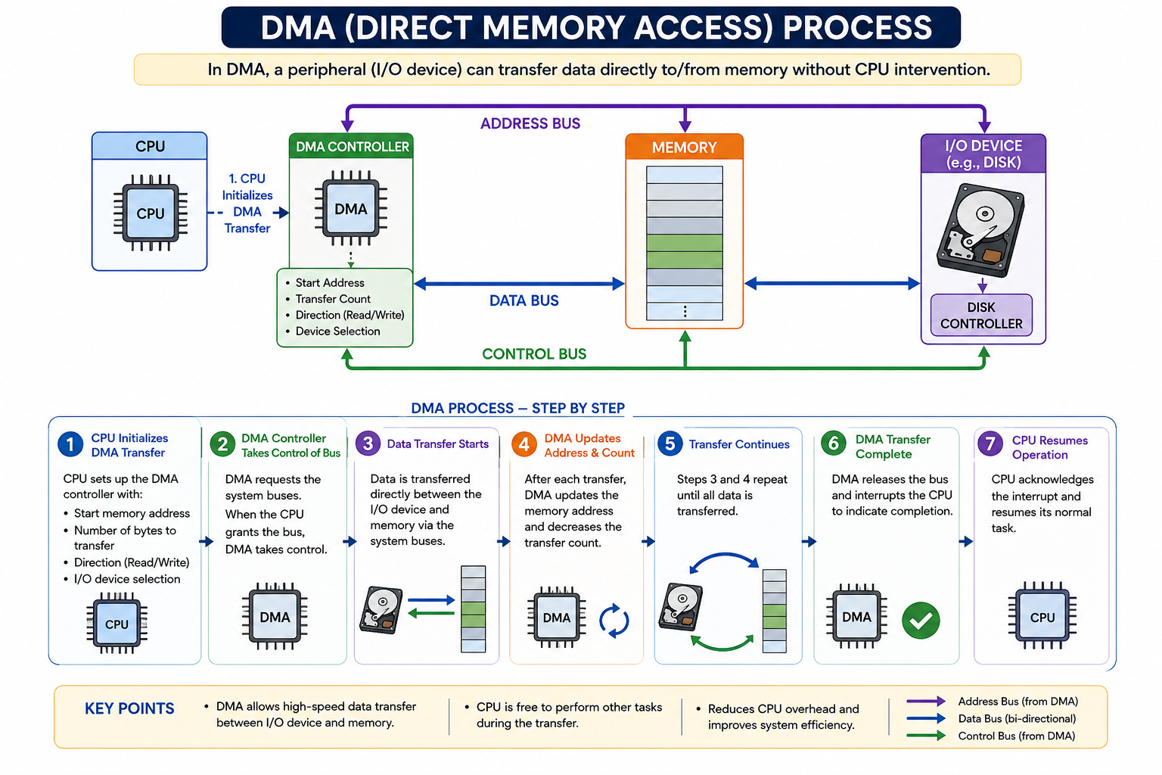
Working of DMA Transfer

Slide 31
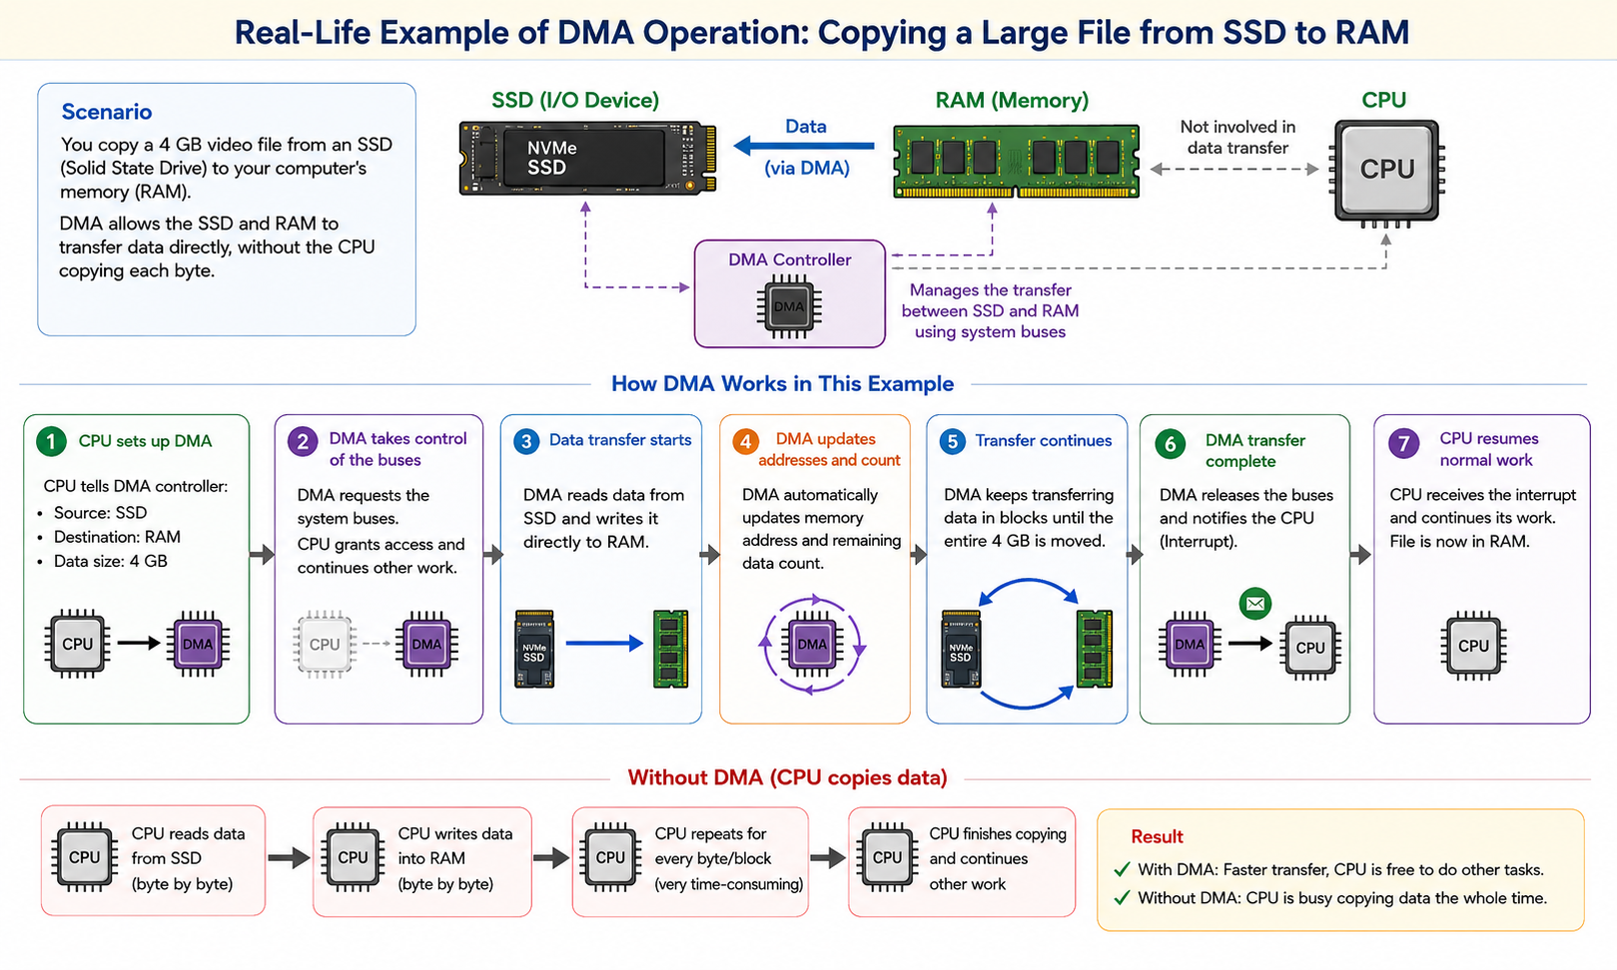

Slide 32
I/O Processor (IOP)
A specialized processor dedicated to managing I/O operations.
Functions:
Executes I/O instructions
Controls multiple I/O devices
Reduces CPU workload
Advantages:
Parallel operation with CPU
Efficient handling of complex I/O tasks

Slide 33
Basic Concepts of Parallel Processing
Parallel processing involves executing multiple tasks simultaneously to improve performance.
Parallel processing is used to increase the computational speed of computer systems by performing multiple data-processing operations simultaneously.
For example, while an instruction is being executed in ALU, the next instruction can be read from memory. The system can have two or more ALUs and be able to execute multiple instructions at the same time.
In addition, two or more processing is also used to speed up computer processing capacity and increases with parallel processing, and with it, the cost of the system increases.

Slide 34
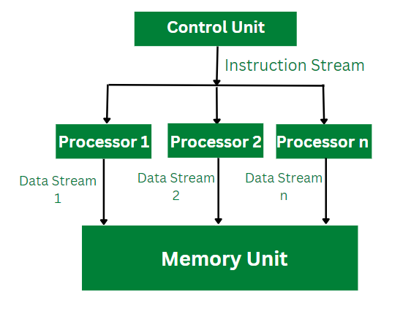
Parallel Processing

Slide 35


