Slide 1
Software Project Management
Uzzal Kumar Prodhan
Professor
Department of Computer Science & Engineering
Jatiya Kabi Kazi Nazrul Islam University

Slide 2
Course Outline
Introduction to Software Project Management
An overview of Project Planning
Project Evaluation
Selection of Appropriate Project Approach
Software Effort Estimation
Monitoring and Control
Managing Contracts
Managing People and Organizing Teams
ISO 12207 an Overview
Project Management Bodies and Knowledge

Slide 3
Book Reference
1. Software Project Management- Bob Hughus and Mike Cotterell
2. Software Project Management For Dummies – Teresa Luckey,PMP, MBA,and Joseph Phillips,PMP (Published by Wiley Publishing, Inc.)

Slide 4
Course Overview
An experienced software project manager who is interested in improving your skills and finding out a little bit more from other experienced software project managers’ perspectives.
An experienced general project manager who is moving into software
project management.
Just starting to get to know the discipline of project management and deciding whether you should move in the direction of software project management.
An ambitious project team member who has become an ad-hoc project manager because your boss isn’t showing enough leadership.

Slide 5
Course Overview
Not involved in a project management career at all, but contemplating
software project management as an alternative.

Slide 6
Chapter One
Introduction to Software Project Management
Chapter Overview:
Defining what a software project is
Examining project management attributes
Starting and finishing a software project
Dealing with software project nuances
Leading and managing project teams
Stages of a Software Project
Main elements of role of Management
Stack-holders of a project, their Objectives, the way of measuring the success

Slide 7
Chapter One
Introduction to Software Project Management
Project:
A project, technically, is a temporary endeavor to create a unique product or service.
For some people, everything is a project; for others, projects are special,
lofty activities that occur infrequently.
A project is a unique entity. In other words, the creation of a new application is unique, whereas the maintenance and day-to-day support of an existing application is not so unique.

Slide 8
Chapter One
Introduction to Software Project Management
Project Attributes:
Projects can have many attributes:
They change or improve environments in organizations.
Work is carried out in phases
Non routine tasks are involved
Planning is required
Specific objectives should be meet
They get things done.
They are unique from other work.
They have a defined start and end date.
They require resources and time.
They solve problems.
They seize opportunities.
They are sometimes challenging.
The project is large or complex

Slide 9
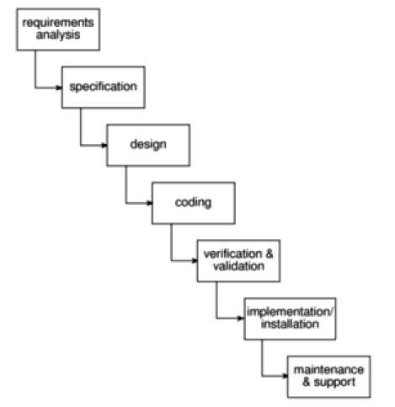
Chapter One
Introduction to Software Project Management
A Typical Life Cycle of a Project:

Slide 10
Chapter One
Introduction to Software Project Management
Software Project Management :
Software project management is a type of project management that focuses specifically on creating or updating software.
Project management involves coordinating people, vendors, and resources.
Project management requires excellent communication skills, a strong will to protect the project scope, and leadership skills to enforce quality throughout the project work.

Slide 11
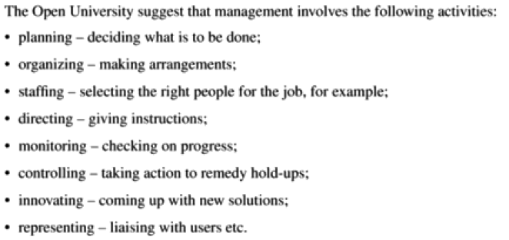
Chapter One
Introduction to Software Project Management
What is Management?

Slide 12
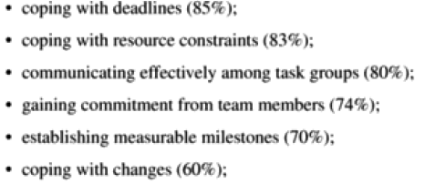
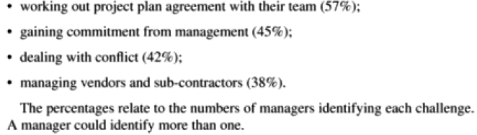
Chapter One
Introduction to Software Project Management
What are the most frequent challenges for Project Managers?

Slide 13
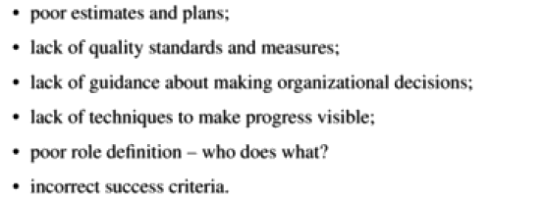
Chapter One
Introduction to Software Project Management
Problems with Software Projects: (From the Managers Point of View)

Slide 14
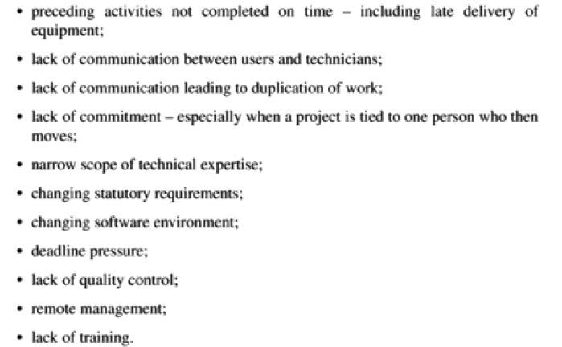
Chapter One
Introduction to Software Project Management
Problems with Software Projects: (From the Members of Project Team)

Slide 15
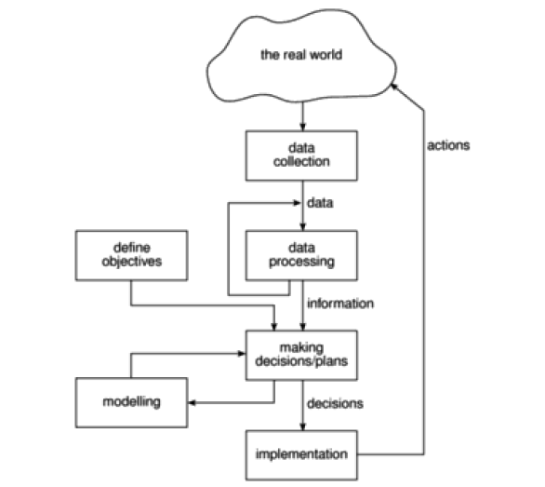
Chapter One
Introduction to Software Project Management
Projects Control Cycle:

Slide 16
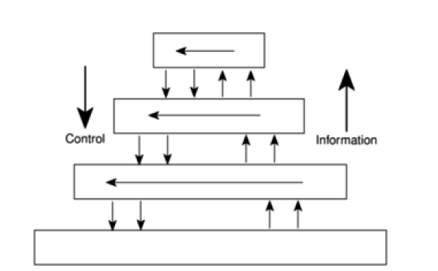
Chapter One
Introduction to Software Project Management
Information and Control in Organizations:

Slide 17
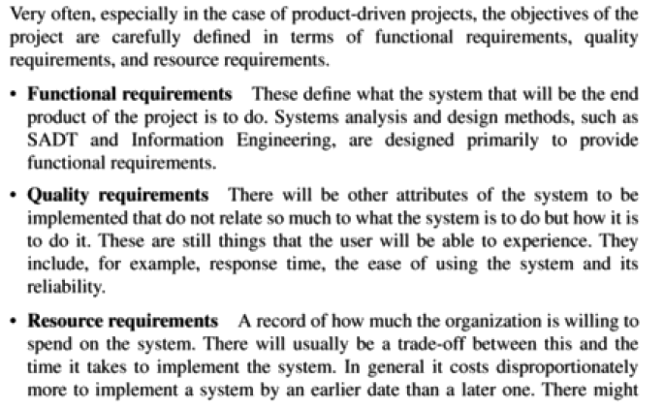

Chapter One
Introduction to Software Project Management
Requirement Specification:

Slide 18
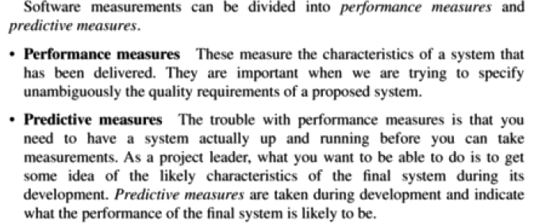
Chapter One
Introduction to Software Project Management
Software Measurements:

Slide 19
Chapter One
Introduction to Software Project Management
The Nine Project Management Knowledge Areas:
Knowledge Area | What it does
Project Scope Management | Controlling the planning, execution, and content of the project is essential. You need to pay special attention to both project and product scope so that the software you end up with is what you intended to make in the first place.
Project Time Management | project’s schedule is crucial. Who wants tax software that comes out on April 16?
Project Cost Management | Projects cost money, and this knowledge area centers on cost estimating, budgeting, and control.
Project Quality Management | No project is a good project if the deliverable stinks. Quality doesn’t happen by accident, so this knowledge area works to ensure that the product you are producing is a quality product that meets customer expectations.

Slide 20
Chapter One
Introduction to Software Project Management
The Nine Project Management Knowledge Areas:
Knowledge Area | What it does
Project Human Resources Management | The members of the project team must get their work done. Hiring or assigning people who are competent and managing them well are at the center of this knowledge area.
Project Communications Management | Project managers spend 90 percent of their time communicating. Communications management focuses on who needs what information — and when.
Project Risk Management | This knowledge area is about avoiding doom. The focus is on how to anticipate risks, handle them when they arise, and take advantage of the opportunities that can help a project.

Slide 21
Chapter One
Introduction to Software Project Management
The Nine Project Management Knowledge Areas:
Knowledge Area | What it does
Project Procurement Management | Sometimes during the course of your software project, you may be required to work with vendors to purchase goods and/or services. You may even be the vendor that someone else is contracting for their project. This knowledge area is concerned with the processes to create vendor contracts and to purchase goods and services.
Project Integration Management | What happens in one knowledge area affects attributes of the other knowledge areas. The ninth knowledge area is fan-freakin-tastic because its purpose is to ensure the coordination of all the other knowledge areas.

Slide 22
Chapter One
Introduction to Software Project Management
Examining Project Constraints:
A constraint is anything that restricts the project manager’s options. Constraints are requirements, confines, or, if you’re a glass-is-half-empty kind of person, prison walls. Constraints can include:
Resource constraints such as a team member being assigned to too
many concurrent projects
Tight deadlines
Budgetary limitations
Government regulations
Limitations of software
Scope limitation, such as being required to use a particular existing
interface
Hardware requirements
Anything else that restricts your options

Slide 23
Chapter One
Introduction to Software Project Management
Examining Project Constraints:
A constraint is anything that restricts the project manager’s options. Constraints are requirements, confines, or, if you’re a glass-is-half-empty kind of person, prison walls. Constraints can include:
Resource constraints such as a team member being assigned to too
many concurrent projects
Tight deadlines
Budgetary limitations
Government regulations
Limitations of software
Scope limitation, such as being required to use a particular existing
interface
Hardware requirements
Anything else that restricts your options

Slide 24
Chapter One
Introduction to Software Project Management
Managing the Scope:
There are two scopes within project management:
Product scope: The product scope describes, lists, and categorizes all the features and components of the finished deliverable. This is what the customers see in their minds’ eye.
Project scope: This is where you focus. The project scope is all the required work, and only the required work, to create the project deliverable. The project scope focuses on work, activities, and progress to achieve the product scope. The project scope must be protected from unapproved changes because it dictates what the project team will do and what the end result of the project will be.

Slide 25
Chapter One
Introduction to Software Project Management
Making Sense of Project Success (Or Failure):
Most projects start with an optimistic attitude about creating a deliverable, keeping the customer happy, and making this the best software project ever.
And then things (bad things) happen. The good projects end on time and as planned. Ah, paradise. We’d wager that these projects have three things in common:
A leader who knows what he or she is doing
A tight change control system
Team members who understand what the project is supposed to deliver
and can therefore get results

Slide 26
Chapter One
Introduction to Software Project Management
Making Sense of Project Success (Or Failure):
Commonly, projects limp to the finish line, late, over budget, and after crushing the morale of everyone involved. Done, but maybe not done well. These projects typically have three attributes:
Poor requirements from the project customers
Poor communications through the project manager
Poor morale from the project team

Slide 27
Chapter One
Introduction to Software Project Management
Making Sense of Project Success (Or Failure):
The saddest of projects are the ones that never make it to the finish. This bunch misses deadlines, blows budgets, or experiences a radical change of scope so often that no one (not even the PM) knows exactly what the project should be creating anymore. Failed projects usually have some, if not all, of these attributes:
No clear vision of what the project priorities are
Lack of leadership from the project manager and/or sponsor
A timid project manager
Lack of autonomy for the project manager
New resumes being typed in unison

Slide 28
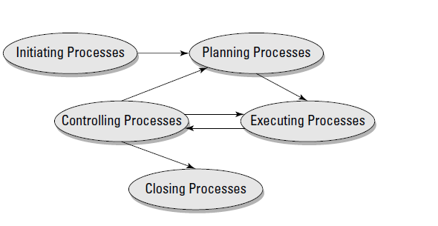
Chapter One
Introduction to Software Project Management
Starting Software Project: Process Groups (Fig-1)

Slide 29
Chapter One
Introduction to Software Project Management
Process Groups:
1. Initiating: The project is in the process of getting selected, sponsored, funded, and launched.
2. Planning: As you can see in Figure 1, planning is an iterative process. Planning basically determines how the project work will get accomplished.
3. Executing: After you get a plan, your project team does the work.
4. Controlling: Your project team does the work, but you control them.
5.Closing: Ah, paradise. After the project work has been completed, you
tie up loose ends and close out the software project.

Slide 30
Chapter One
Introduction to Software Project Management
Understanding What Makes Software Project Management So Special:
Software development is weird and requires a specialized skill set to do
it well.
Software creation is tough.
Software development can be boring, routine, and mind numbing.
Software creation can create challenges within the development of the
code.

Slide 31
Chapter One
Introduction to Software Project Management
Understanding What Makes Software Project Management So Special:
Software development is weird and requires a specialized skill set to do
it well.
Software creation is tough.
Software development can be boring, routine, and mind numbing.
Software creation can create challenges within the development of the
code.

